Slide 1

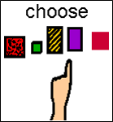
Cut out, laminate and put soft Velcro in the middle of the white squares

Slide 2
Choice photo template Insert photo and enter word in text box. Cut, laminate and put hard Velcro on the back
text
text
text
text
text
text

