Slide 1


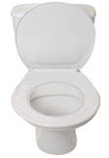

Swing tag photo template
Insert photo and enter word in text box. Punch a hole on the top left corner, put them on a keyring/shower curtain ring and then attach to a lanyard.
finished
toilet
help

Slide 2
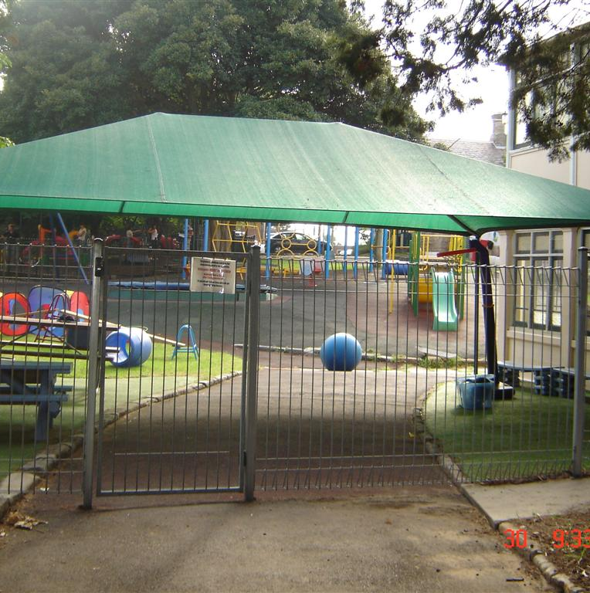

Giant Steps
yes
no

Slide 3
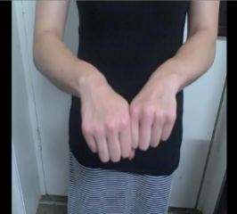
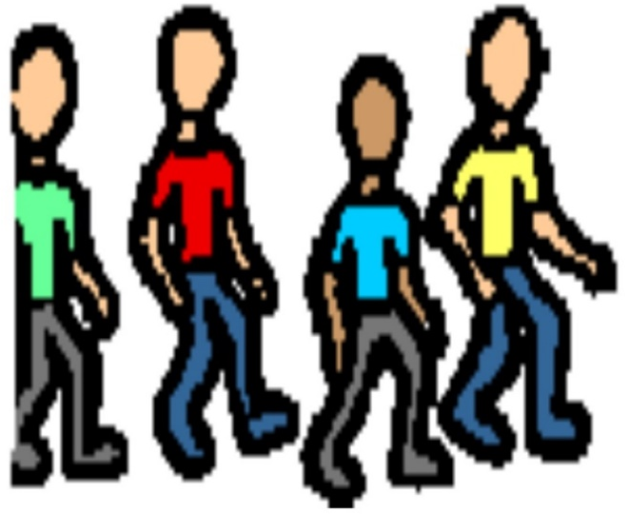
walk
break
text

Slide 4
text
text
text

