Slide 1
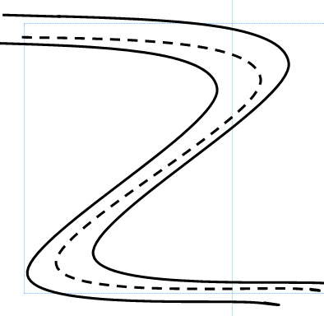
Cut out, laminate and put soft Velcro in the middle of the squares
Transport Card
Student pic
Staff/Parent pic (who)
Mode of transport walking –bus- car train
Mode of transport walking –bus- car train
Destination (where)

Slide 2
Transport Card Photo Templates
Insert photo of person, mode of transport or destination and enter then text box.
Cut out, laminate, put hard velcro on the back and use transport card.
text
text
text
text
text
text
text
text

