Slide 1

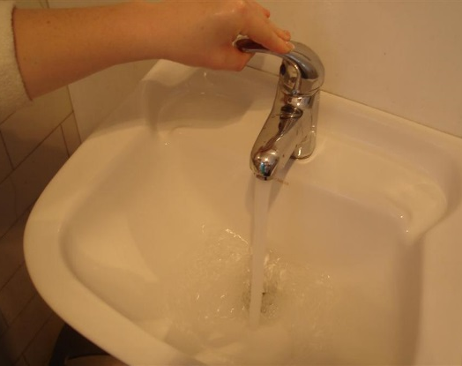
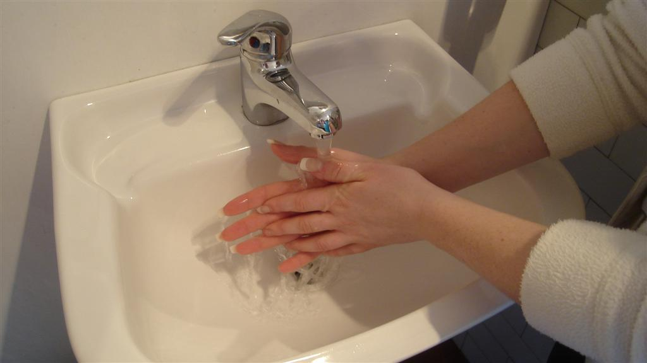

1
2
3
tap on
soap
wash 5 4 3 2 1
Hand Washing Procedure
Print, cut and stick schedule together (L to R) and laminate

Slide 2

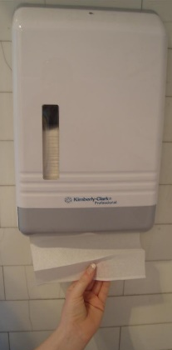
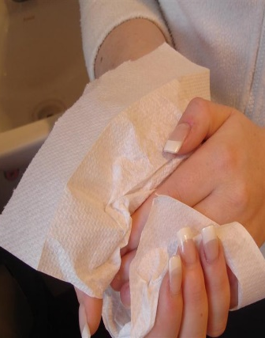
4
5
tap off
dry hands

