Slide 1
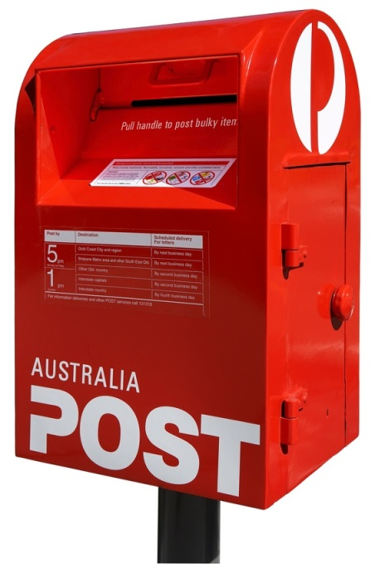

postal adventures

Slide 2
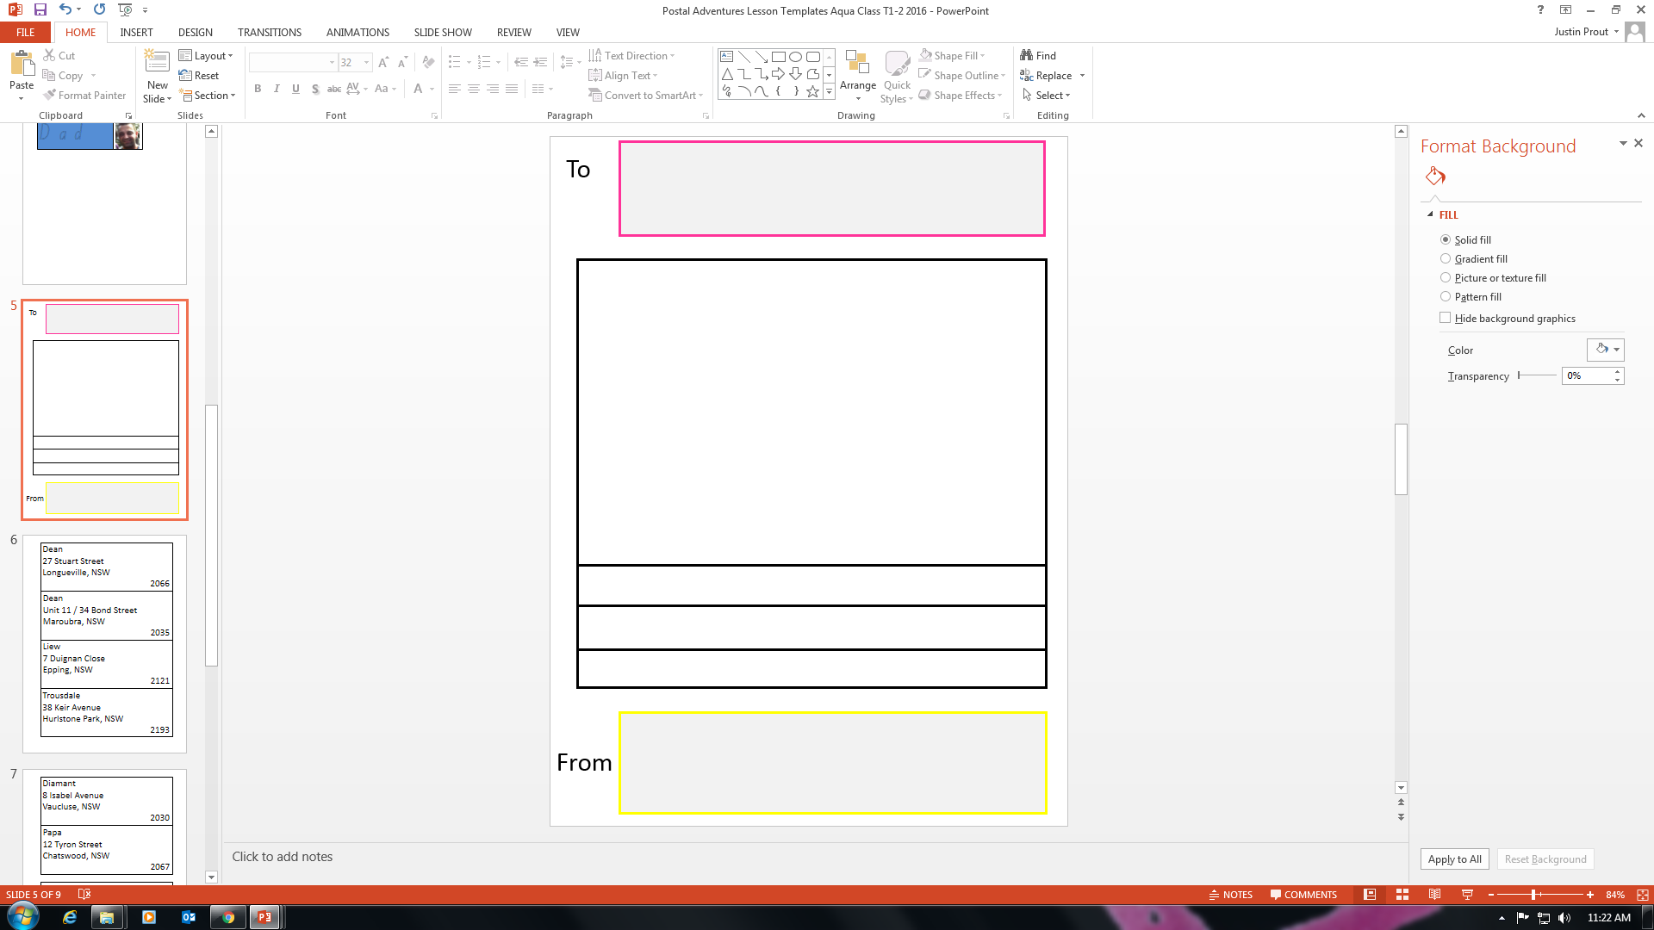
get letter

Slide 3
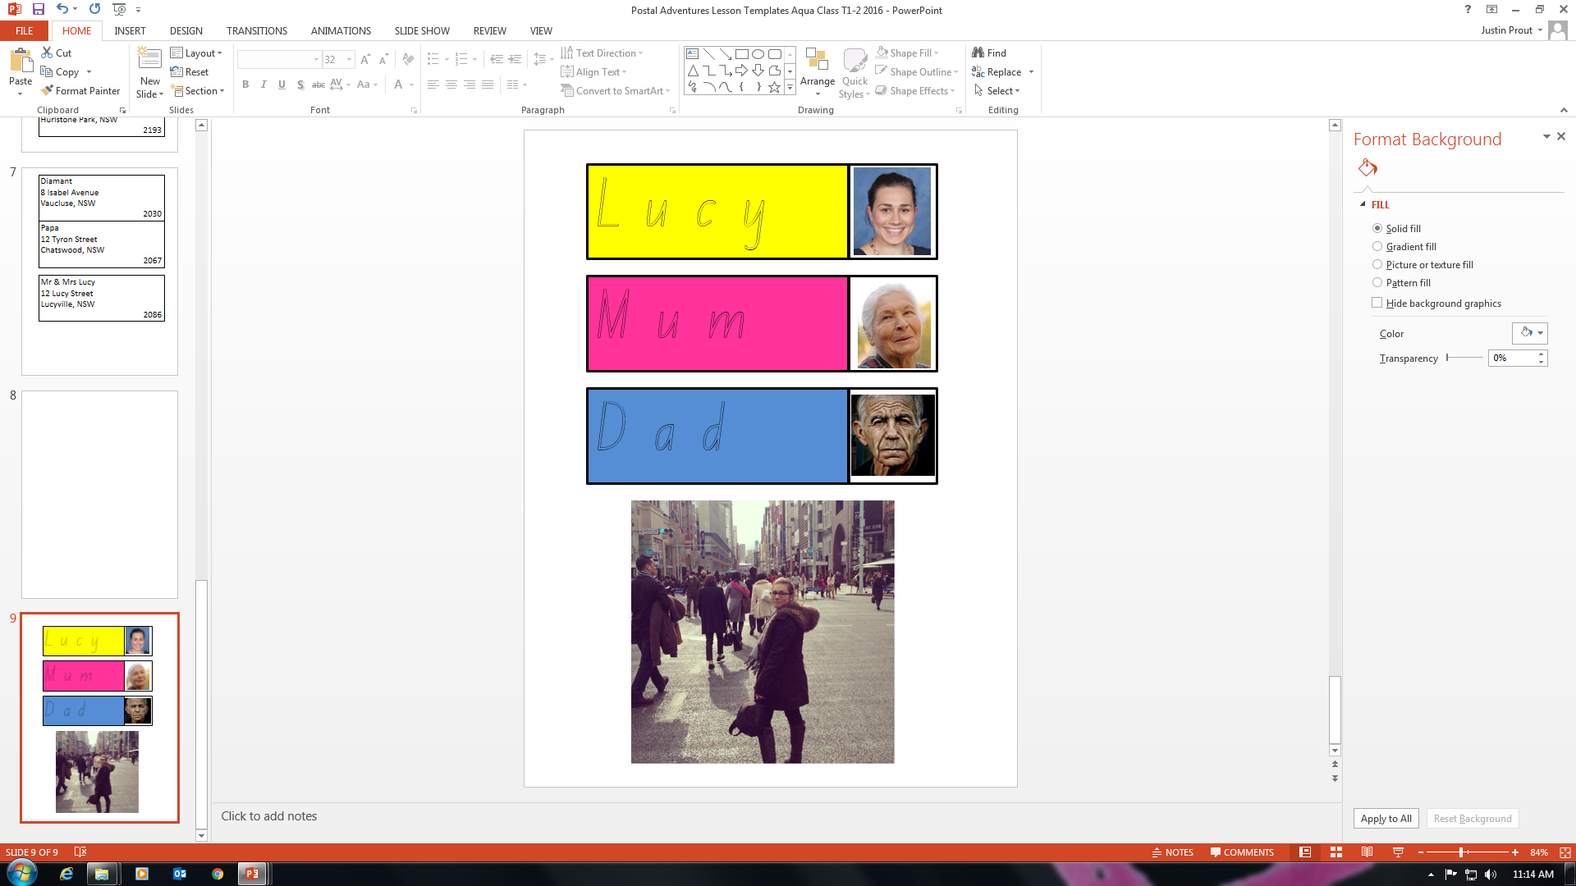
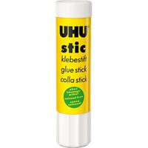
2. Choose Mum or Dad

Slide 4
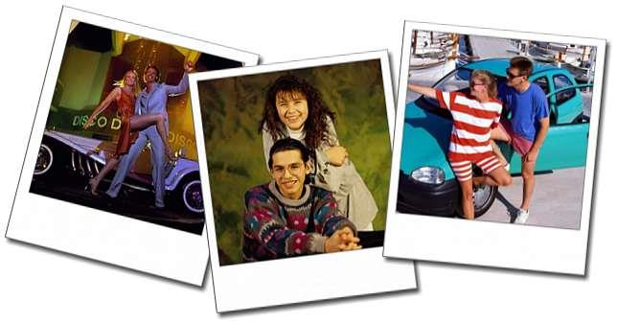
3. Choose photo

Slide 5
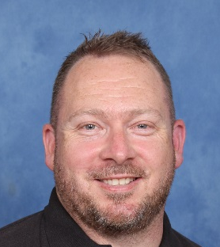
4. get picture
J u s t i n

Slide 6
5. put letter in envelope
Mr & Mrs Lucy
12 Lucy Street
Lucyville, NSW
2086

Slide 7
6. address on envelope
Mr & Mrs Justin
12 Justin Street
Justinville, NSW 2086

Slide 8

7. Put 2 stamps on envelope
Mr & Mrs Justin
12 Justin Street
Justinville, NSW 2086
1
2

Slide 9
7. Walk to Post Box

Slide 10


8. Letter in Post Box
Mr & Mrs Justin
12 Justin Street
Justinville, NSW 2086

Slide 11
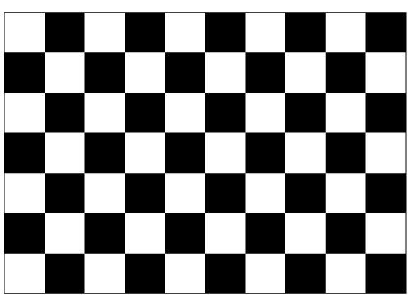
9. Postal Adventures is finished

