Slide 1
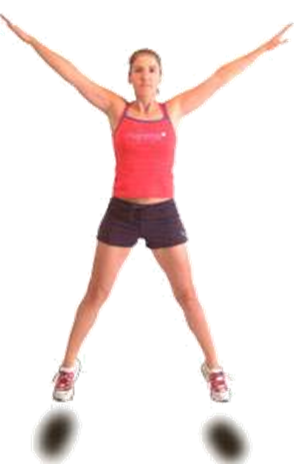
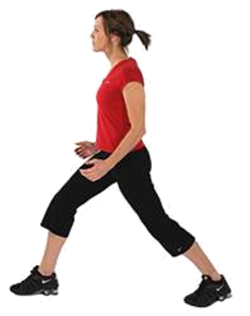
thousands | hundreds | tens | ones
2 | 8 | 0 | 8

Slide 2
thousands | hundreds | tens | ones
7 | 2 | 4 | 0

Slide 3
thousands | hundreds | tens | ones
1 | 0 | 2 | 4

Slide 4
thousands | hundreds | tens | ones
4 | 1 | 0 | 5

Slide 5
thousands | hundreds | tens | ones
3 | 2 | 3 | 5

Slide 6
thousands | hundreds | tens | ones
0 | 6 | 0 | 1

Slide 7
thousands | hundreds | tens | ones
5 | 0 | 0 | 9

Slide 8
thousands | hundreds | tens | ones
9 | 0 | 0 | 0

Slide 9
thousands | hundreds | tens | ones
0 | 0 | 4 | 5

Slide 10
thousands | hundreds | tens | ones
0 | 7 | 6 | 2

