Slide 1

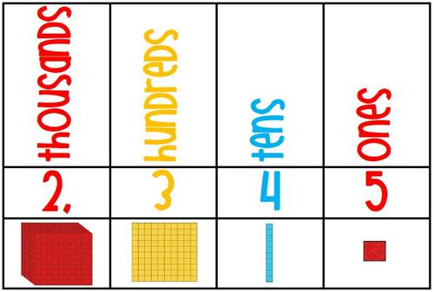
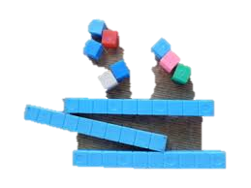
counting columns

Slide 2

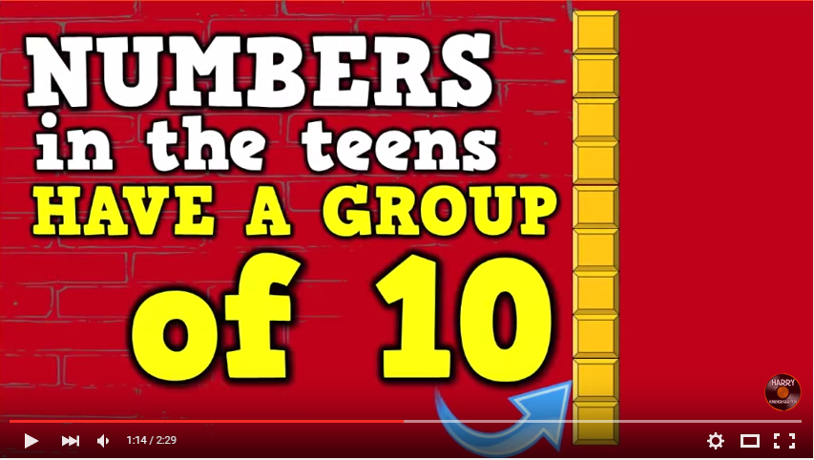

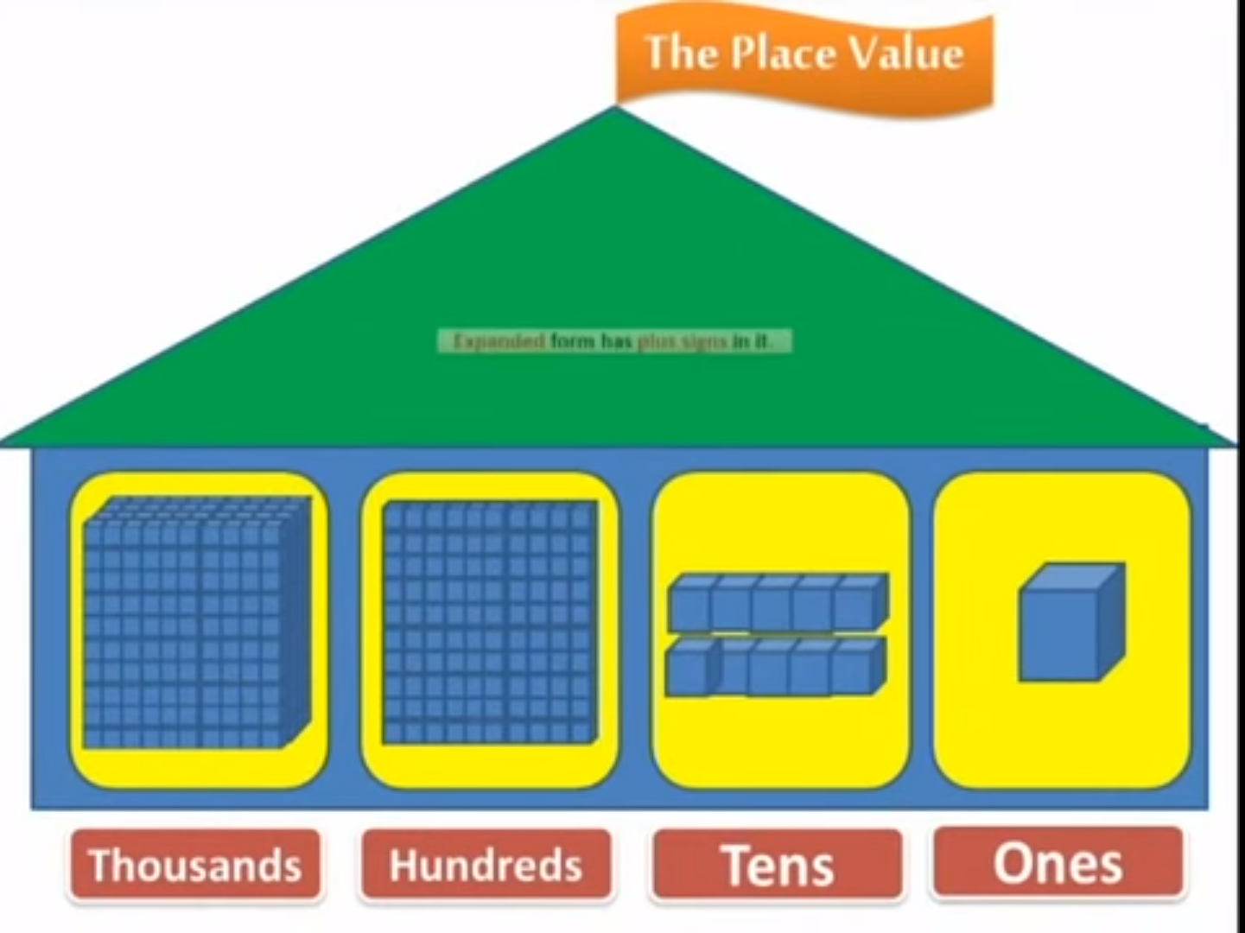
You tube choice
Notes:
Hyperlinked You tube Videos – pause video throughout and use base ten blocks to create numbers shown within videos

Slide 3

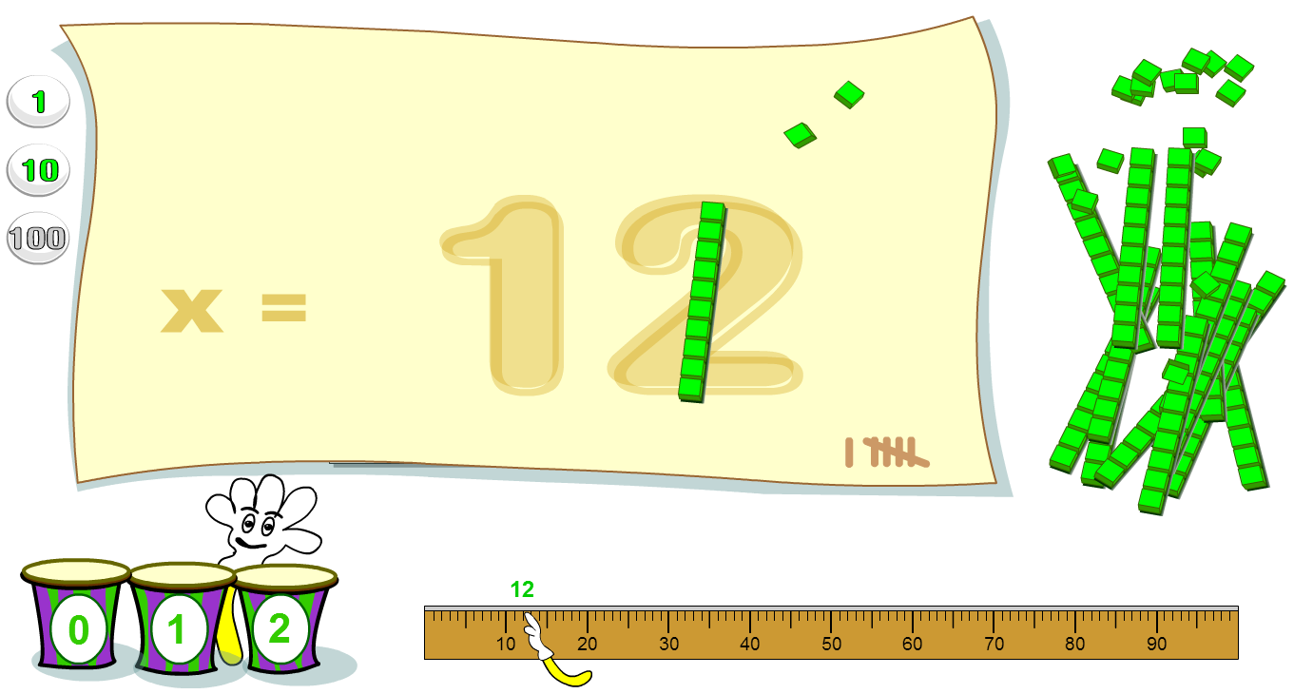




Alex Liz Owen
Mary John Jack Jo
2314
online game
blocks
make that number!
Notes:
Split groups making numbers – alternate weeks with students at interwrite board using a click and drag online game (hyperlinked) to make numbers versus sitting at tables with base ten blocks to create numbers

Slide 4
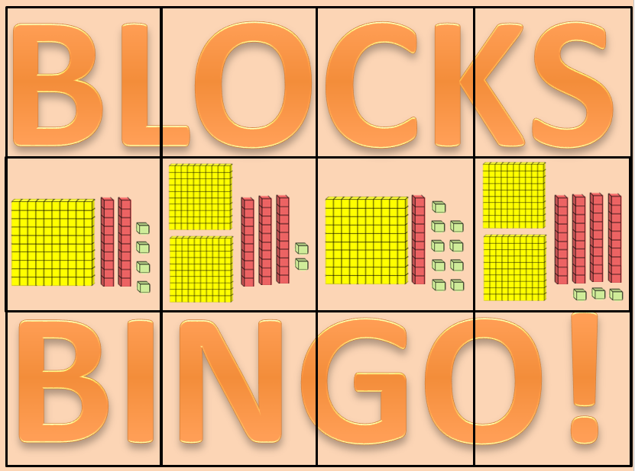
block bingo
Notes:
Bingo – bingo cards for each student. Place counter on top of number when it comes up on the board (PowerPoint showing blocks and numbers attached via hyperlink) until they get bingo

Slide 5
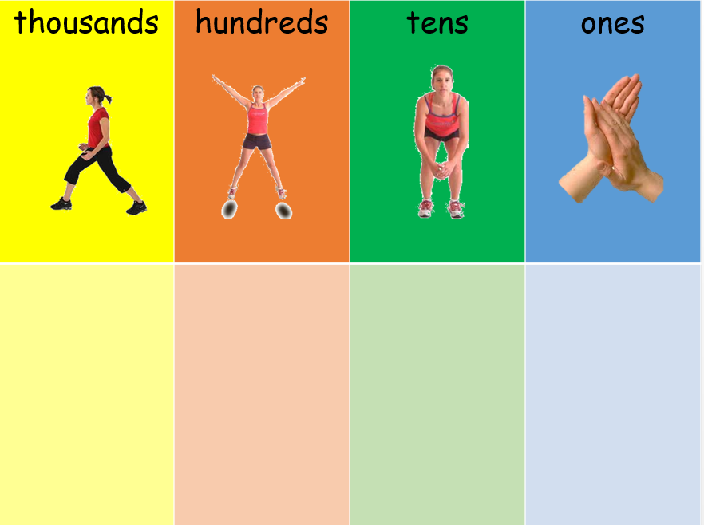
aerobic numbers
Notes:
Hyperlinked PowerPoint – getting students up and moving by doing lunges for thousands, star jumps for hundred, tuck jumps for tens and clapping for ones while counting out these big numbers

Slide 6
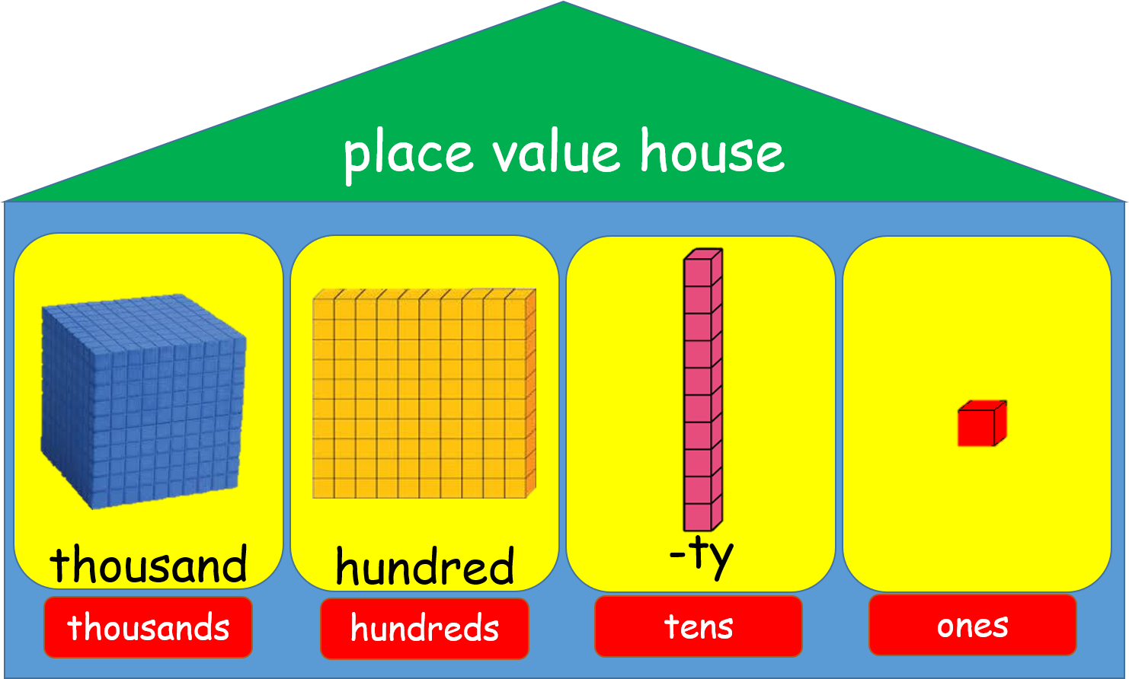
Notes:
Click and drag the numbers to the correct place in the place value house so you can read them out correctly – directly builds into the ‘guess that number’ activity next up

Slide 7

easy
hard
guess that number!
Notes:
Guess that number – two different versions for different ability groups. Using a microphone students call out the numbers as they show on the screen

Slide 8
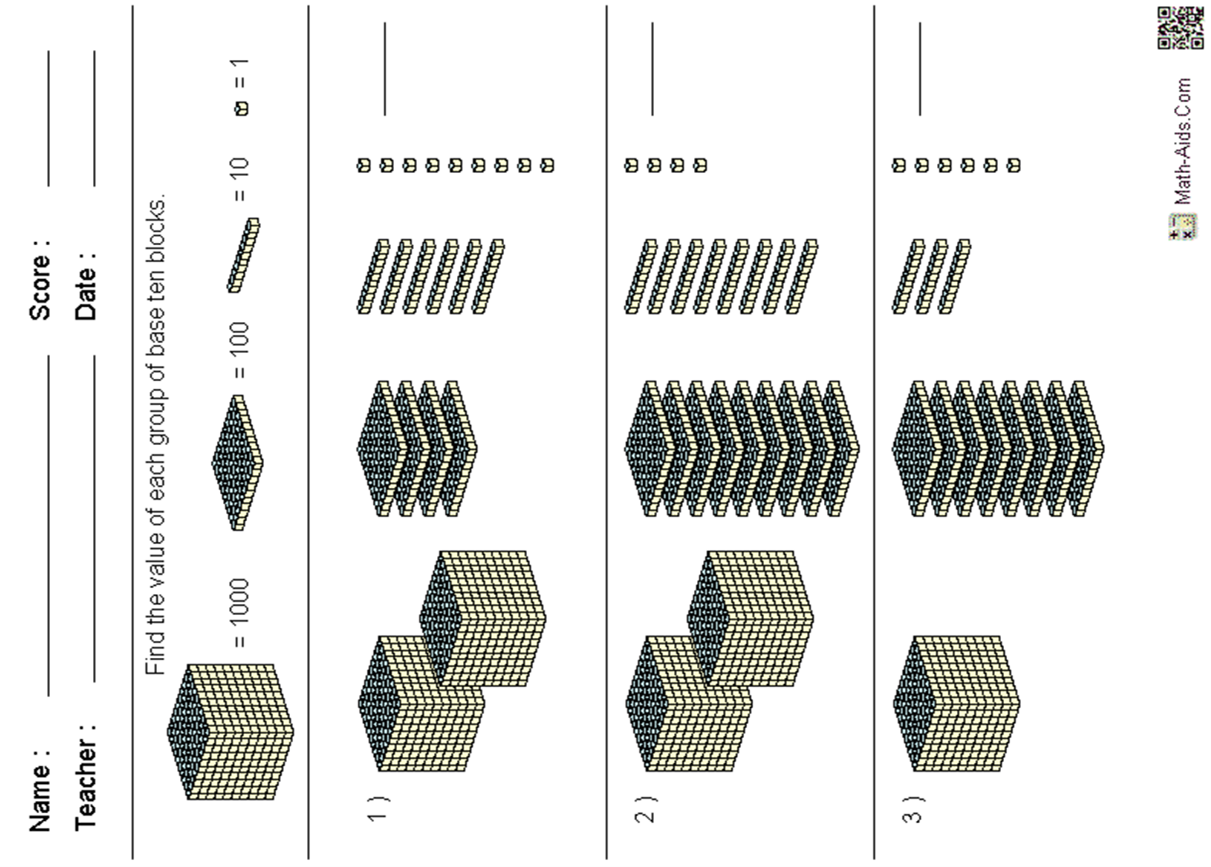
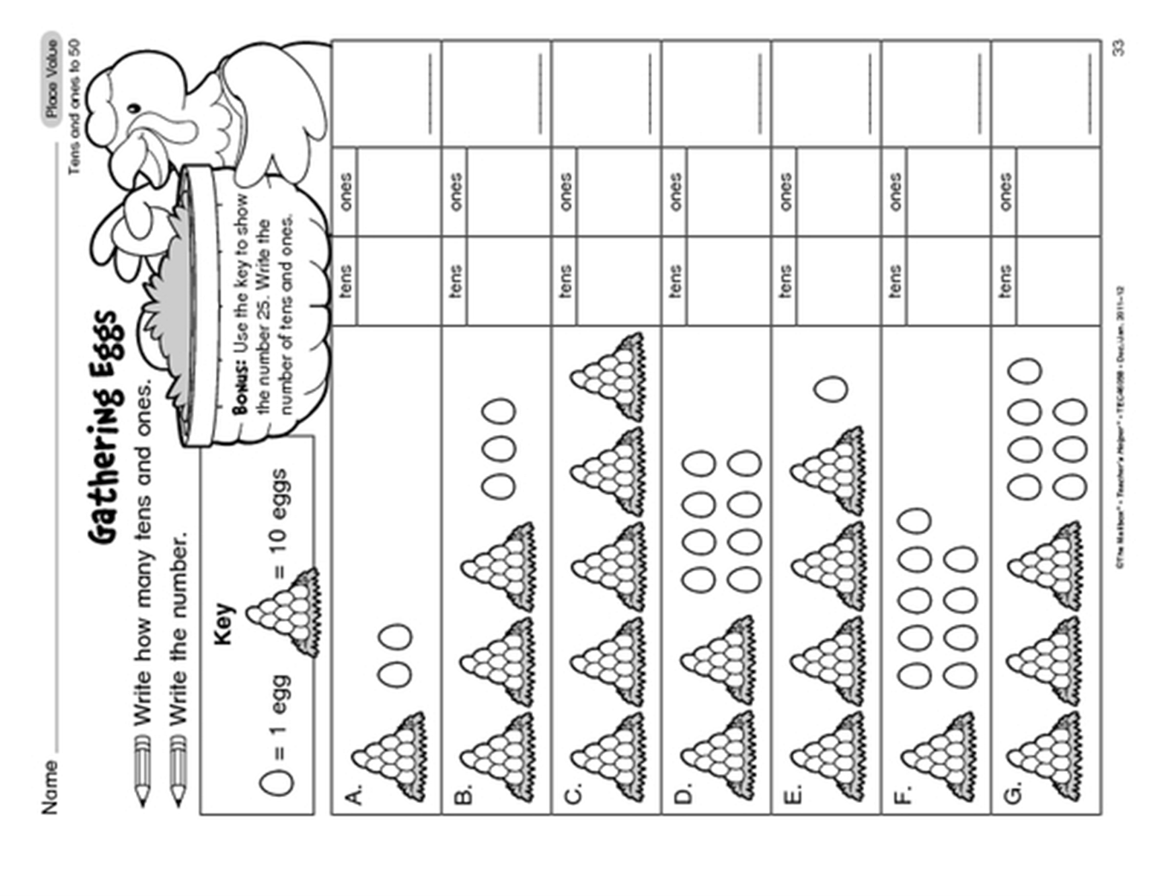
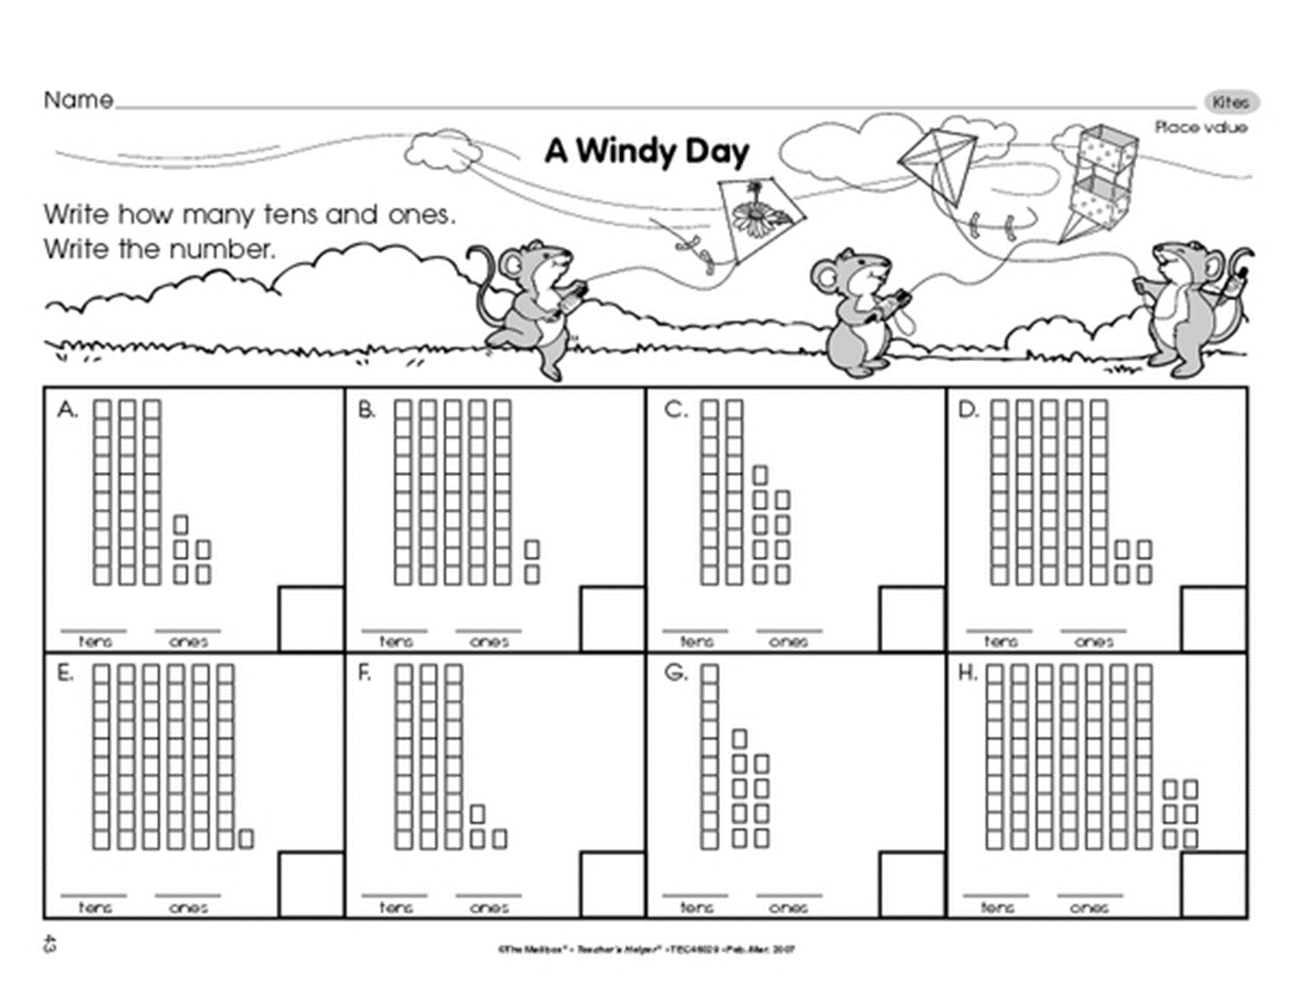
worksheets
Notes:
An array of worksheets used throughout the unit of work to establish place value. Worksheets found at the end of this Powerpoint presentation to be printed out each week

Slide 9
counting columns
finished

Slide 10
5
4

Slide 11
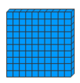
2
4
3

Slide 12
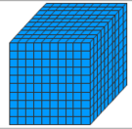
2
4
3

Slide 13
5
4
54

Slide 14
6
2
62

Slide 15
4
6
2
462

Slide 16
5
4
54

Slide 17

Cut out the numbers and match them to the block bingo board
24
32
51
28
36
34
53
71
46
62
18
12

Slide 18
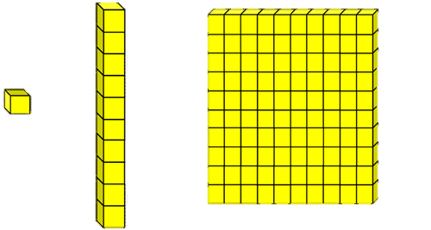


Slide 19
Cut out the numbers and match them to the block bingo board
124
236
312
164
223
421
252
435
342
280
163
211

Slide 20





Slide 21
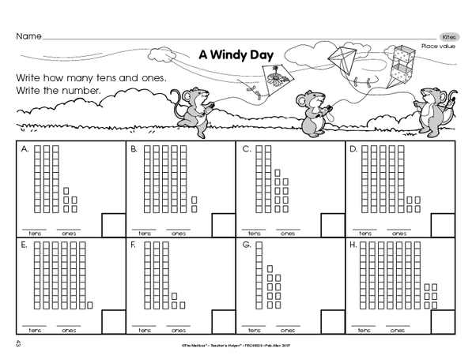
3
5
35

Slide 22
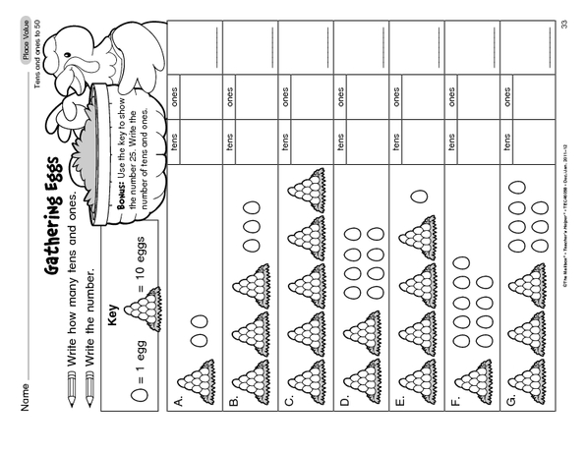
12
2
1

Slide 23
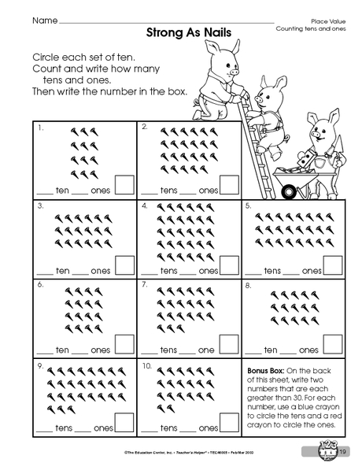

Circle groups of ten
2. Count the tens and ones
12
2
1

Slide 24
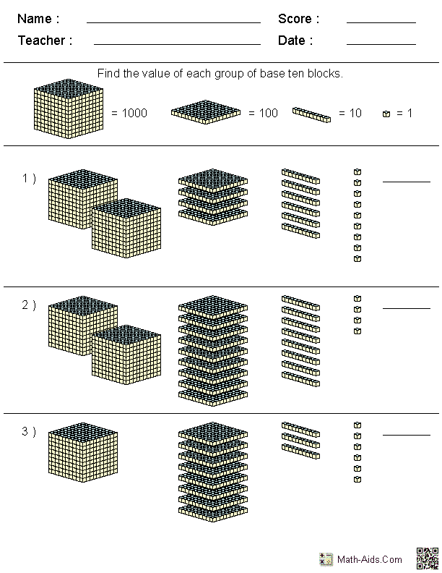

Slide 25
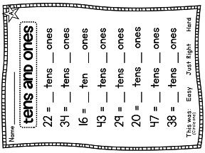

Slide 26
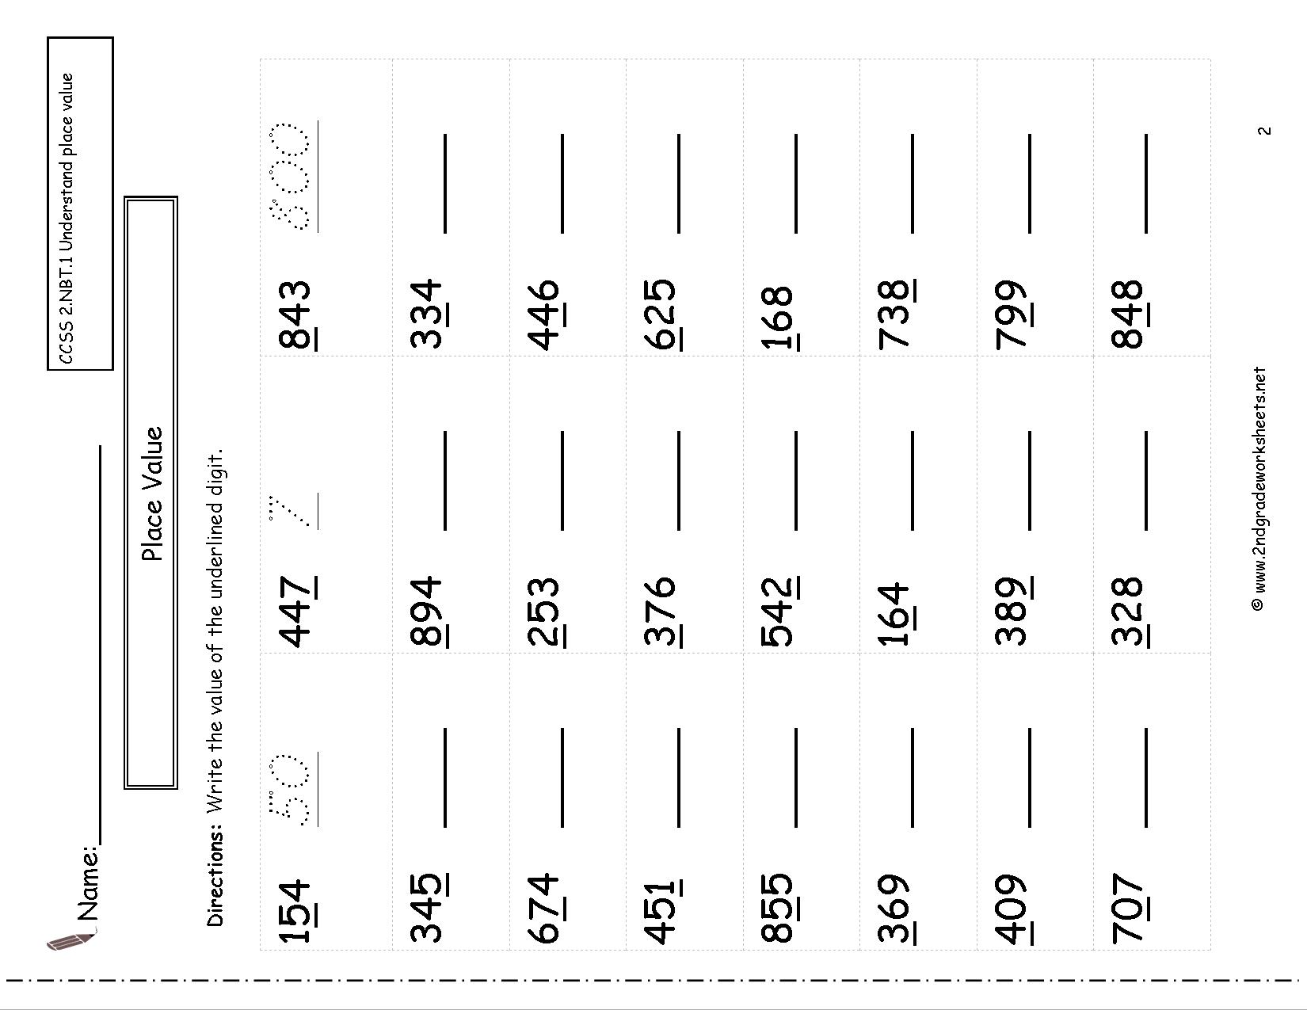

Slide 27
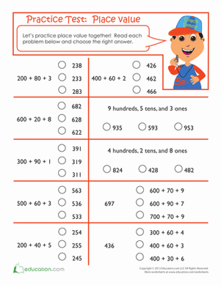

Slide 28
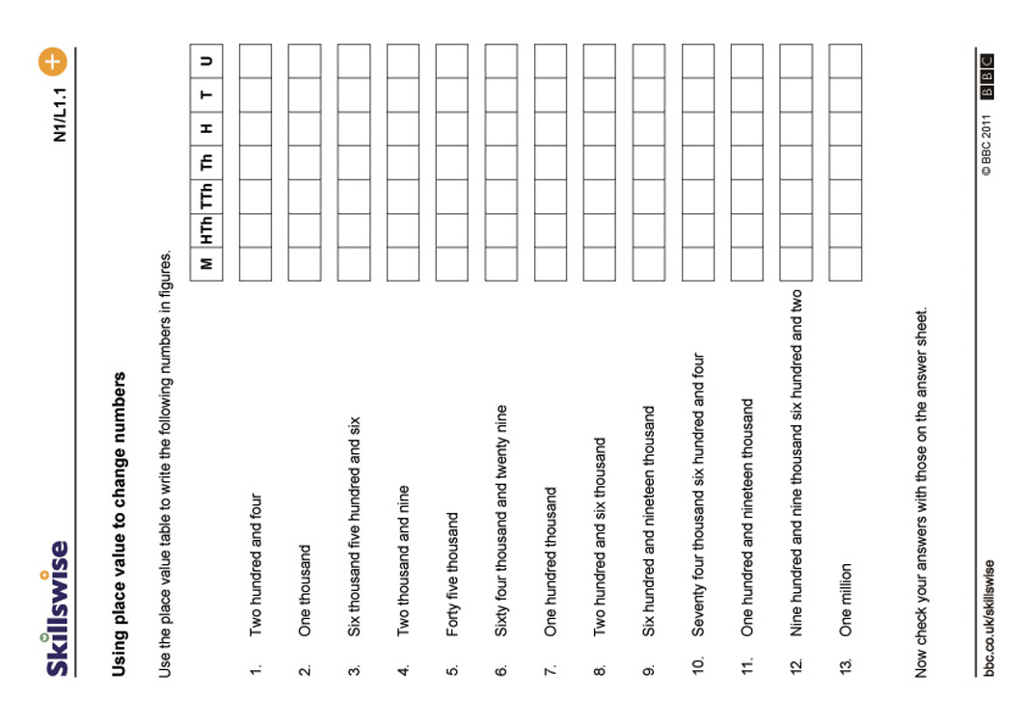

Slide 29
