Slide 1



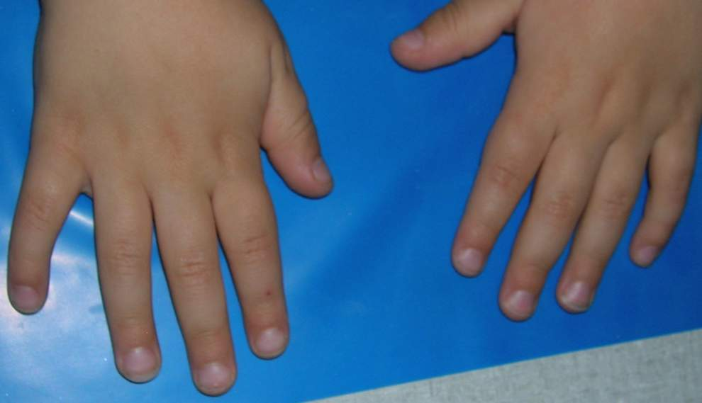




3
2
4
1
5
Notes:
WITH ANIMATIONS

Slide 2

3
2
4
1
5
Notes:
WITHOUT ANIMATIONS

