Slide 1




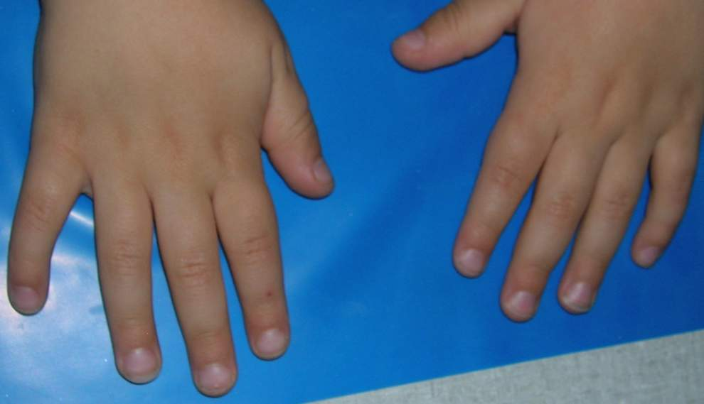




8
9
7
3
10
2
4
1
6
5
Notes:
WITH ANIMATIONS

Slide 2
8
9
7
3
10
2
4
1
6
5
Notes:
WITHOUT ANIMATIONS

