Slide 1
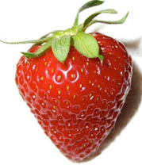
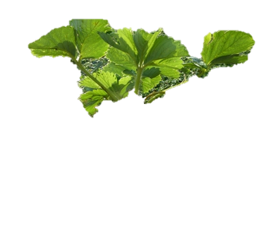
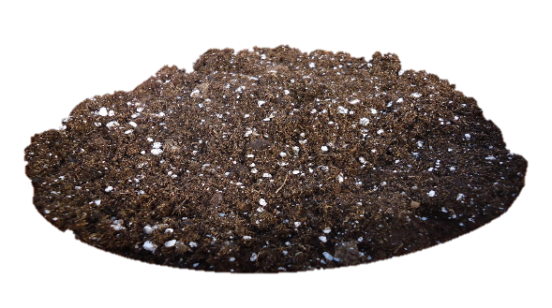
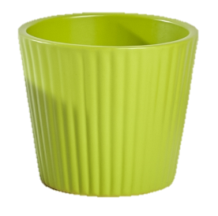
Care for strawberries

Slide 2
Measure plant

Slide 3
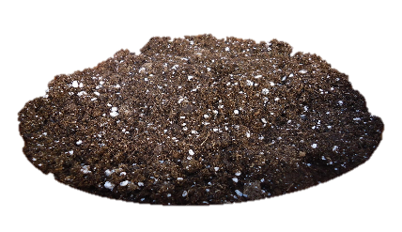
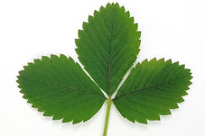
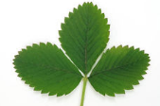
Count leaves

Slide 4
Count flowers

Slide 5
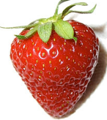
Count strawberries

Slide 6
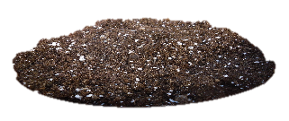
my strawberry plant
How tall?
How many leaves?
How many flowers?
How many strawberries?
0 2 4
6 8 10
12 14 16
0 1 2
4 5
6 7 8
0 1 2
4 5
6 7 8
0 1 2
4 5
6 7 8

Slide 7
my strawberry plant
How many leaves?
How many flowers?
How many strawberries?
0 1 2
4 5
6 7 8
0 1 2
4 5
6 7 8
0 1 2
4 5
6 7 8

Slide 8
my strawberry plant
How many leaves?
How many flowers?
How many strawberries?
0 1 2
4 5
6 7 8
0 1 2
4 5
6 7 8
0 1 2
4 5
6 7 8

Slide 9
my strawberry plant
How many leaves?
How many strawberries?
0 1 2
4 5
0 1 2
4 5

Slide 10
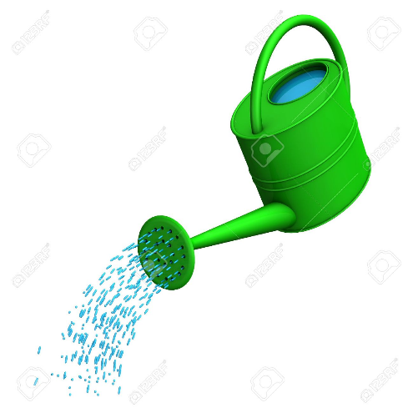
Water plant

