Slide 1
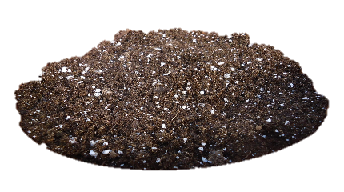
Planting strawberries

Slide 2
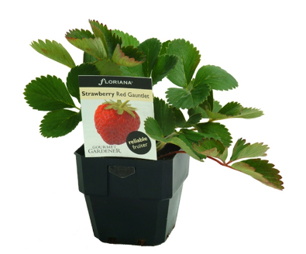
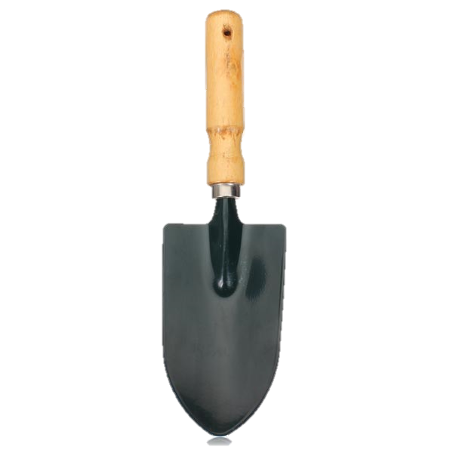
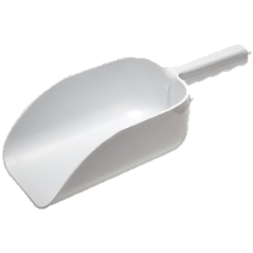
We need:
pot
strawberry bush
soil
hand scoop

Slide 3
step 1: pour soil into pot

Slide 4
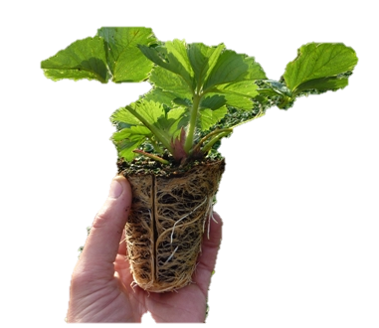
step 2: take off pot

Slide 5
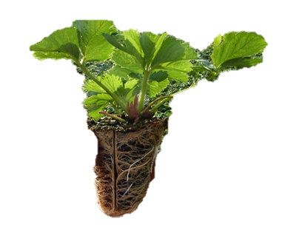
step 2: place strawberry bush in pot

Slide 6
step 3: sprinkle soil onto pot

Slide 7
step 4: pour water into pot

