Slide 1
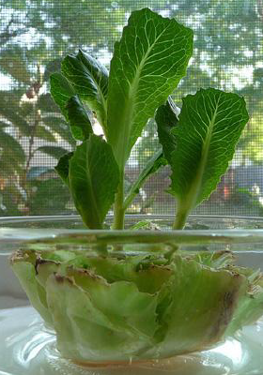
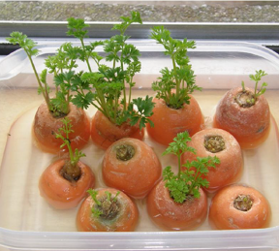
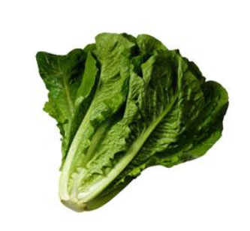
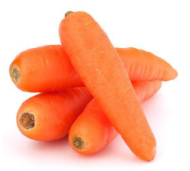
Regrowing vegetables

Slide 2
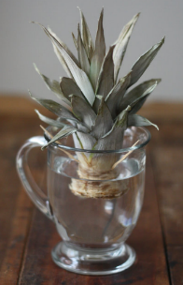
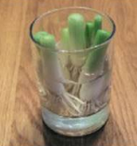
Some fruits and vegetables can be regrown to eat again!
carrots
spring onion
pineapple
lettuce

Slide 3
grow a carrot

Slide 4
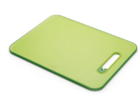
We need:
Sharp knife
containers
chopping board
carrots
water

Slide 5
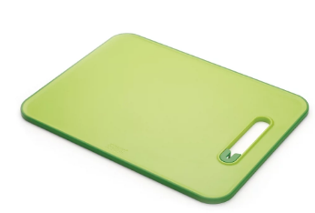
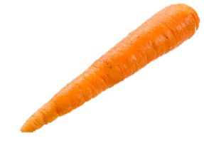
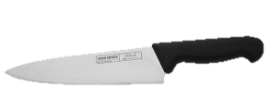
cut top off carrot

Slide 6
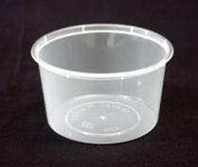
carrot top in container

Slide 7
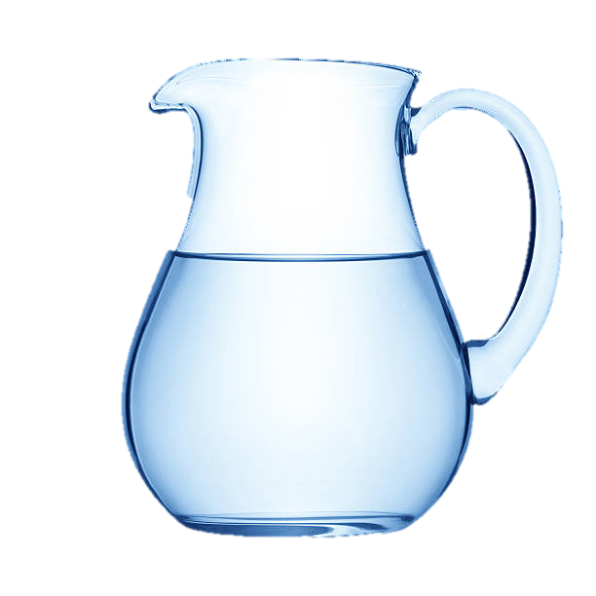
water into container
cover base of container

Slide 8
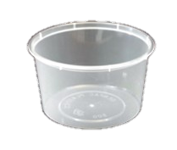
put on window sill

Slide 9
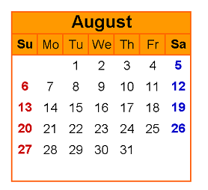
More water every 2 days

Slide 10
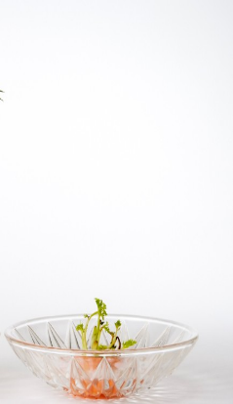
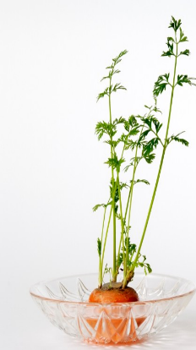
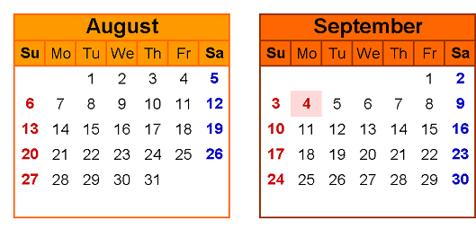
wait for carrot to grow

Slide 12
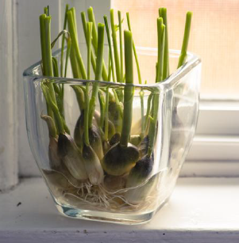
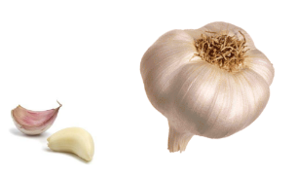
grow garlic

Slide 13
We need:
containers
garlic
water

Slide 14
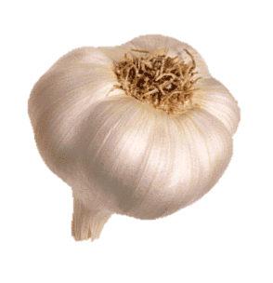
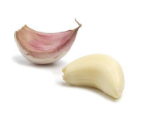
Break garlic

Slide 15
Garlic in container

Slide 16
water into container
cover base of container

Slide 17
put on window sill

Slide 18
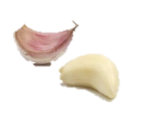
More water every 2 days

Slide 19
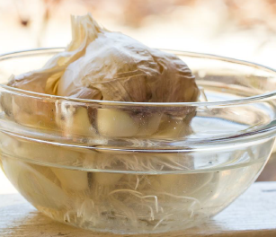
wait for garlic to grow

Slide 21
grow spring onions

Slide 22
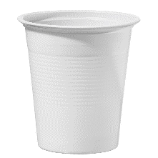
We need:
Sharp knife
chopping board
water
cup
Spring onions

Slide 23
cut root off spring onion

Slide 24
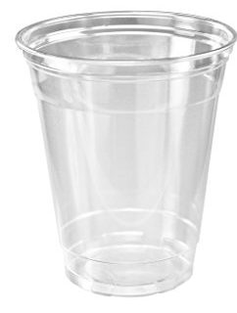
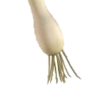
Spring onion roots in cup

Slide 25
water into cup
cover base of container

Slide 26
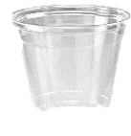
put on window sill

Slide 27
new water every day

Slide 28
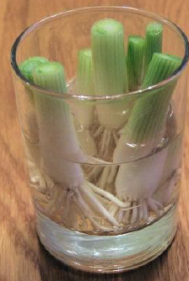
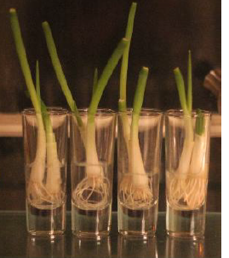
wait for spring onion to grow

Slide 30
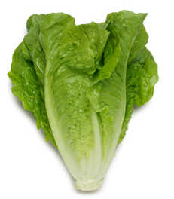
grow lettuce

Slide 31
We need:
Sharp knife
chopping board
containers
water
lettuce

Slide 32
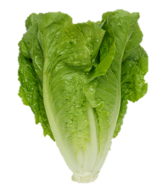
cut root off lettuce

Slide 33
Lettuce root in container

Slide 34
Water into container
cover base of container

Slide 35
put on window sill

Slide 36
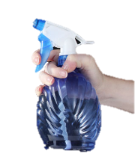
Every 3 days spray with water

Slide 37
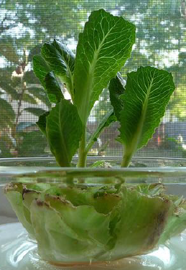
wait for lettuce to grow

