Slide 1
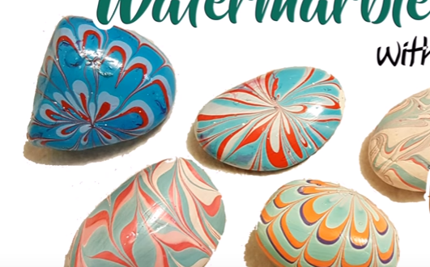
This document is released under Creative Commons License Attribution 4.0 International. Please feel free to share and adapt this document with appropriate credit to Giant Steps School.
Rock painting

Slide 2
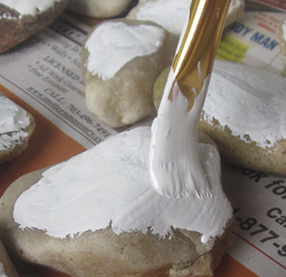
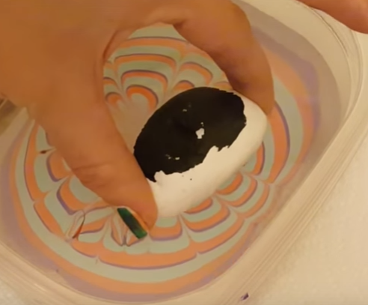
Week 7
Week 8
Paint white
Dip colours

Slide 3
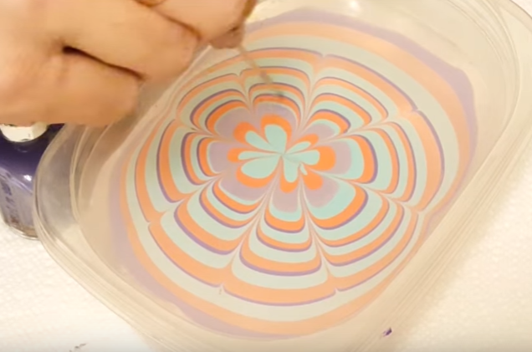
youtube

Slide 4
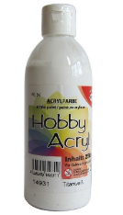
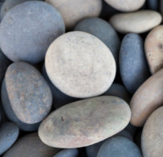
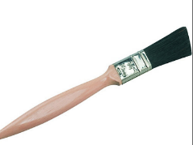
Week 7
We need:
White paint
rocks
paintbrush

Slide 5
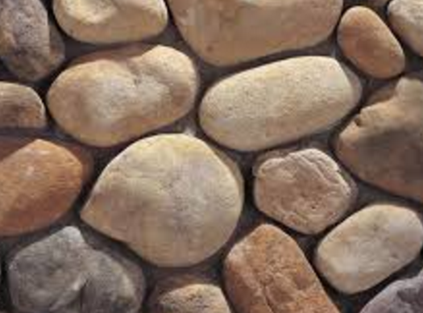
Choose rock

Slide 6
Paint rock white

Slide 7
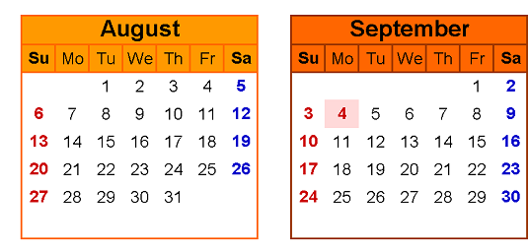
Wait to dry

Slide 9
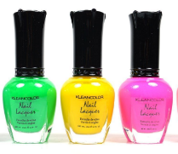
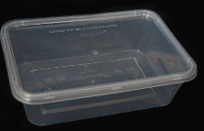
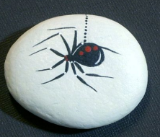
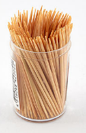
Week 7
We need:
Nail polish
container
water
white rock
toothpick

Slide 10
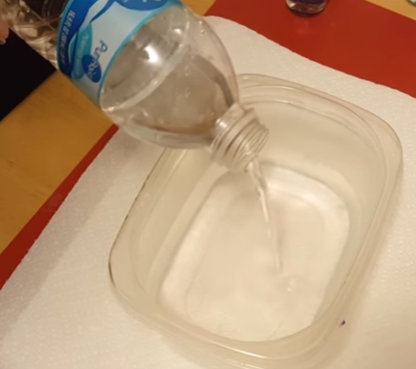
Water in container

Slide 11
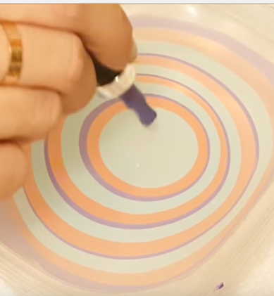
Nail polish in water
10, 9, 8,7, 6, 5, 4, 3, 2, 1

Slide 12
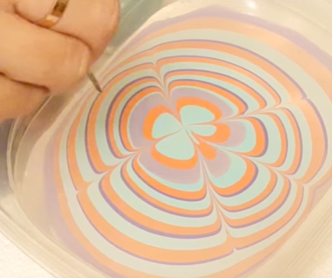
Make pattern

Slide 13
rock in water

Slide 14
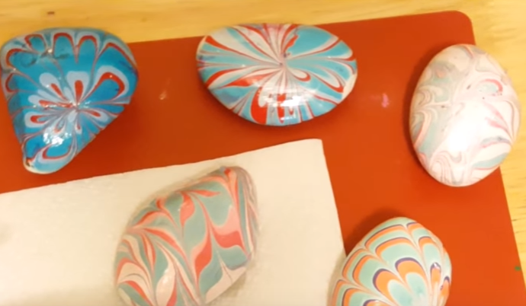
leave to dry

Slide 15
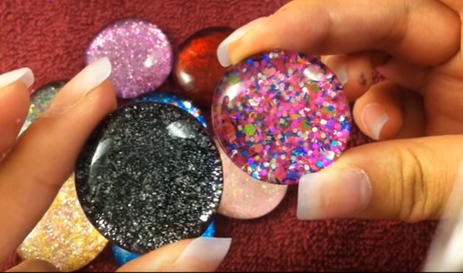
Version 2
youtube

Slide 16
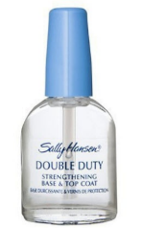
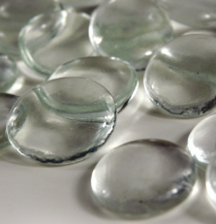
We need:
clear gems
glitter
Clear nail polish

Slide 17
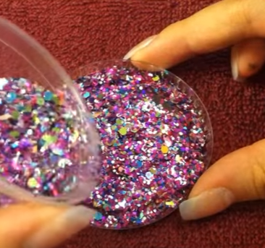
Glitter on plate

Slide 18
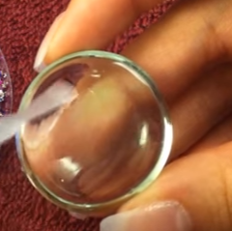
Paint flat side with nail polish

Slide 19
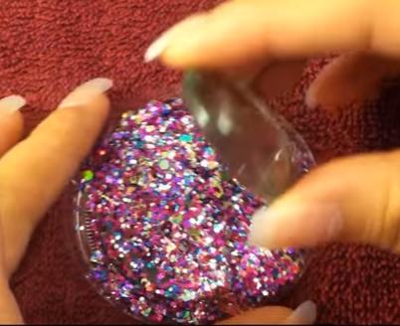
Gem in glitter

Slide 20
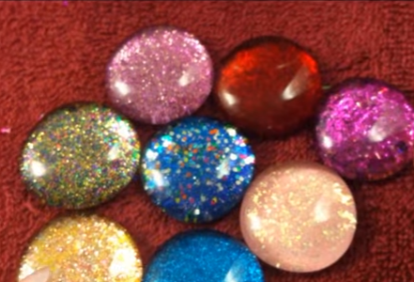
Leave to dry

