Slide 1
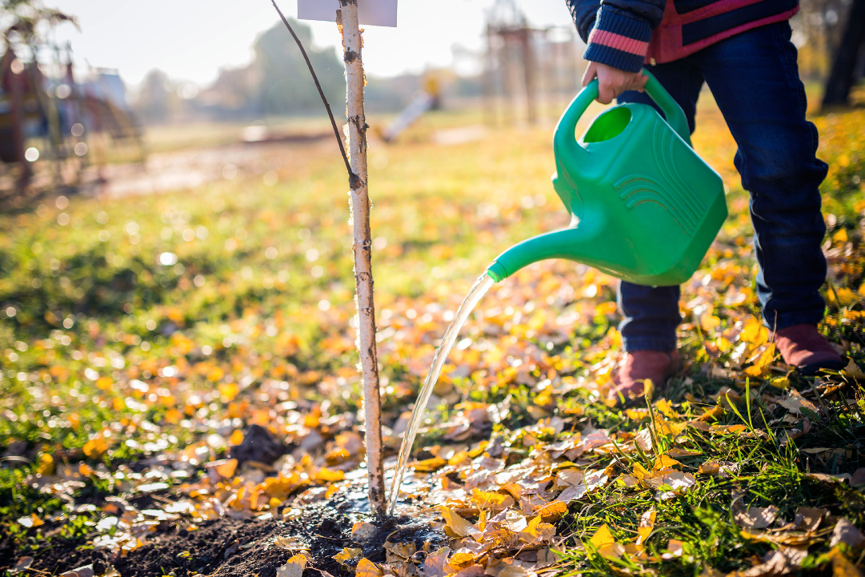
Water the trees

Slide 2
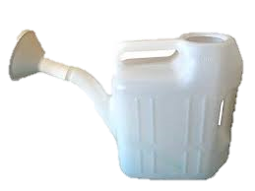
get watering cans

Slide 3
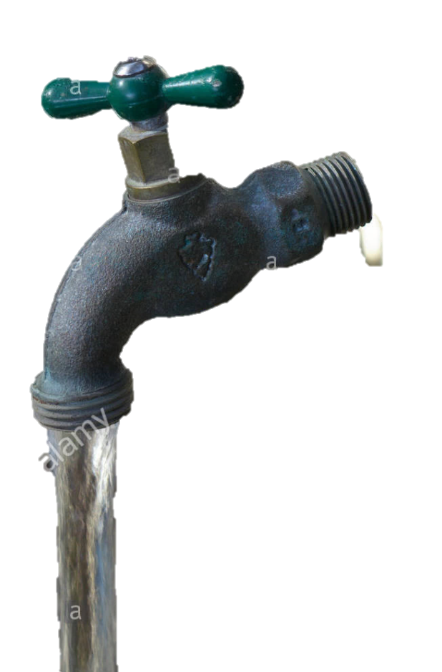
fill with water

Slide 4
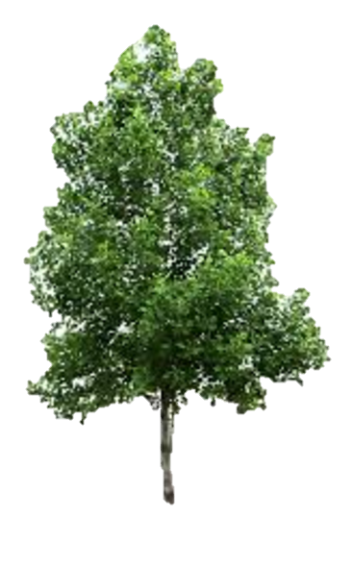
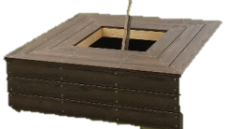
water trees
1
2
3
4

Slide 5
Pack away watering can

Slide 6
finished

