Slide 1
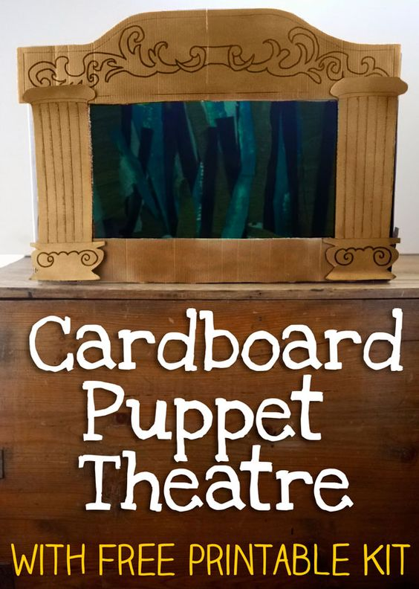

Slide 2
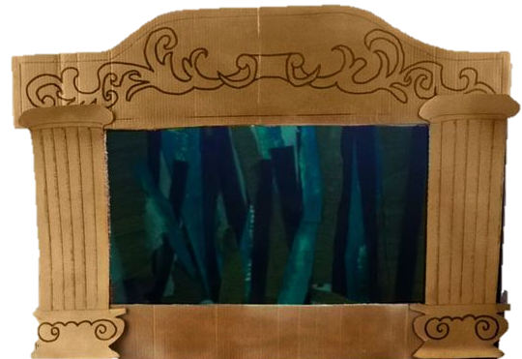
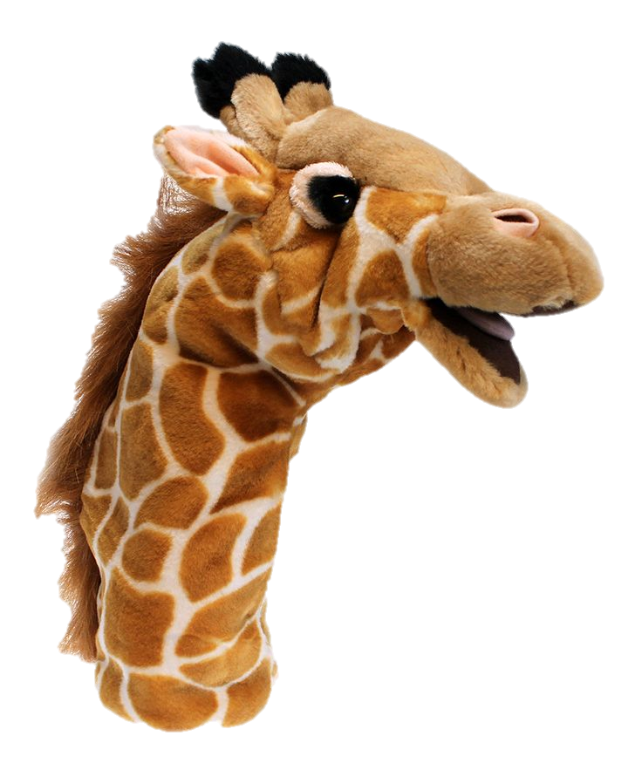
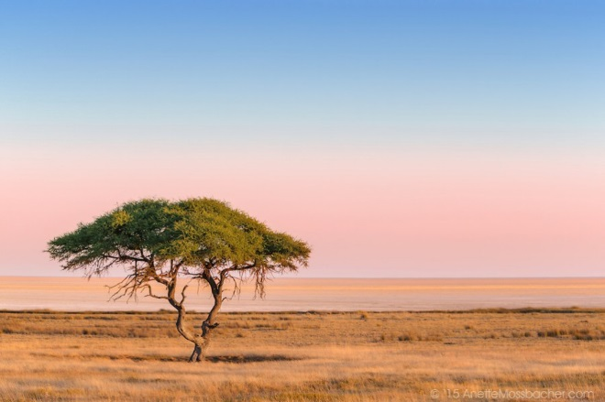
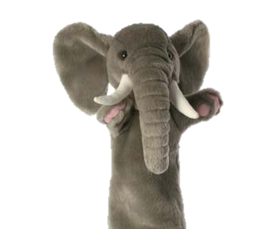

Slide 3
Hello
I am elephant
Hello
I am giraffe

Slide 4
I like
walking
I like eating

Slide 5
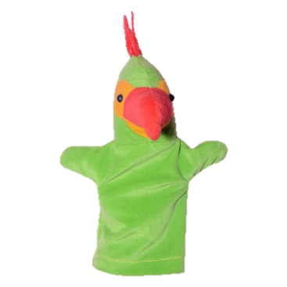
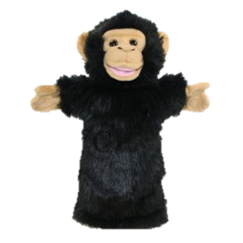
Hello
I am monkey
Hello
I am parrot

Slide 6
I like dancing
I like flying

Slide 7
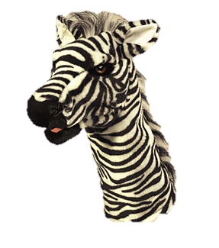
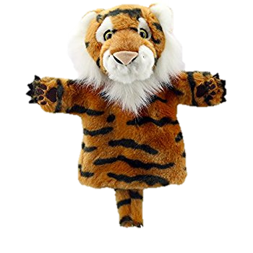
Hello
I’m Zebra
Hello
I’m Tiger

Slide 8
I like to eat zebras
I like to eat bananas

Slide 9
Roar!!!
Yikes!!!!

