Slide 1
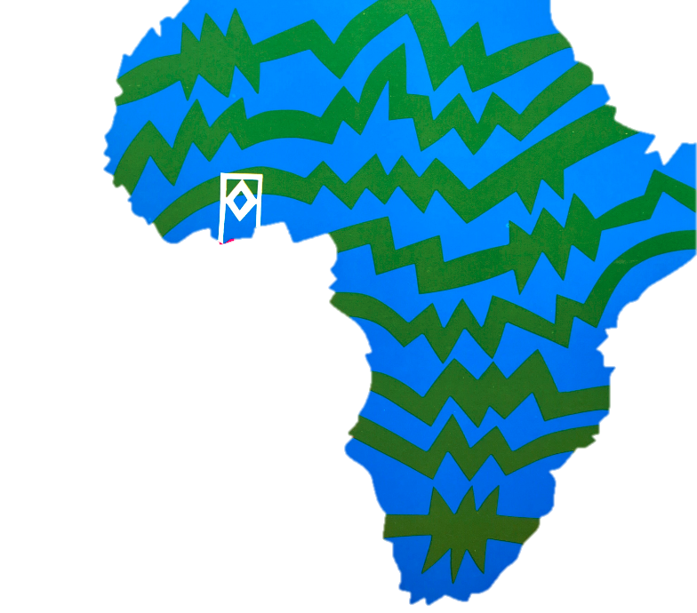
Siyahamba

Slide 2

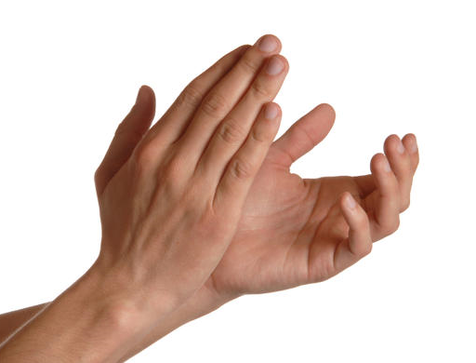
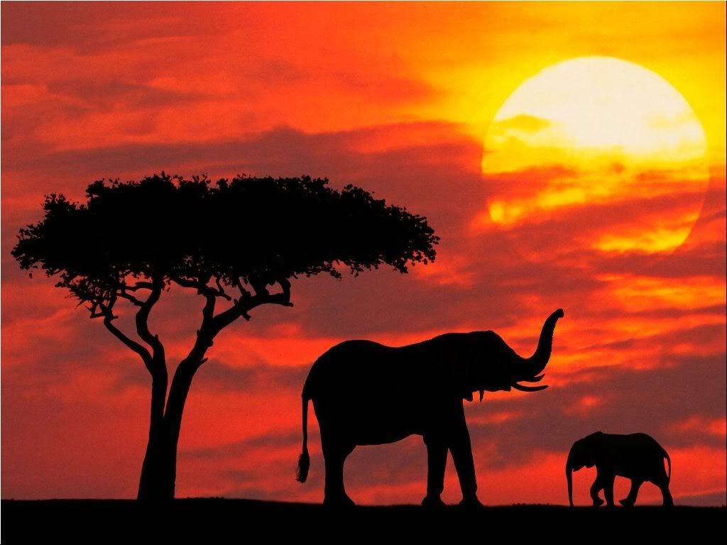
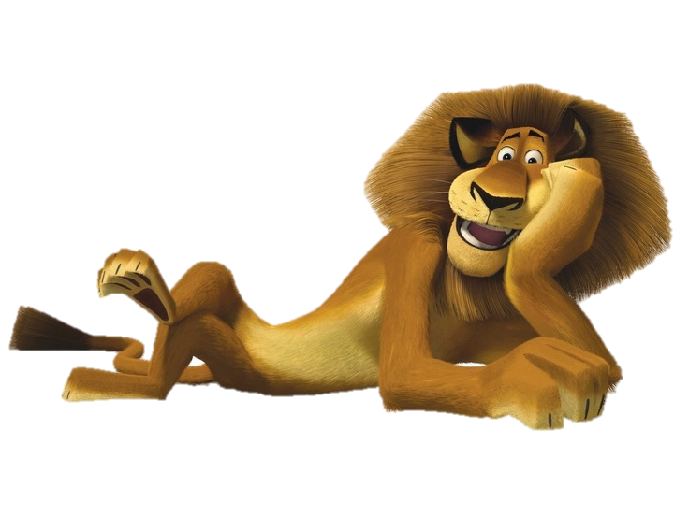
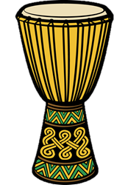



Siya hamba ku khan yen kwen kos
Africa
Siya hamba ku khan yen kwen kos
Siya hamba ku khan yen kwen kos
Siya hamba ku khan yen kwen kos

Slide 3
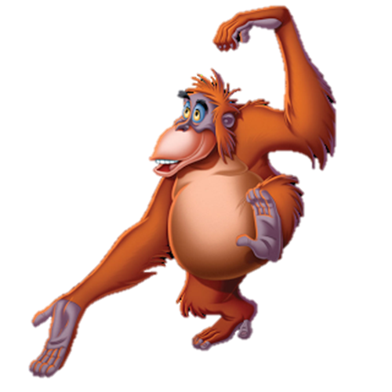
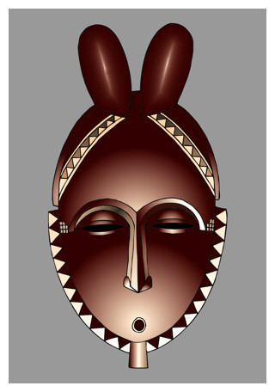
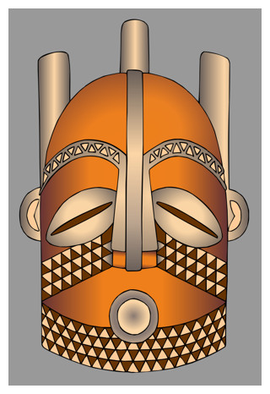
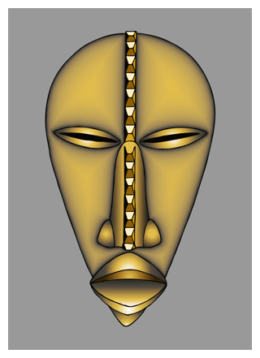
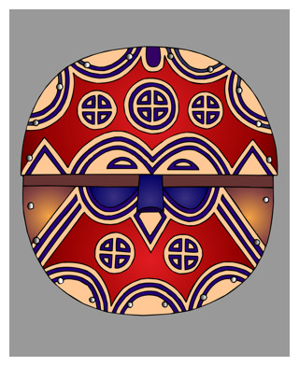
Siya hamba…siya hamba oo oo
Siya hamba ku khan yen kwen kos
Siya hamba…siya hamba oo oo
Siya hamba ku khan yen kwen kos

Slide 4
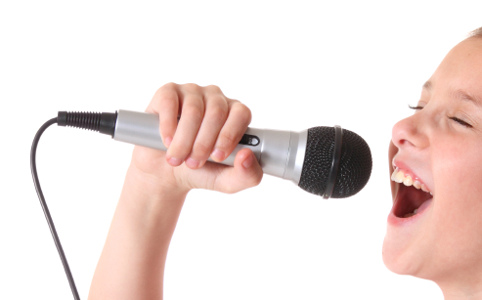
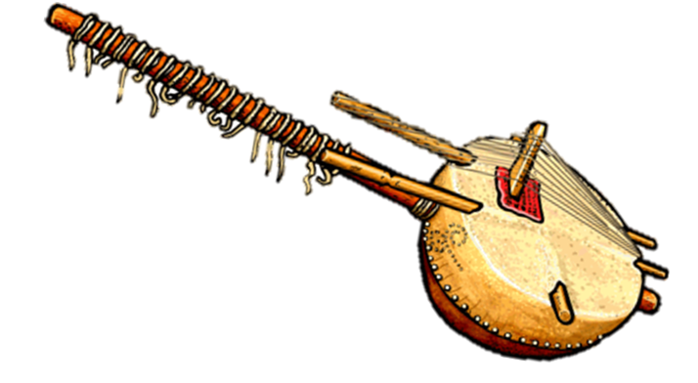
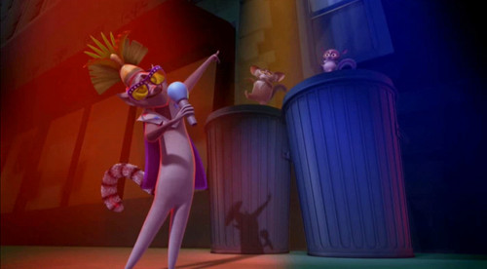
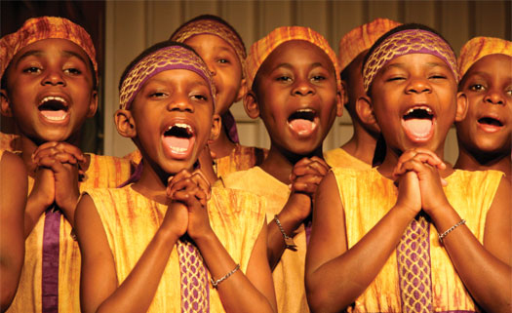

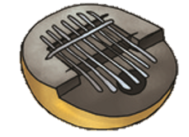
We are singing in the microphone
We are singing in the microphone
We are singing in the microphone
We are singing in the microphone

Slide 5

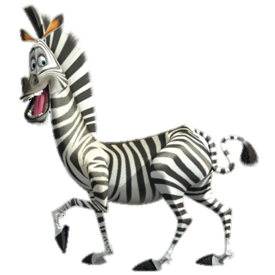

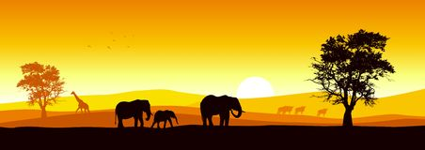
Siya hamba…siya hamba oo oo
Siya hamba ku khan yen kwen kos
Siya hamba…siya hamba oo oo
Siya hamba ku khan yen kwen kos

Slide 6
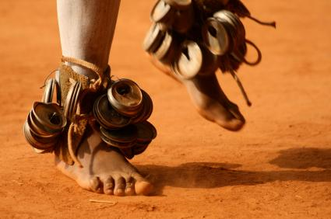
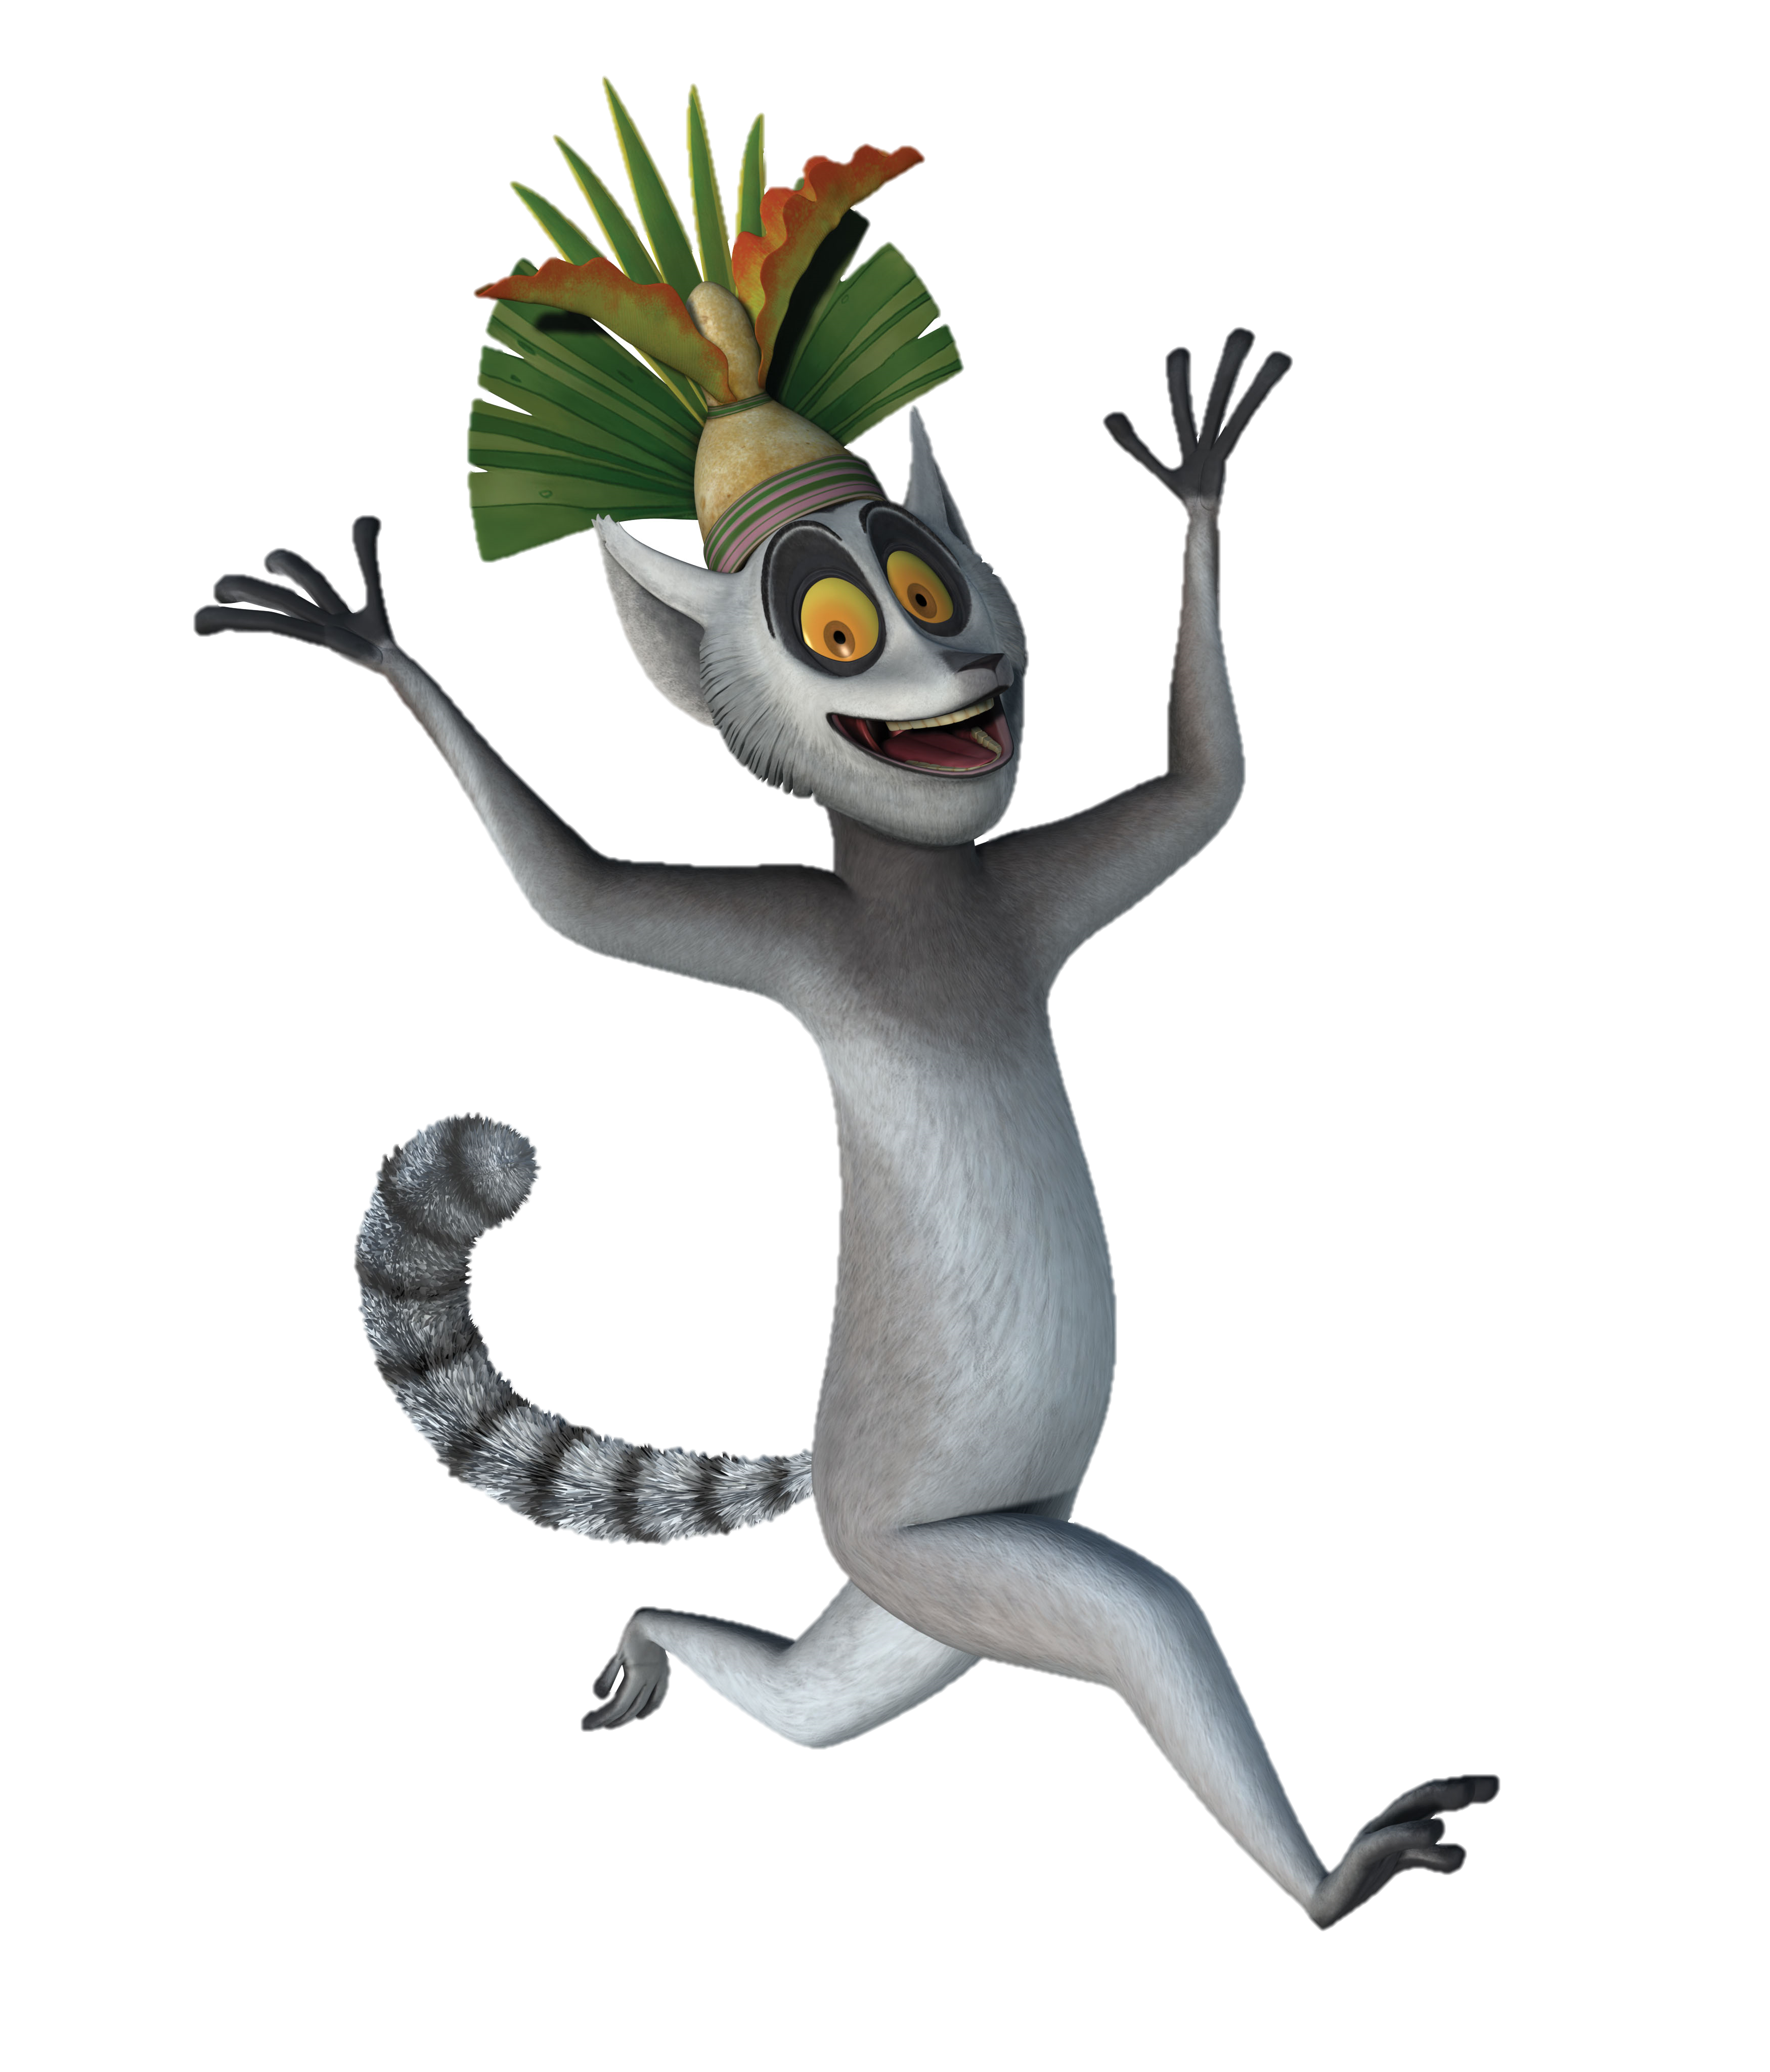
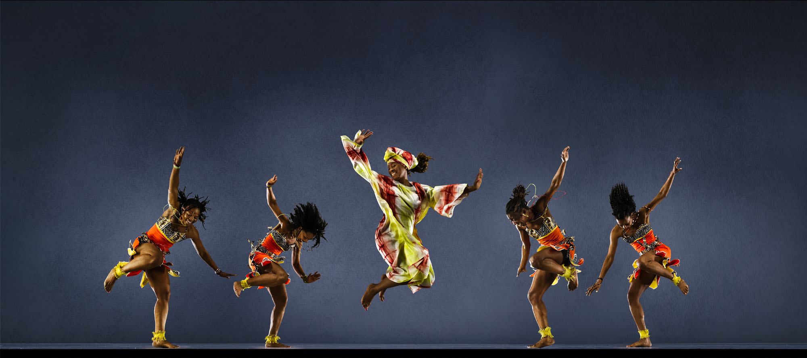

We are marching to the beat of the song
We are marching to the beat of the song
We are marching to the beat of the song
We are marching to the beat of the song

Slide 7
Siya hamba…siya hamba oo oo
Siya hamba ku khan yen kwen kos
Siya hamba…siya hamba oo oo
Siya hamba ku khan yen kwen kos

Slide 8
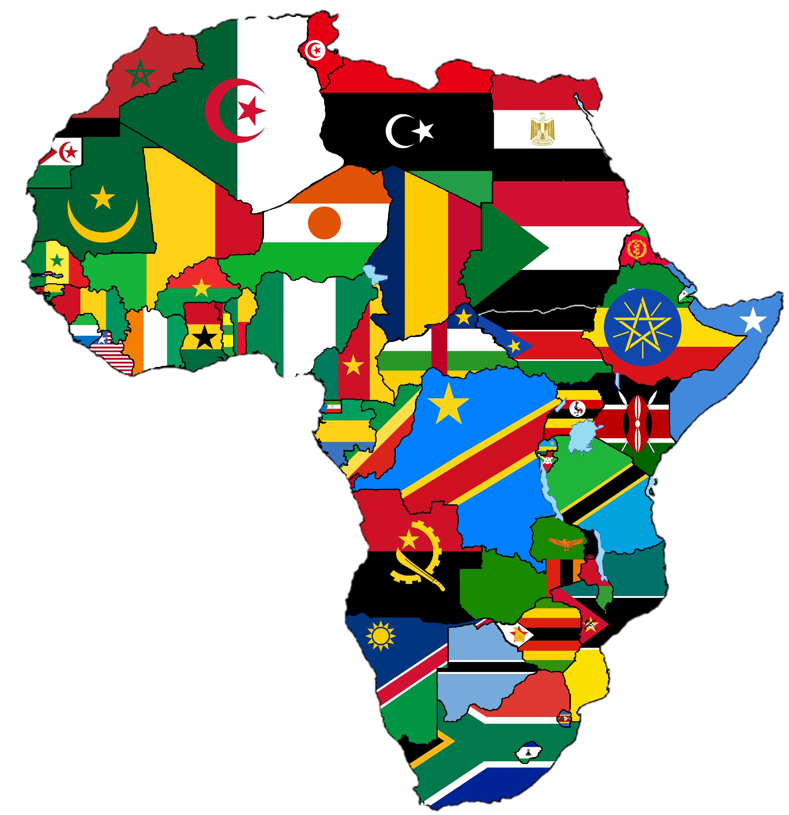
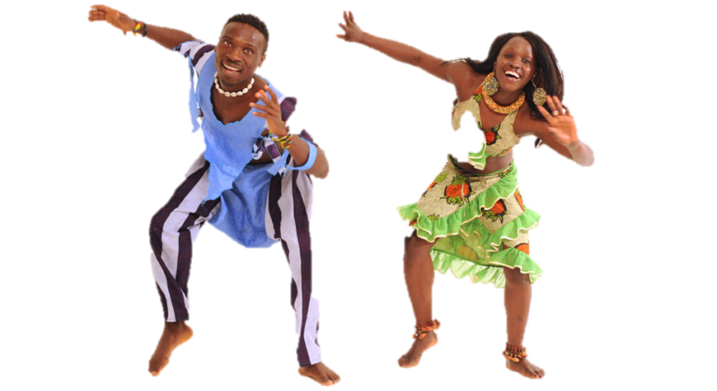
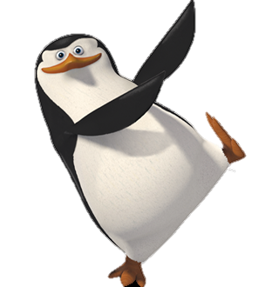

Feel the rhythm of Africa
Feel the rhythm of Africa
Feel the rhythm of Africa
Feel the rhythm of Africa

Slide 9
Siya hamba…siya hamba oo oo
Siya hamba ku khan yen kwen kos
Siya hamba…siya hamba oo oo
Siya hamba ku khan yen kwen kos

Slide 10

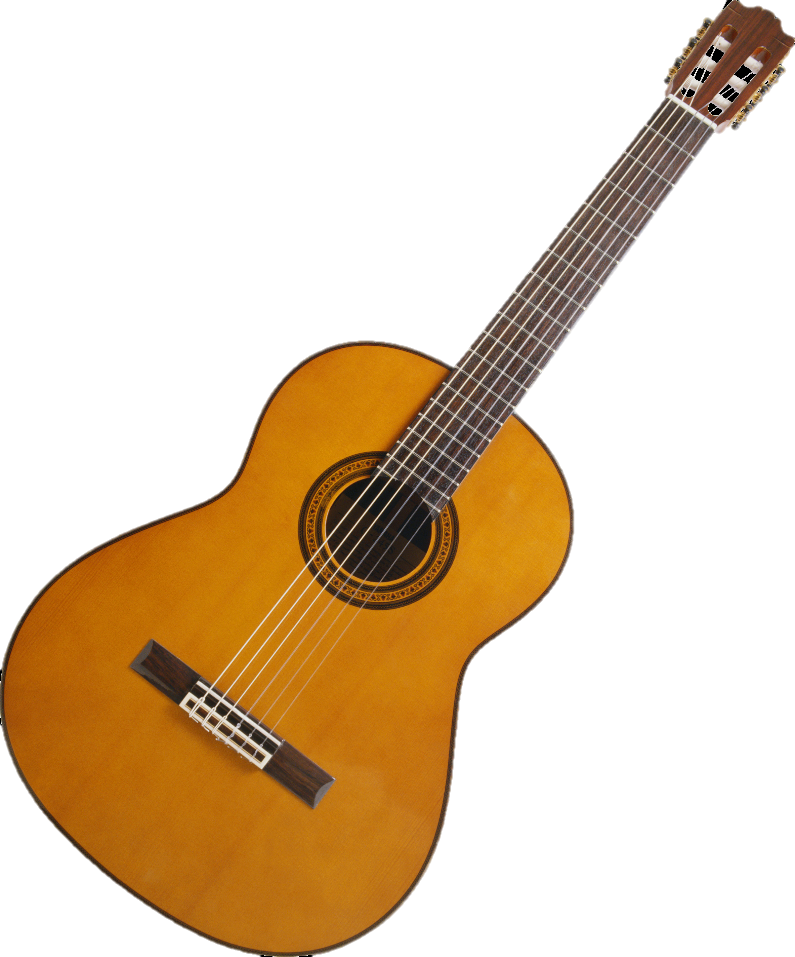
Siya hamba ku khan yen kwen kos
Africa
Siya hamba ku khan yen kwen kos
Siya hamba ku khan yen kwen kos
Siya hamba ku khan yen kwen kos

Slide 11
Siya hamba…siya hamba oo oo
Siya hamba ku khan yen kwen kos
Siya hamba…siya hamba oo oo
Siya hamba ku khan yen kwen kos

Slide 12

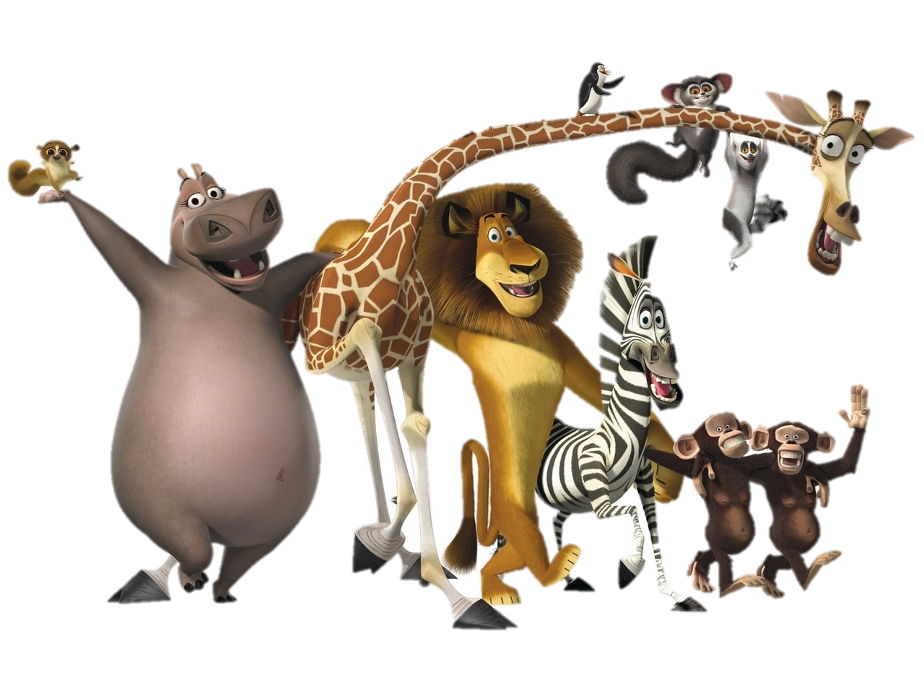
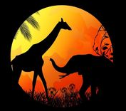

Siya hamba ku khan yen kwen kos
Siya hamba ku khan yen kwen kos

