Slide 1
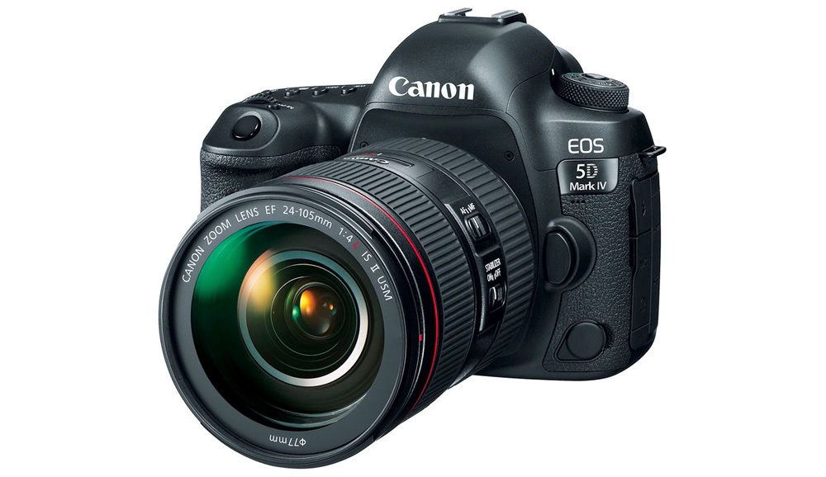
Photography
This document is released under Creative Commons License Attribution 4.0 International. Please feel free to share and adapt this document with appropriate credit to Giant Steps School.

Slide 2
song

Slide 3
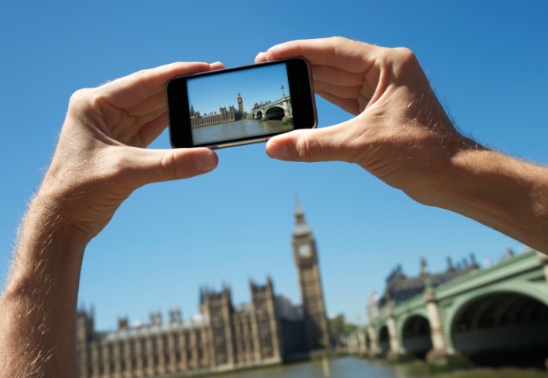
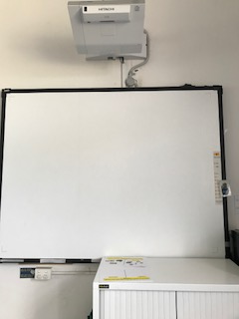
1
3
4
5
Interwrite Board
Take photo
worksheet
You tube

Slide 4
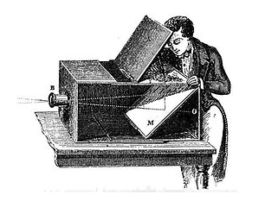
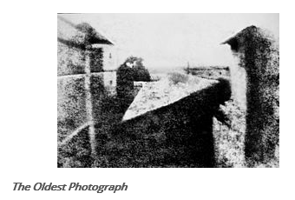
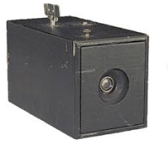
History of Photography
Camera Obscura
It was officially invented over 700-800 years ago,
The camera obscura was a box with a hole in one end, where light came in and hit a mirror. This made a picture on the back of the box of whatever was in front of the hole.
Unfortunately, this picture would disappear when the light was gone.
Daguerreotypes
Joseph Niepce and Louis Daguerre were the two scientists who first figured out how to make real photographs.
Daguerre, called the 'Father of Photography,' figured out how to bring photography to all people. His photographs, called daguerreotypes,
The ‘Kodak’ camera was developed by George Eastman and went on sale in 1888, pioneering the use of photographic film. It was simple box camera with a single shutter speed and fixed focus lens.

Slide 5
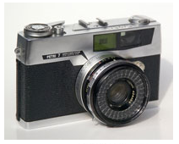
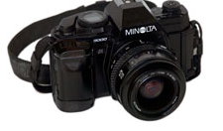
SLR
Single lens reflex cameras (SLR) use a mirror and prism system to allow photographers to accurately see the image that will be captured. This system uses one optical light path whereas previous cameras had two, one through the lens to the film and the other to the viewfinder
Digital Photography
The first successful imaging technology using a digital sensor was made in 1969 by Willard S. Boyle and George E. Smith. In 2009, they were awarded the Nobel Prize in Physics for their contributions which paved the way for digital photography

Slide 6
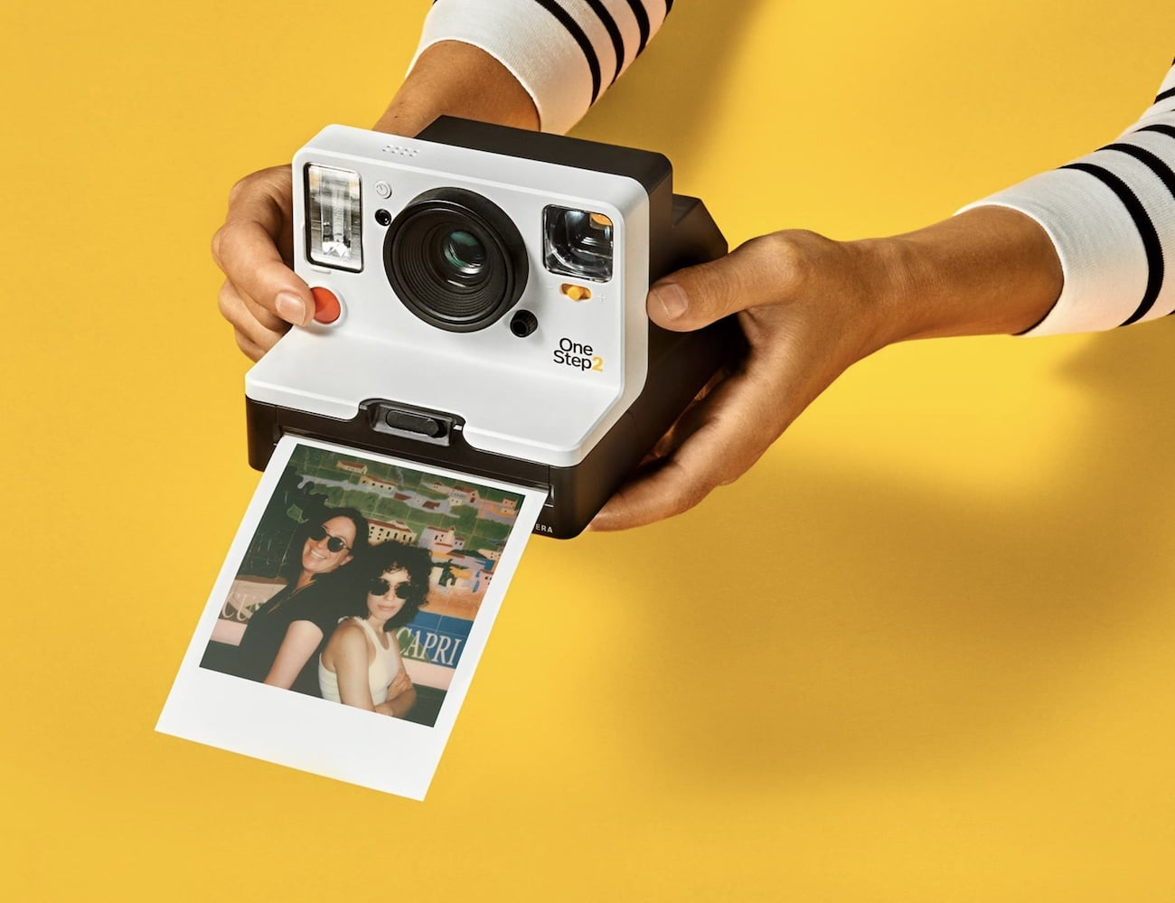
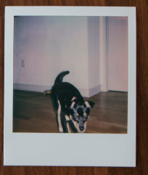
then
polaroid

Slide 7
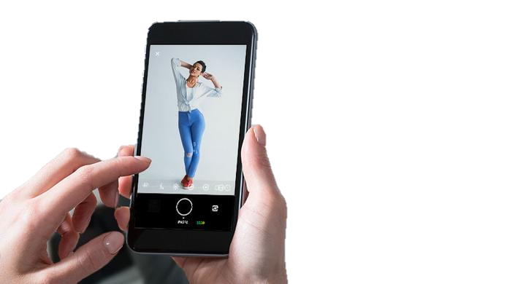
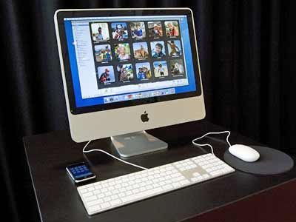
now
phone

Slide 8
later
drone

Slide 9
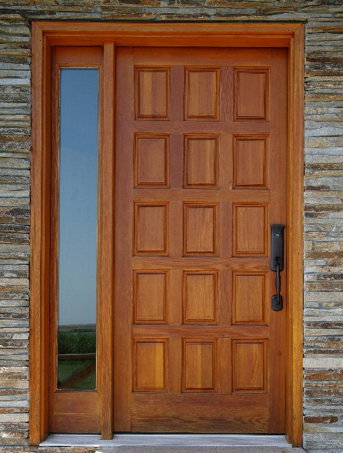
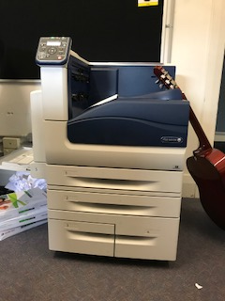
Take photo
1
2
3
4
find Doorways
Take photo
Get photo from printer
Glue in book

Slide 10
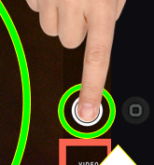
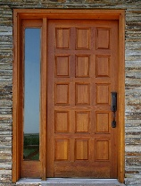
1
2
3
4
unlock
camera
focus
press

Slide 11
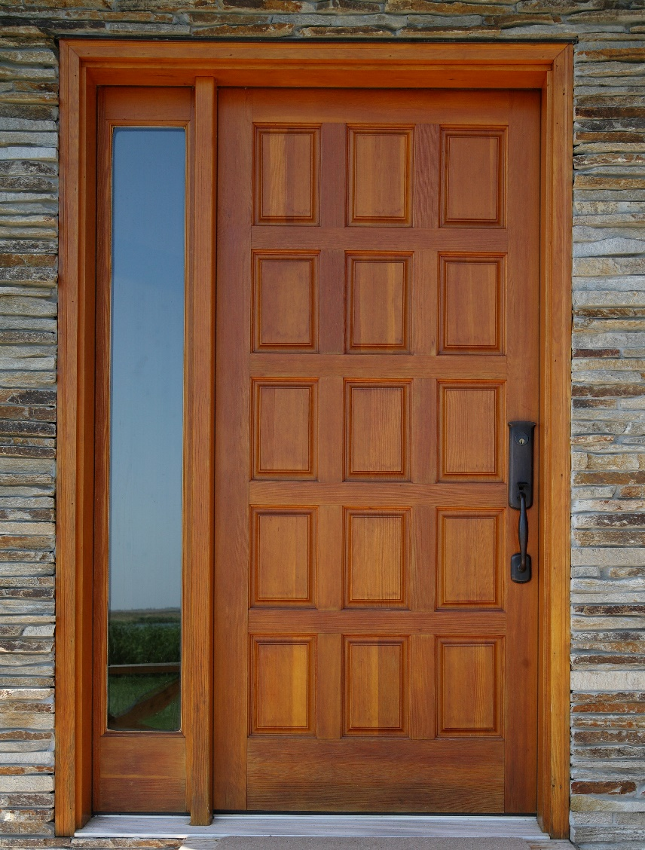
Documentary Photography - Doorways

Slide 12
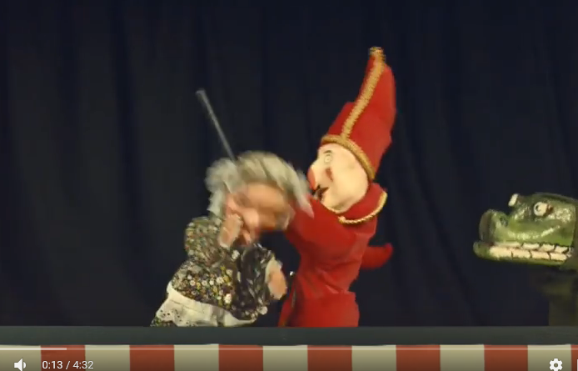
Song

Slide 13
finish

Slide 14
History of Photography - worksheet
SLR
Camera Obscura
Digital
Photography
Daguerreotypes
‘Kodak’

Slide 15
History of Photography - worksheet
SLR
Camera Obscura
Digital
Photography
Daguerreotypes
‘Kodak’

Slide 17
polaroid
phone
drone

Slide 18
polaroid
phone
drone

Slide 19
polaroid
phone
drone

Slide 21
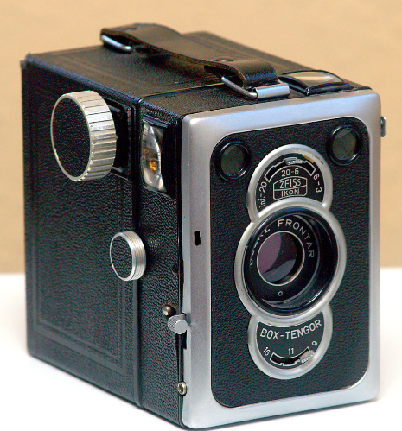
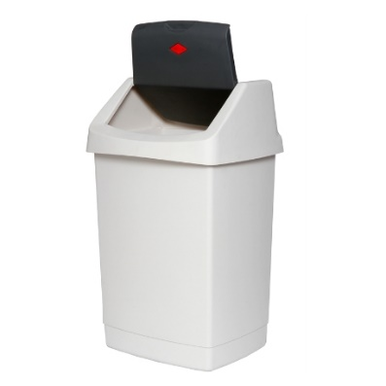
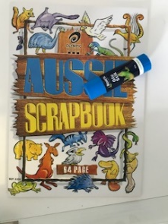
Circle what you took a photo of ?
Review
Circle the camera you used?
Circle where you put your photo?

Slide 22
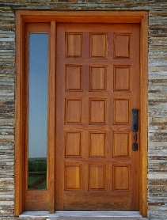
Edgar
1
2
3
4
U _ _ _ _ _
F_ _ _S
TAKE P_ _ _ _ _
W_ _ _ _ _ _ _ _

Slide 23
Jonah & Luke
1
2
3
4
Unlock iPad
focus
Take photo
worksheet

Slide 24
Aidan
1
2

Slide 25
Take photo
1
2
3
4
Arrange objects on desk
Take photo
Get photo from printer
Glue in book

Slide 26
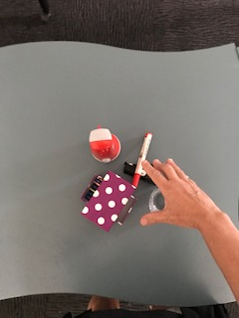
Take photo
1
2
3
4
Arrange objects on desk
Take photo
Get photo from printer
Glue in book

Slide 30
Choose a coloured pencil

Slide 31
Lesson 2 add in slide following

