Slide 1
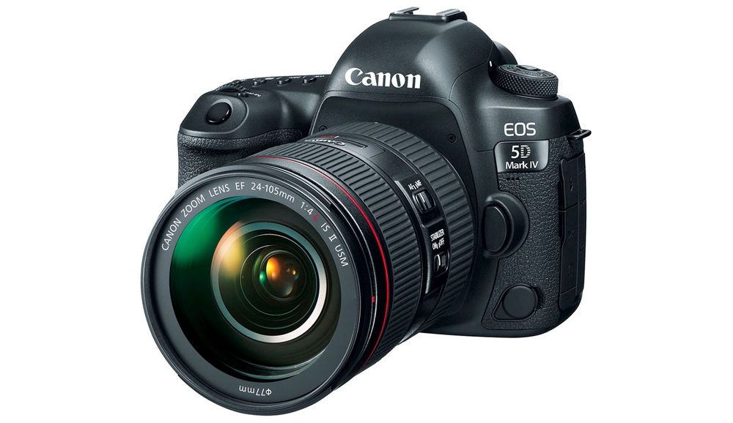
Photography
This document is released under Creative Commons License Attribution 4.0 International. Please feel free to share and adapt this document with appropriate credit to Giant Steps School.

Slide 2
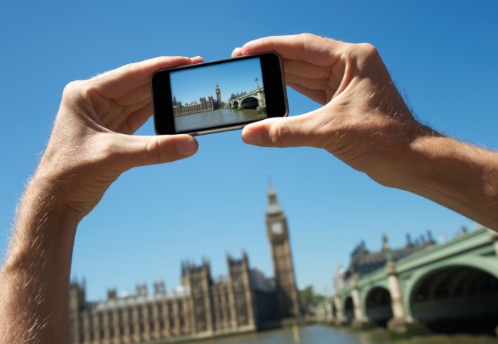
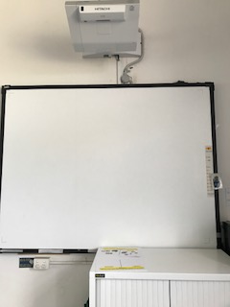
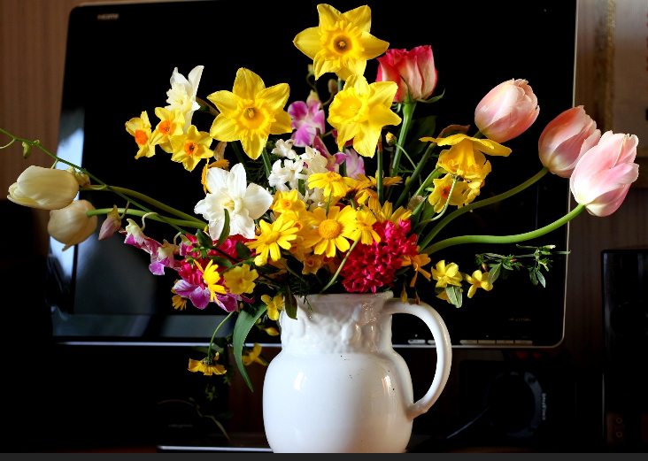
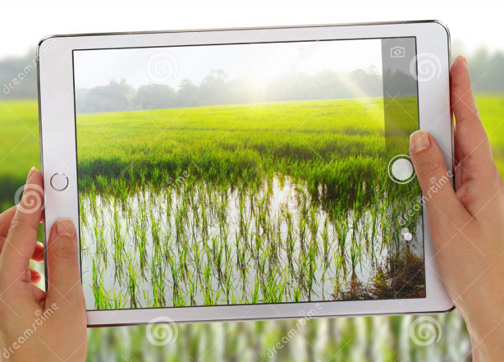
1
2
3
4
5
Walk get flowers
Interwrite Board
Take photo
worksheet
You tube

Slide 3
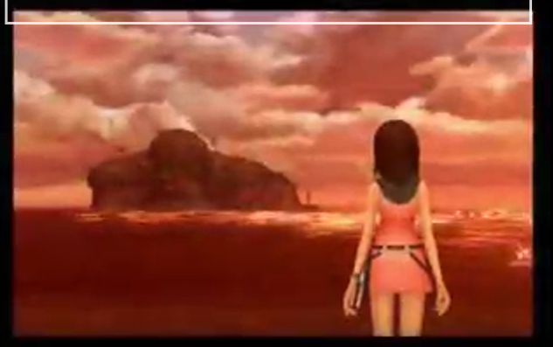
Song

Slide 4
Still life Flowers

Slide 5
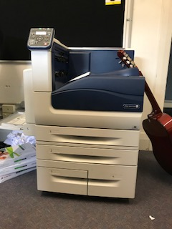
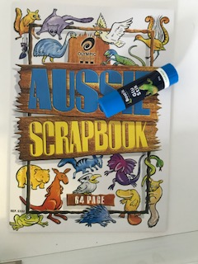
Take photo
1
2
3
4
Arrange Flowers on desk
Take photo
Get photo from printer
Glue in book

Slide 6
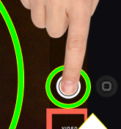
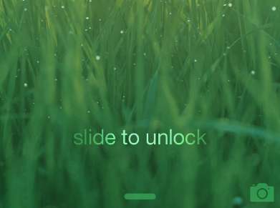
1
2
3
4
unlock
camera
focus
press

Slide 7
slide to unlock iPad

Slide 8
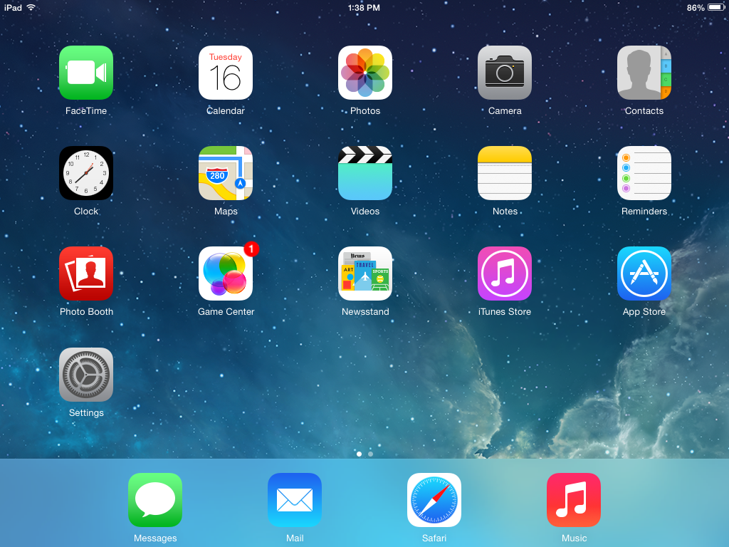
TAP
open camera app

Slide 9
choose photo setting

Slide 10
TAP
find object take picture

Slide 11
zoom in
TAP
pinch
out

Slide 12
zoom out
TAP
pinch
in

Slide 13
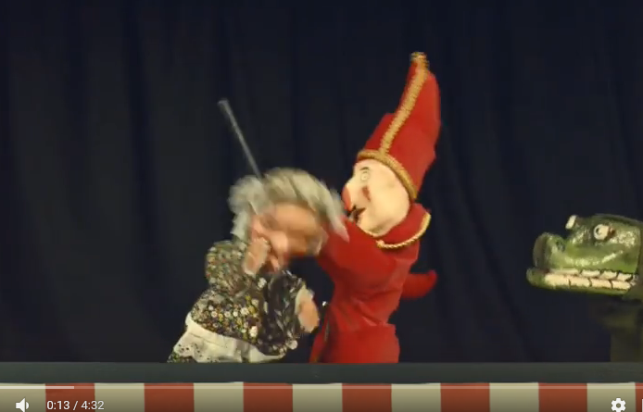
Song

Slide 14
finish

Slide 15
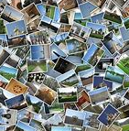
1
2
3
4
5
Interwrite Board
Collage
Take photo
worksheet
You tube

Slide 16
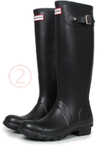
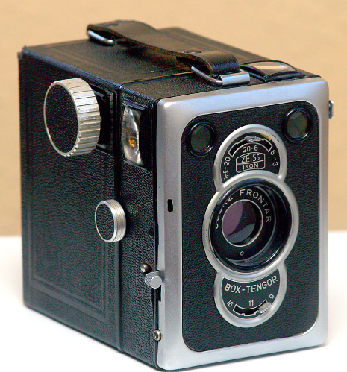
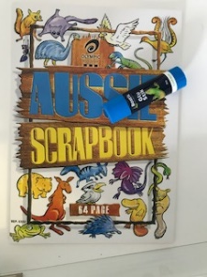
Circle what you took a photo of ?
Review
Circle the camera you used?
Circle where you put your photo?

Slide 17
1
2
3
4
unlock
camera
focus
press

Slide 18
1
2
3
4
U________
C__________
F________
P________

Slide 19
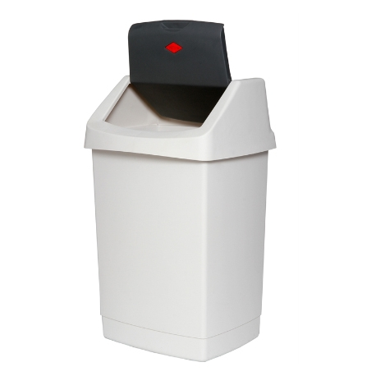

Slide 20
Take photo
1
2
3
4
Arrange objects on desk
Take photo
Get photo from printer
Glue in book

Slide 21
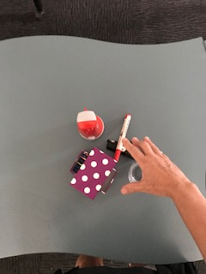
Take photo
1
2
3
4
Arrange objects on desk
Take photo
Get photo from printer
Glue in book

