Slide 1
Photography
This document is released under Creative Commons License Attribution 4.0 International. Please feel free to share and adapt this document with appropriate credit to Giant Steps School.

Slide 2
Documentary Photography - Walls

Slide 3
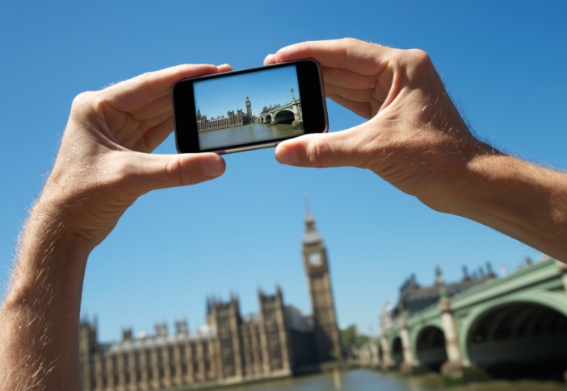
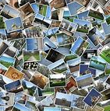
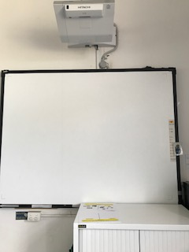
1
2
3
4
5
Interwrite Board
Collage
Take photo
worksheet
You tube

Slide 4
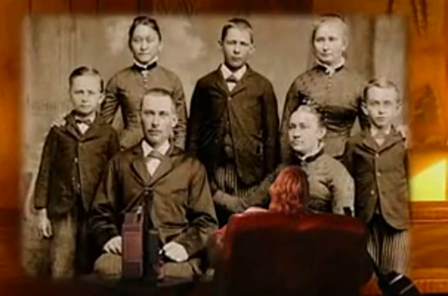
Song

Slide 5
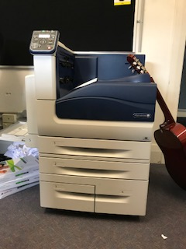
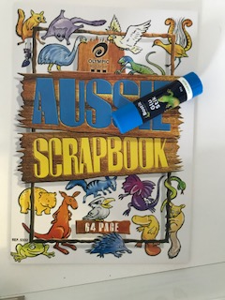
Take photo
1
2
3
4
Walk to wall
Take photo
Get photo from printer
Glue in book

Slide 6
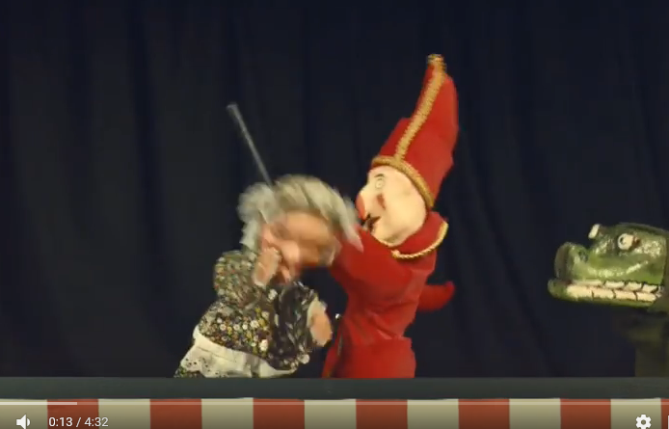
Song

Slide 7
finish

Slide 8
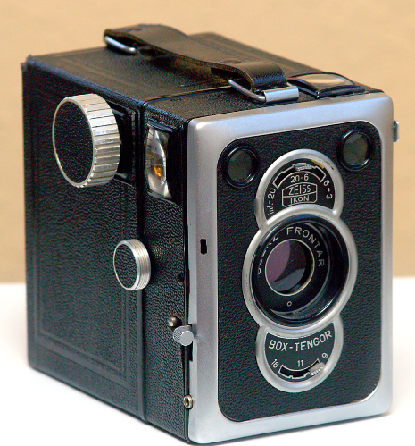
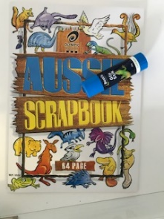
Circle what you took a photo of ?
Review
Circle the camera you used?
Circle where you put your photo?

Slide 9
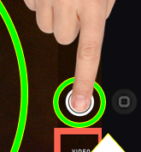
Edgar
1
2
3
4
U _ _ _ _ _
F_ _ _S
TAKE P_ _ _ _ _
W_ _ _ _ _ _ _ _

Slide 10
Jonah & Luke
1
2
3
4
Unlock iPad
focus
Take photo
worksheet

Slide 11
Aidan

Slide 12
Take photo
1
2
3
4
Arrange objects on desk
Take photo
Get photo from printer
Glue in book

Slide 13
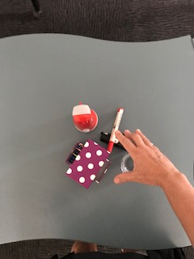
Take photo
1
2
3
4
Arrange objects on desk
Take photo
Get photo from printer
Glue in book

Slide 17
Choose a coloured pencil

