Slide 1

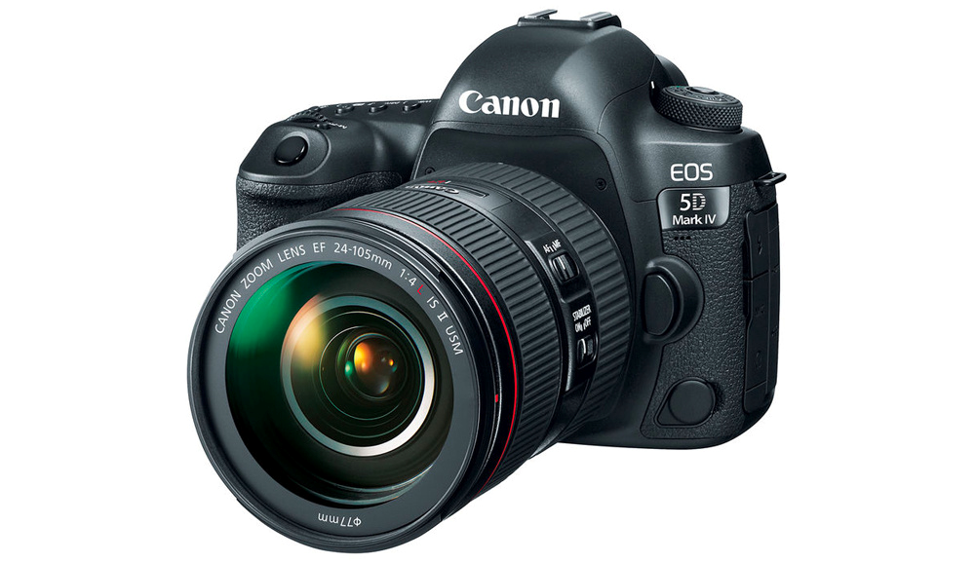
Photography
This document is released under Creative Commons License Attribution 4.0 International. Please feel free to share and adapt this document with appropriate credit to Giant Steps School.

Slide 2
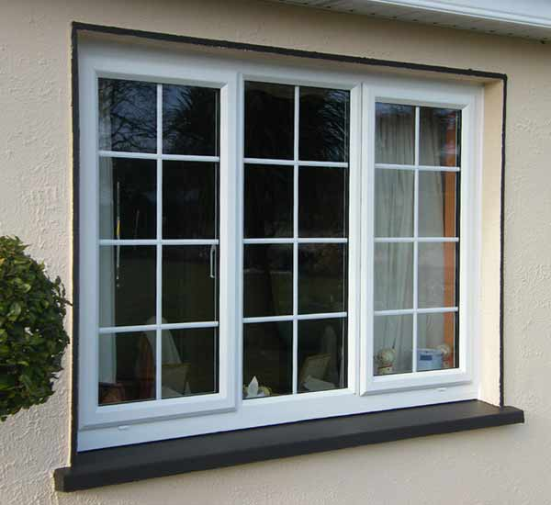
Documentary Photography - Windows

Slide 3
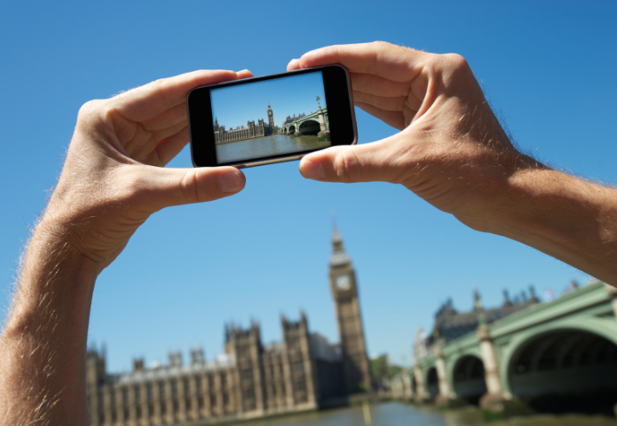

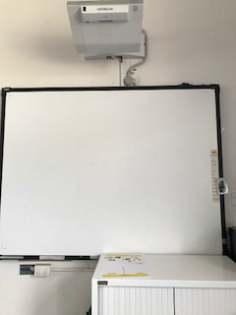

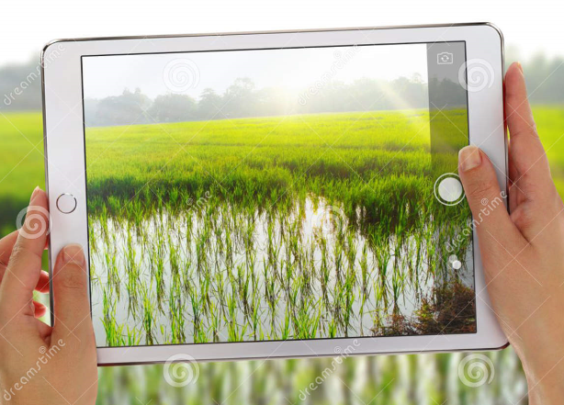
1
2
3
4
Interwrite Board
Take photo
worksheet
You tube

Slide 4

Song

Slide 5
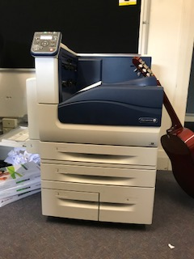
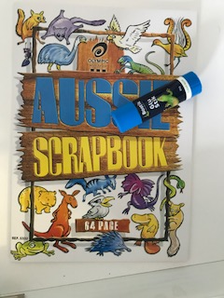
Take photo
1
2
3
4
Arrange Windows on desk
Take photo
Get photo from printer
Glue in book

Slide 6
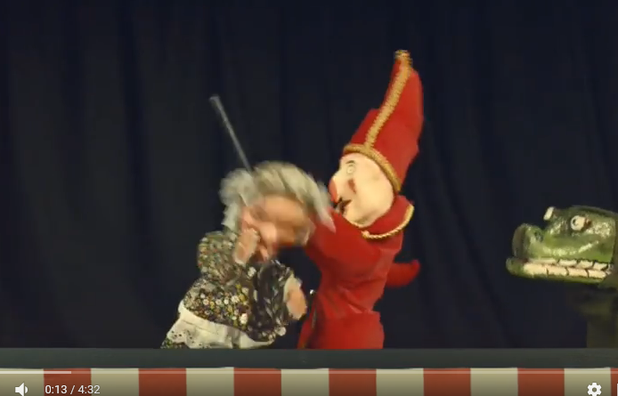
Song

Slide 7

finish

Slide 8
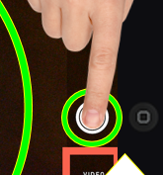

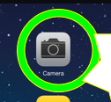
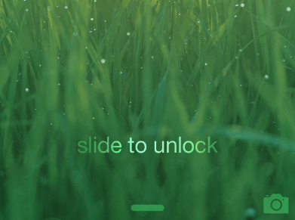
Jonah & Luke
1
2
3
4
Unlock iPad
focus
Take photo
worksheet

Slide 9
What did you photograph?
Review
What camera did you use?

Slide 10
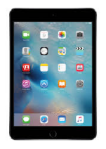
What did you photograph?
Review
What camera did you use?

Slide 11
I took a photo of a
Review
window
IPad
I used an to take my photo

Slide 12
Aidan

Slide 13
