Slide 1
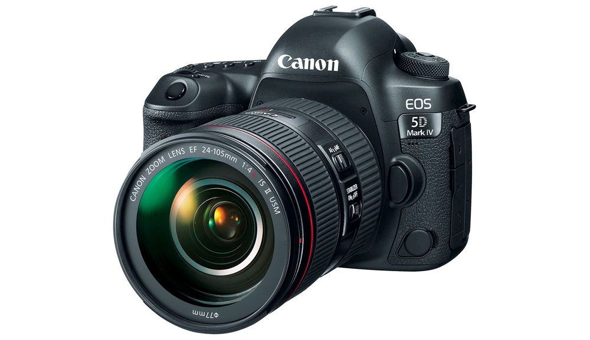
Photography

Slide 2
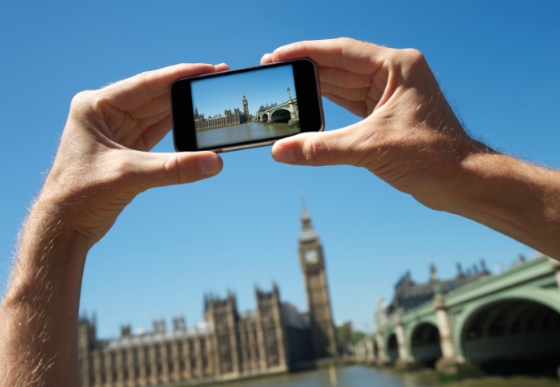
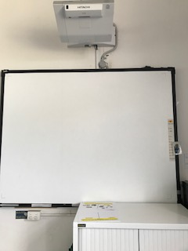
1
2
3
4
Interwrite Board
Take photo
worksheet
You tube

Slide 3
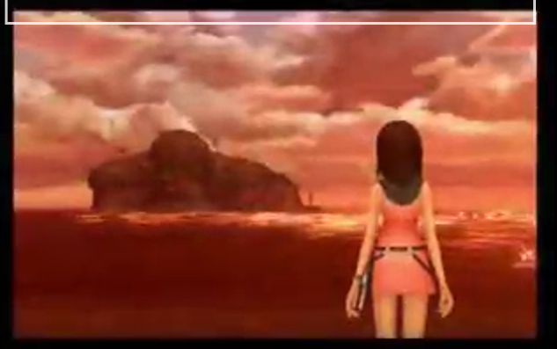
Song

Slide 4
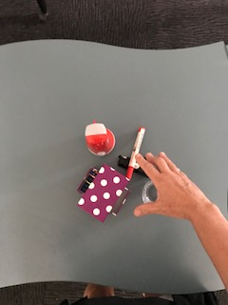
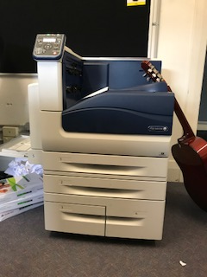
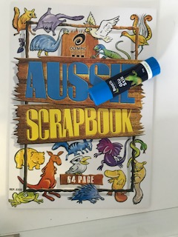
Take photo
1
2
3
4
Arrange objects on desk
Take photo
Get photo from printer
Glue in book

Slide 5
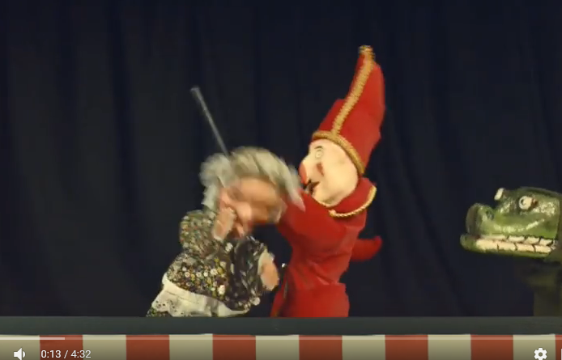
Song

Slide 6
finish

Slide 7
Take photo
1
2
3
4
Arrange objects on desk
Take photo
Get photo from printer
Glue in book

Slide 8
Take photo
1
2
3
4
Arrange objects on desk
Take photo
Get photo from printer
Glue in book

Slide 12
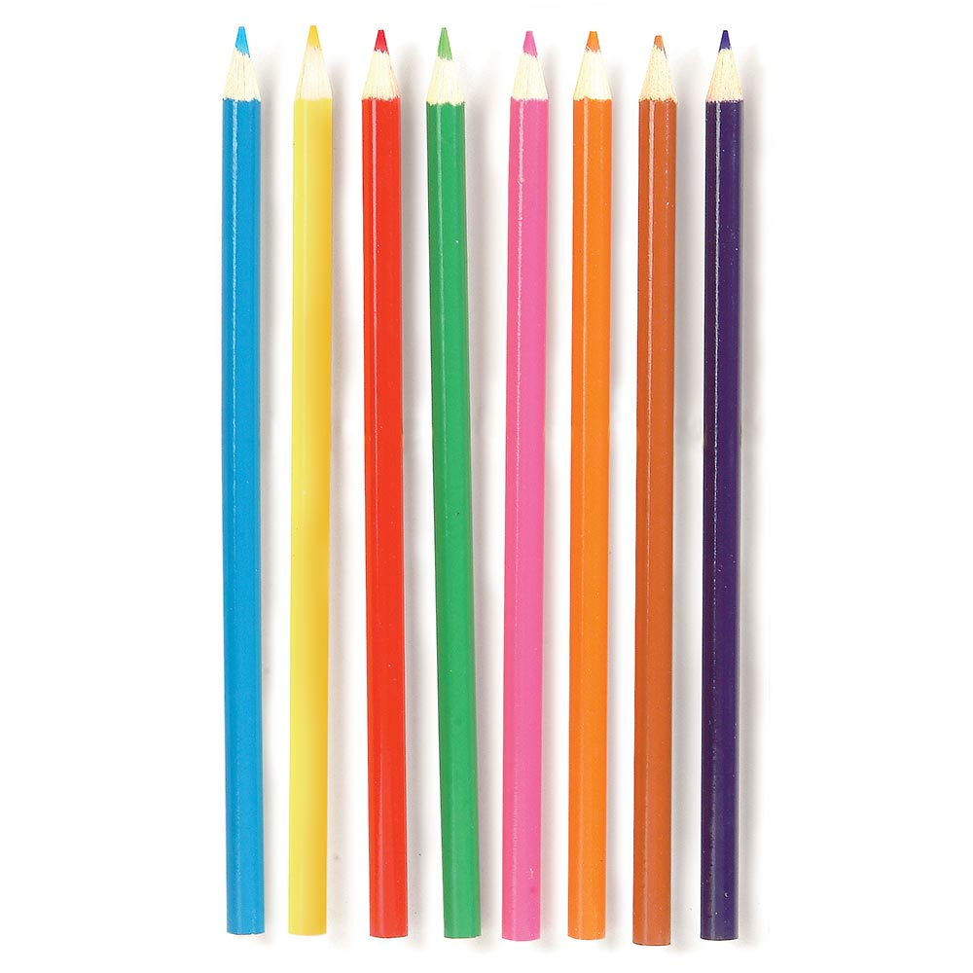
Choose a coloured pencil

