Slide 1
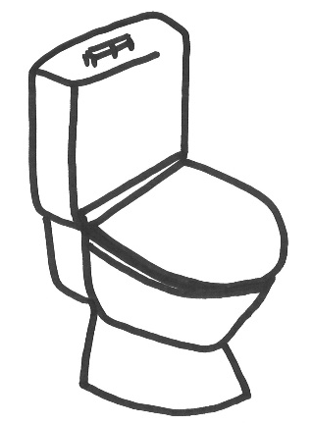

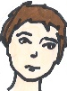
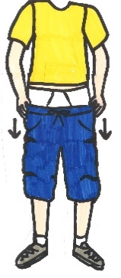
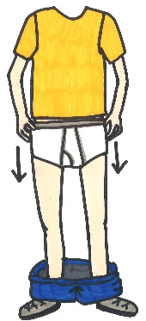

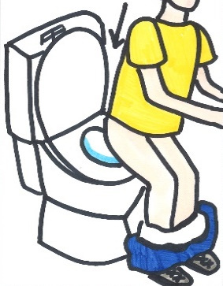
Boys poo
Page 1
Print double sided long edge
Scale to fit paper
toilet
pants down
undies down
sit down do poo

Slide 2

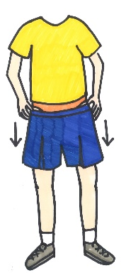
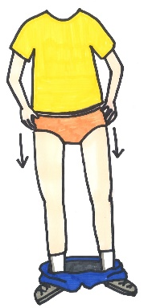

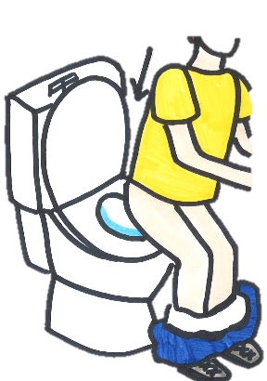
Girls poo
Page 1
toilet
pants down
undies down
sit down do poo

Slide 3
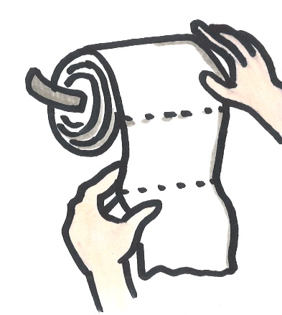

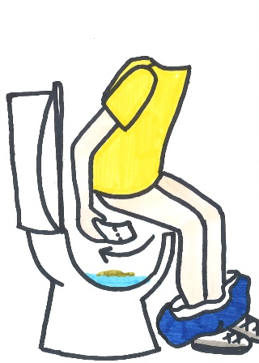
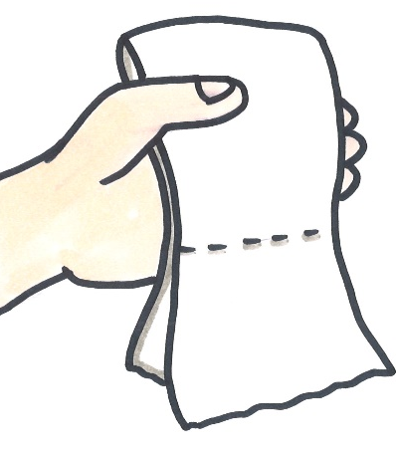
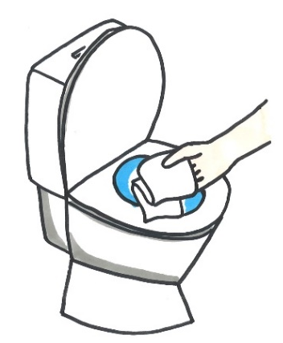
Boys poo
Page 2
get toilet paper
wipe bottom front to back
check paper – paper clean
paper in toilet

Slide 4
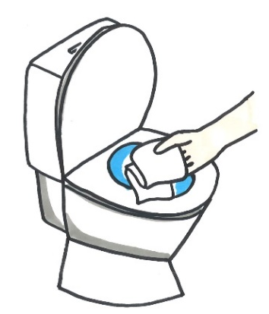
Girls poo
Page 2
get toilet paper
wipe bottom – front to back
check paper – paper clean
paper in toilet

Slide 5

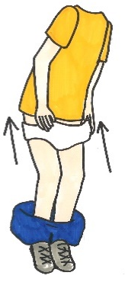

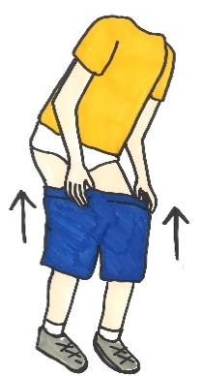

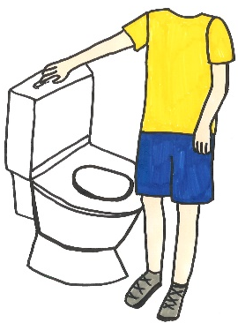
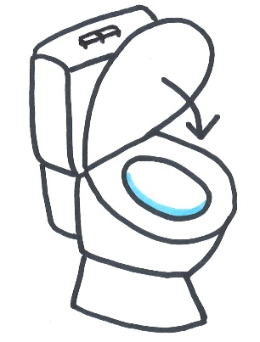
Boy poo
Page 3
undies up
pants up
flush
lid down

Slide 6





Girls poo
Page 3
undies up
pants up
flush
lid down

