Slide 1

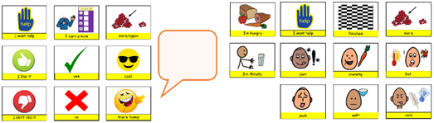
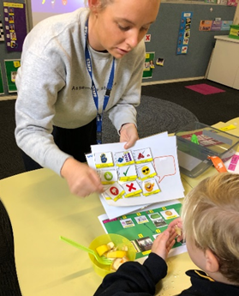



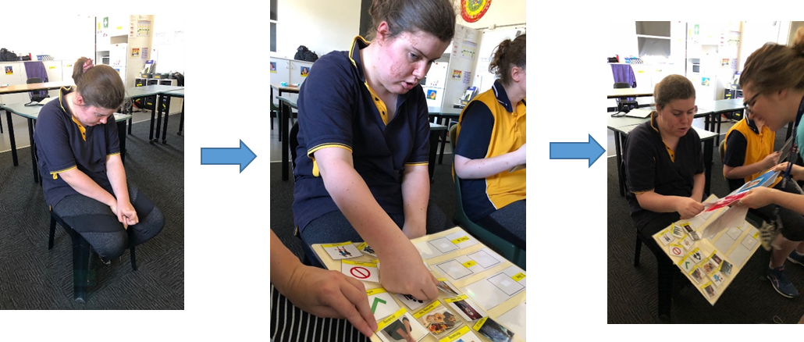

Education Infographic
MORE THAN REQUESTING
Promoting commenting in the classroom
Katherine Halter
My vision is to provide commenting supports in structured lessons so that all students (verbal and non-verbal) are provided with the opportunity to enrich the quality of their interactions and engage in their learning.
Rationale
To increase the range of meaningful interactions students participate in (more than requesting or saying ‘no’)
Commenting establishes social interactions and joint attention through the sharing of information (Coggins & Carpenter, 1981).
It is a challenge for students with ASD to comment as there is often no extrinsic value. It comes naturally to adults and makes up a large part of our interactions.
Commenting involves…
naming/ labelling
events outside experience
giving commands
possession
description
immediate context
past/future events
special interests
mistakes
conversation turns
The change process
Evaluated existing commenting supports
Researched commenting and its importance
Discussed project with speech therapists
Discussed project with Stage 6 team and provided education
Compiled existing commenting boards, created generic commenting board and templates
Commenting boards implemented in 2019 programs
Implemented commenting boards in classroom
Who? Stage 6 Secondary students who are mostly non-verbal and actively disengage from the lesson content that is displayed on the interwrite board
When? - During Stage 6 English lessons
At present
Encouraging 2019 teams to implement commenting boards in the classroom.
Both generic and specific commenting boards hold value and both offer opportunities for individual and group teaching methods to expose students to vocabulary and common social phrases
Combined previous work by speech therapy team on Colourful Semantics with commenting boards to colour code and structure commenting supports.
In the future
Expressing vision to the whole school body through professional development with a focus on HOW to promote commenting
Encourage teachers to write commenting supports into their teaching and learning sequence for all appropriate programs
Continue sharing commenting resources through a common folder on the server to reduce resourcing load.
Data collection – case study or recording comments versus demands
Inner Journey
- Implemented a democratic leadership style by asking the team for their perspective and taking into account their experience
- Require those people who can see the big picture (holistic thinkers)
- Difficult to inspire change for people who are busy and have other priorities
- Quiet achiever – feed off others enthusiasm for validation
Outer Journey
- Leaders look to their team to provide answers to questions
- It is an ongoing, continuous process where learning from our peers occurs
- It takes persistence and perseverance to affect change.
Journey
Reflection
Staff from other disciplines have enquired about commenting boards indicating that they are being used across the school.
Speech Therapy team are aware of the resources and templates available and commenting strategies are being implemented most frequently during English programs.
Encouraged student engagement and enhanced the quality of interactions between staff and students.
“Using commenting vocabulary with a student’s talker, I saw a decrease in her standing up and removing herself from the classroom during a new, unfamiliar lesson”
“With practice and consistent use, the students can become very confident and efficient at selecting a visual to correspond to the interwrite board to make a comment.”

