Slide 1
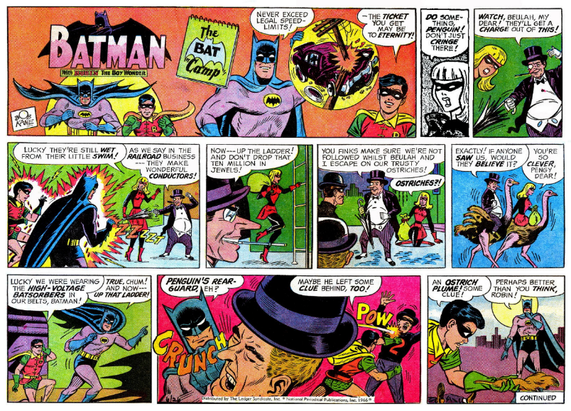
Make comic strip

Slide 2
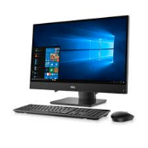
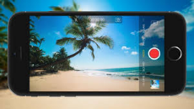
Split groups
Insert student photo
Insert student photo
Insert student photo
Insert student photo
Insert student photo
Insert student photo
Continue working on comic
Make a movie based on your comic

Slide 3
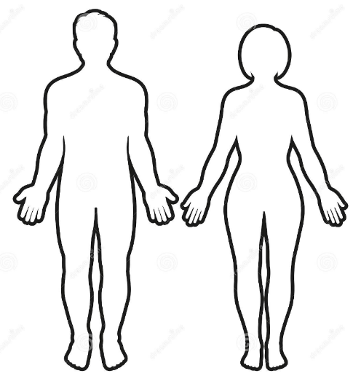
Choose male or female

Slide 4
Choose features: face

Slide 5
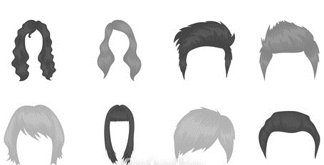
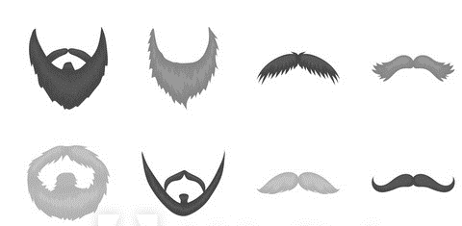
Choose features: hair

Slide 6
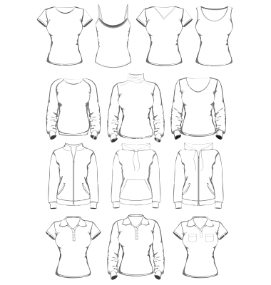
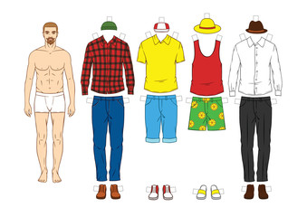
Choose outfit

Slide 7
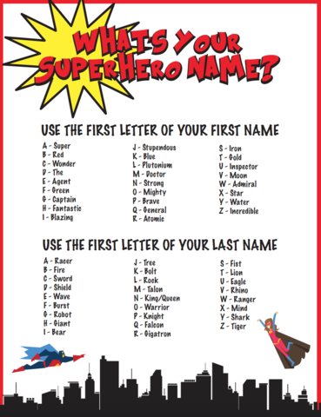
Choose Superhero name

Slide 8
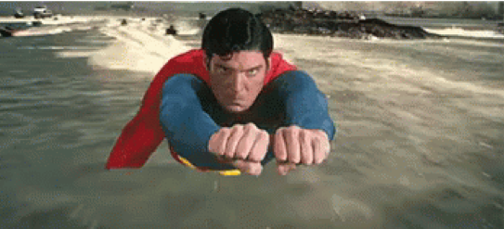
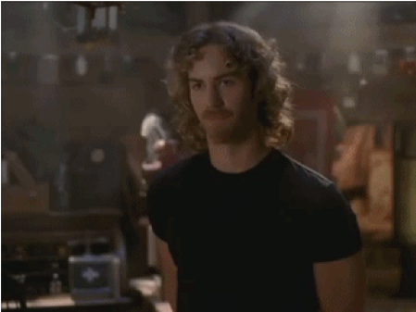
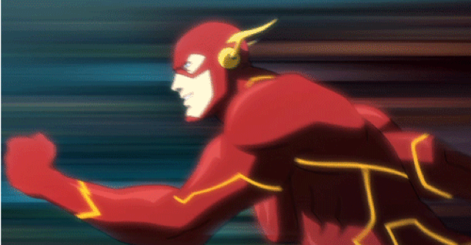
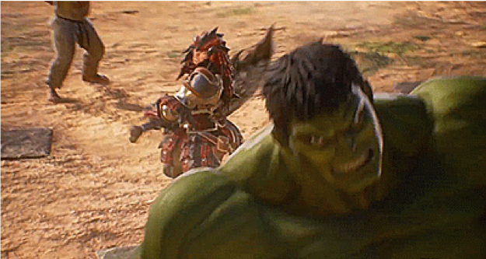
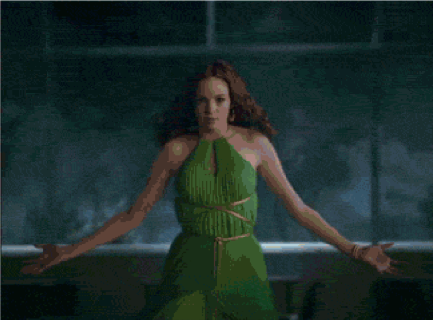
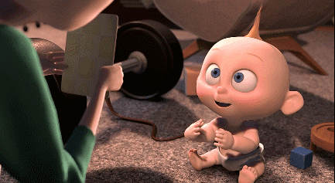
Choose a superpower
fly
invisibility
speed
strength
water
fire

Slide 9
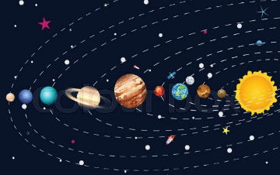
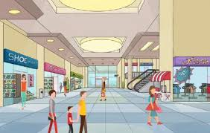
Choose a setting
Where will your superhero story happen?
city
space
jungle
Shopping centre

Slide 10
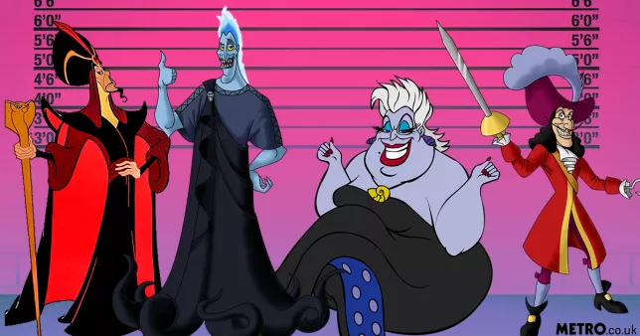
Choose a villain

Slide 11
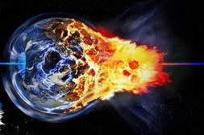
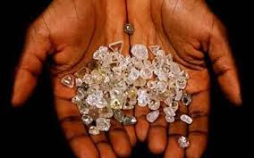
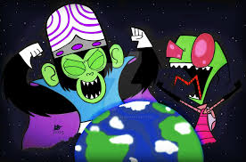
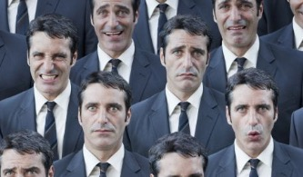
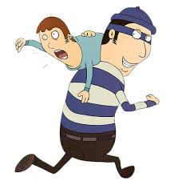
Choose the villain’s mission
Destroy the world
Steal diamonds
Rule the world
Make everyone feel sad
Make everyone into clones
Kidnap someone

Slide 12
Make title page
Include picture of superhero and villain you have chosen
Include a title for your comic

Slide 13
Title

Slide 14
How does your story start?
How’s the weather?
How does it start

Slide 15
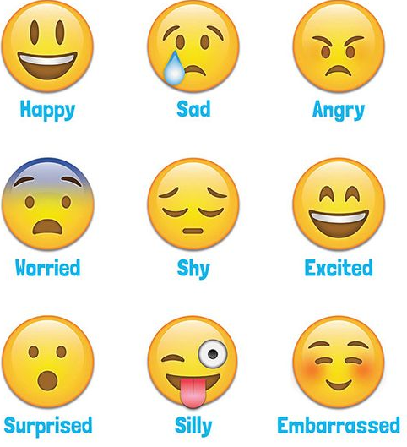
How does the superhero feel?

Slide 16
How does the villain feel?

Slide 17
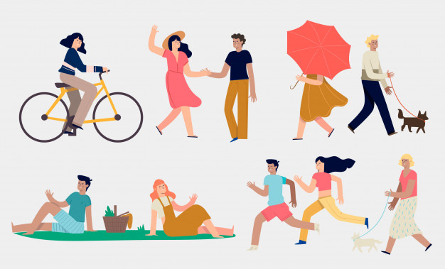
What is the superhero doing?

Slide 18
What is the villain doing?

Slide 19
One day in the...

Slide 20
There was a superhero called...

Slide 21
There was a villain called...

Slide 22
This was his/her plan - to ...

Slide 23
This was his/her plan - to ...

