Slide 1
MEALTIMES

Slide 2
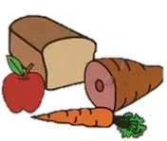

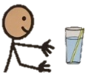
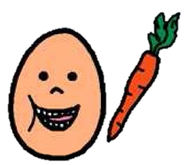
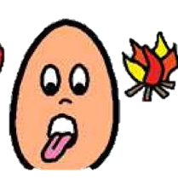

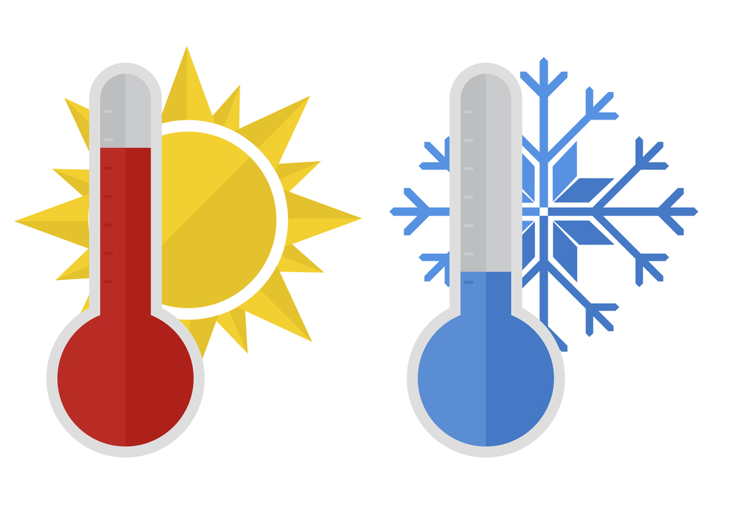

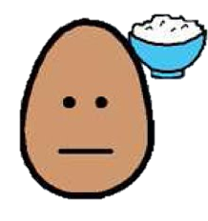

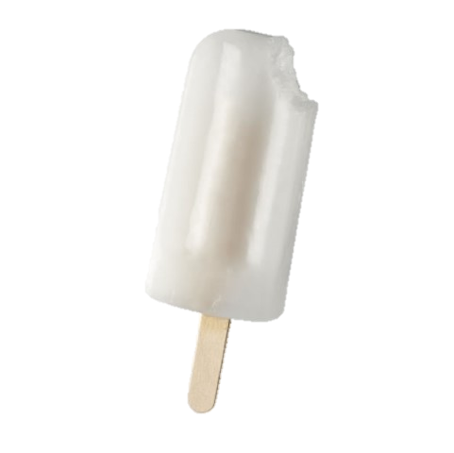
ç√
ç√
ç√
ç√
I’m hungry
I want help
finished
more
ç√
ç√
ç√
ç√
I’m thirsty
yum
crunchy
hot
ç√
ç√
ç√
yuck
soft
cold
Notes:
Mealtimes
State: I’m hungry, I’m thirsty
Opinions: Yummy, yucky, I like… I don’t like…
Adjectives: Crunchy, hard, soft, hot, cold, sweet, sour
Basic: more, finished, help

