Slide 1

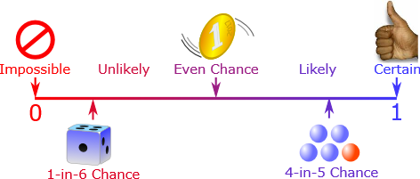
What are the chances?

Slide 2
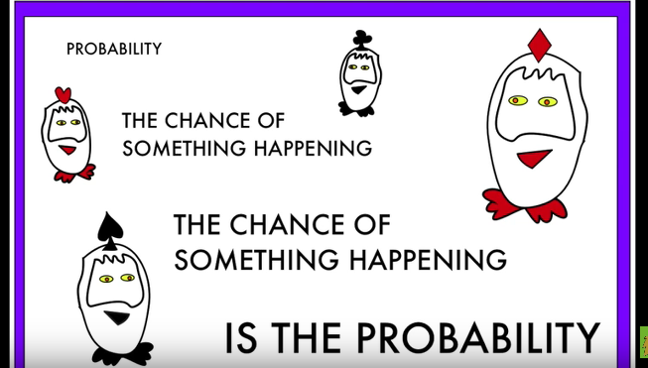
Probability song

Slide 3


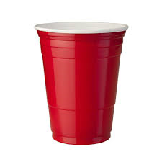
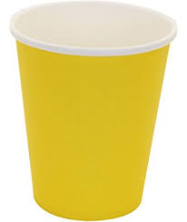

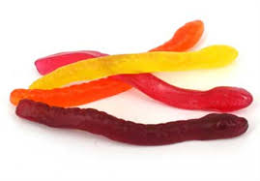


Certain, maybe, impossible
What cup is the lolly under?
red
blue
impossible
impossible
impossible
impossible
Certain
maybe
impossible
Certain
maybe
Certain
maybe
Certain
maybe
maybe
yellow
green

Slide 4
Certain, maybe, impossible
What cup is the lolly under?
red
blue
impossible
impossible
impossible
impossible
Certain
maybe
impossible
Certain
maybe
Certain
maybe
Certain
maybe
maybe
yellow
green

Slide 5
Certain, maybe, impossible
What cup is the lolly under?
red
blue
impossible
impossible
impossible
impossible
Certain
maybe
impossible
Certain
maybe
Certain
maybe
Certain
maybe
maybe
yellow
green

Slide 6
Certain, maybe, impossible
What cup is the lolly under?
red
blue
impossible
impossible
impossible
impossible
Certain
maybe
impossible
Certain
maybe
Certain
maybe
Certain
maybe
maybe
yellow
green

Slide 7
Certain, maybe, impossible
What cup is the lolly under?
red
blue
impossible
impossible
impossible
impossible
Certain
maybe
impossible
Certain
maybe
Certain
maybe
Certain
maybe
maybe
yellow
green

Slide 8
Certain, maybe, impossible
What cup is the lolly under?
red
blue
impossible
impossible
impossible
impossible
Certain
maybe
impossible
Certain
maybe
Certain
maybe
Certain
maybe
maybe
yellow
green

Slide 9
Certain, maybe, impossible
What cup is the lolly under?
red
blue
impossible
impossible
impossible
impossible
Certain
maybe
impossible
Certain
maybe
Certain
maybe
Certain
maybe
maybe
yellow
green

Slide 10
Certain, maybe, impossible
What cup is the lolly under?
red
blue
impossible
impossible
impossible
impossible
Certain
maybe
impossible
Certain
maybe
Certain
maybe
Certain
maybe
maybe
yellow
green

Slide 11
Certain, maybe, impossible
What cup is the lolly under?
red
blue
impossible
impossible
impossible
impossible
Certain
maybe
impossible
Certain
maybe
Certain
maybe
Certain
maybe
maybe
yellow
green

Slide 12
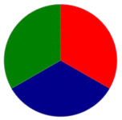



0
0
Colour | Tally | Total
Red
Green
Blue
1
1
1
2
2
2
1. Spin the spinner
2. Mark the tally
3. Spin 20 times
4. Count the total
2
3
3
3
3
4
4
4
4
5
5
5
5
6
6
6
6
7
7
7
7
8
8
8
8
9
9
9
9
10
10
10
10
20
19
18
17
16
15
14
13
12
11
10
9
8
7
6
5
4
3
2
1

Slide 13
Questions
1
2
How many times did you spin red?
How many times did you spin blue?
How many times did you spin green?
How many times did you spin yellow?
3
4
5
6
7
8
9
10

Slide 14
Whos turn | Prediction | Result | Was your prediction correct/
 | Red Yellow Blue | Red Yellow Blue | Yes No
 | Red Yellow Blue | Red Yellow Blue | Yes No
 | Red Yellow Blue | Red Yellow Blue | Yes No
 | Red Yellow Blue | Red Yellow Blue | Yes No
 | Red Yellow Blue | Red Yellow Blue | Yes No
 | Red Yellow Blue | Red Yellow Blue | Yes No
 | Red Yellow Blue | Red Yellow Blue | Yes No
 | Red Yellow Blue | Red Yellow Blue | Yes No
 | Red Yellow Blue | Red Yellow Blue | Yes No

Slide 15

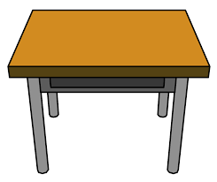
work

Slide 16
