Slide 1
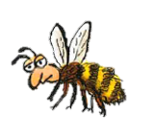
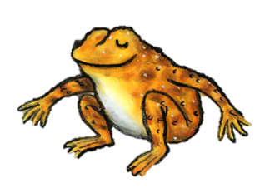
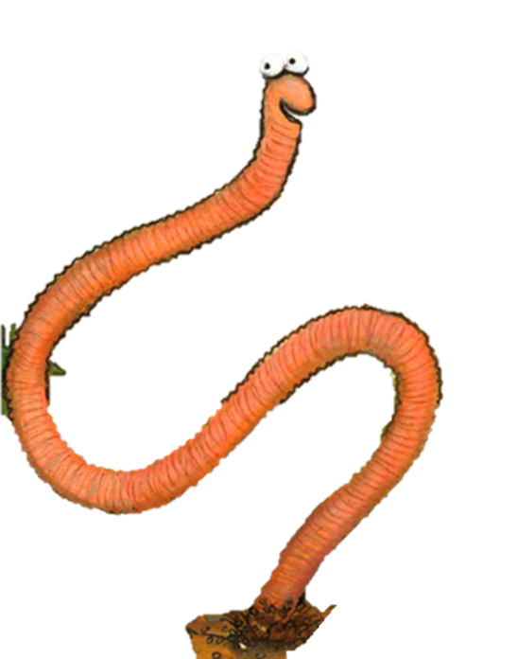
Is Superworm short or long?
.
short long
Match the rhyming words
squirm
long
toad
road
strong
worm
Is a ‘disaster’ bad or good?
bad good
Write the first letter
__ee
__rog
__orm

Slide 2
Is Superworm short or long?
.
short long
Match the rhyming words
squirm
long
toad
road
strong
worm
What is a ‘disaster’?
____________________________________________________________________________
____________________________________________________________________________
Write the name
_ _ _
_ _ _ _
_ _ _ _

Slide 3
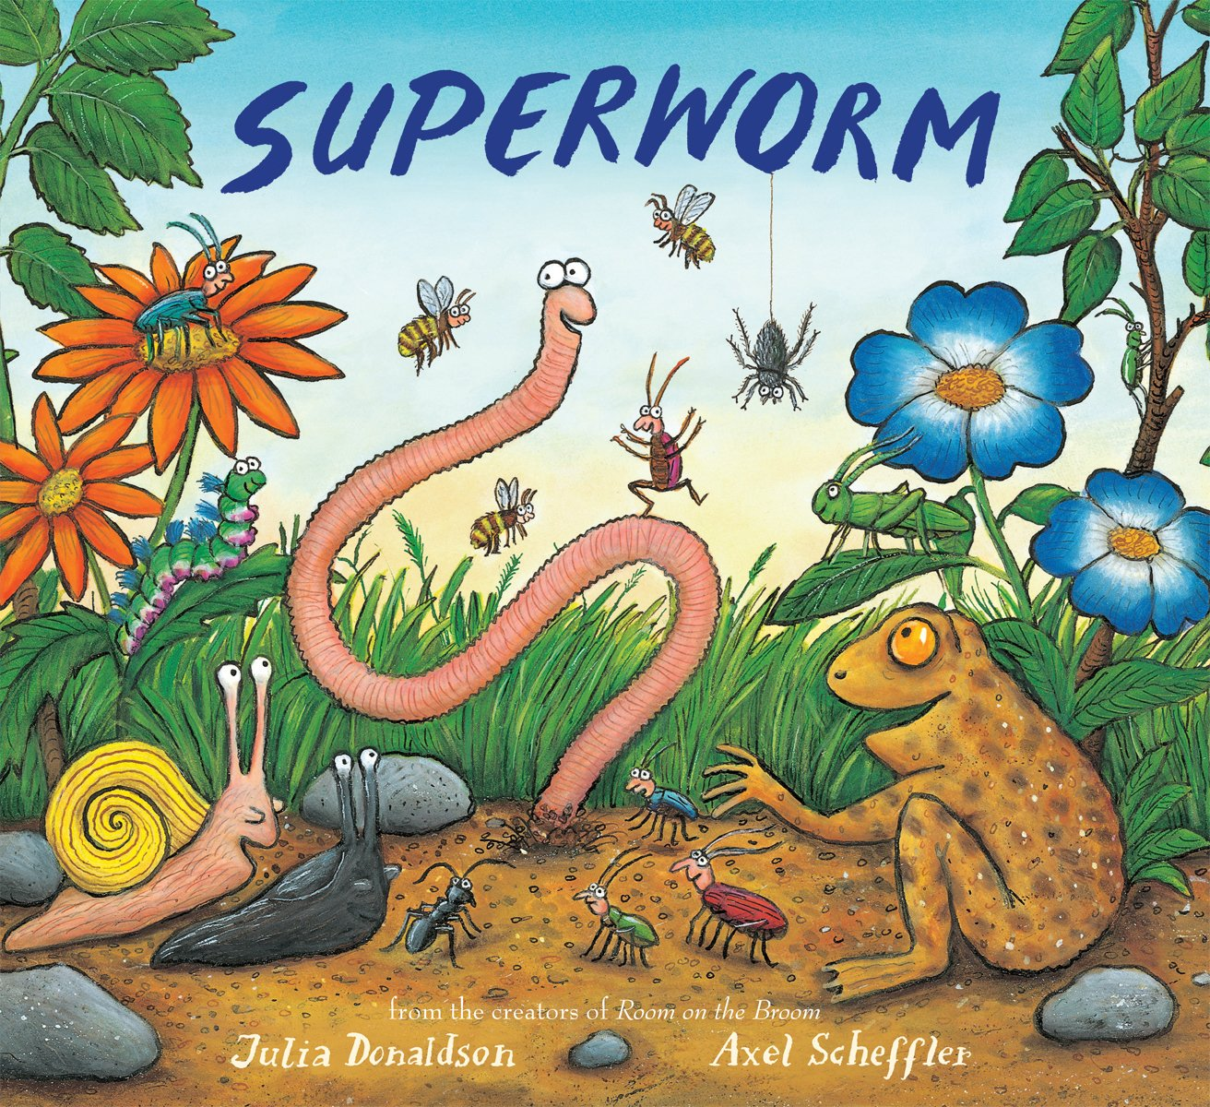
Write the title.
____________________________________________________________________________
Highlight the 2 authors.
Julia Donaldson
Superworm
Axel Scheffer
Draw the main character
How does the character feel?
happy
surprised
frustrated
sad

Slide 4
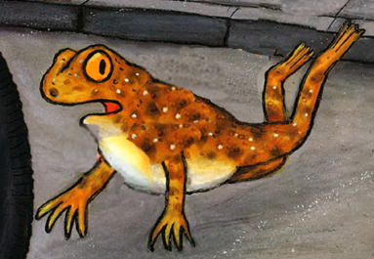
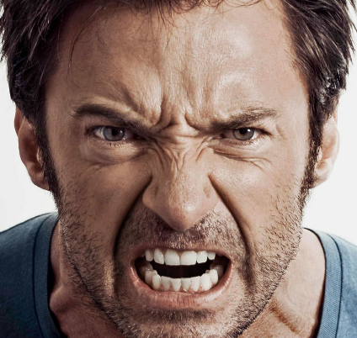
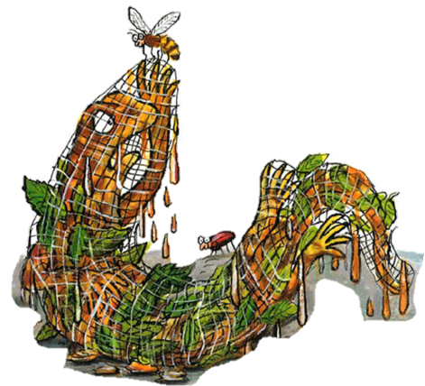
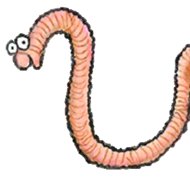
How do these characters feel?

Slide 5
Describe each character with two adjectives

