Slide 1






1. Interwrite board
2. Yes and No
3. Volcano
4. video
2. Colours

Slide 2
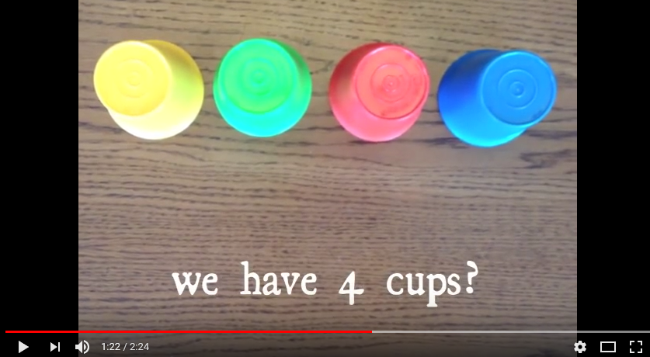
Which cup is the marshmallow under?

Slide 3
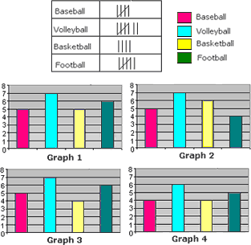
Tally and graph
Today you will be learning abut collecting information and making a graph.

Slide 4





Collecting information
Colour | Tally | Total
red
blue
orange
green
pink

Slide 5
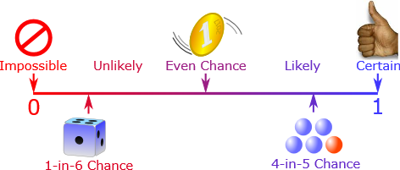
What are the chances?

Slide 6
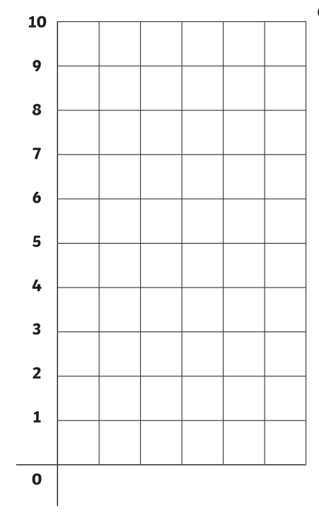





Putting it in a graph
red
blue
orange
green
pink

Slide 7
Answering question
Which colour has the most?
Which colour has the least?
Which colour has 0?
pink
pink
pink
green
pink
green
green
red
orange
green
red
orange
red
orange
red
blue
orange
blue
blue
blue

Slide 8

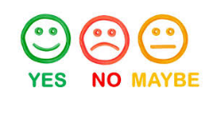

Certain, maybe, impossible
Yes
Certain
If something is certain it will definitely happen.

Slide 9

Certain, maybe, impossible
No
Impossible
If something is impossible it will NOT happen.

Slide 10

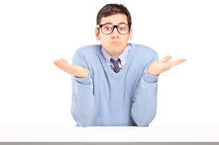
Certain, maybe, impossible
Maybe
Maybe
Maybe means that something might happen

Slide 11




The cup is red.
Certain
Impossible

Slide 12


Try Again!
BACK

Slide 13
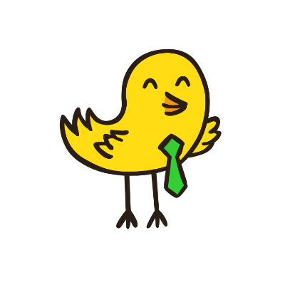


Well Done!
NEXT

Slide 14
……. has brown hair.
Insert student photo
Certain
Impossible

Slide 15
Try Again!
BACK

Slide 16
Well Done!
NEXT

Slide 17
Today is Tuesday.
Tuesday
Certain
Impossible

Slide 18
Try Again!
BACK

Slide 19
Well Done!
NEXT

Slide 20
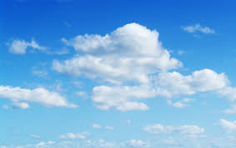
Is the sky blue?
Certain
Impossible

Slide 21
Try Again!
BACK

Slide 22
Well Done!
NEXT

Slide 23
……… has orange hair.
Insert student photo
Certain
Impossible

Slide 24
Try Again!
BACK

Slide 25
Well Done!
NEXT

Slide 26
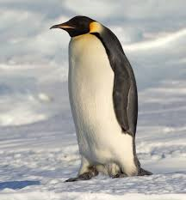
This is a penguin.
Certain
Impossible

Slide 27
Try Again!
BACK

Slide 28
Well Done!
NEXT

Slide 29
Today is Saturday.
Saturday
Certain
Impossible

Slide 30
Try Again!
BACK

Slide 31
Well Done!
NEXT

Slide 32
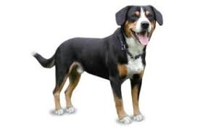
The dog is pink?
Certain
Impossible

Slide 33
Try Again!
BACK

Slide 34

Well Done!
NEXT

Slide 35
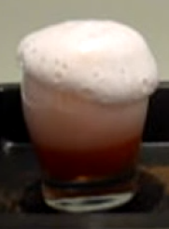
Volcano

Slide 36

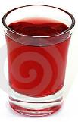

Prediction
Will we see bubbles?
Prediction | Tally | Total
Yes
No
Yes
No
1
2
3
4
5
6
7
8
9
10

Slide 37
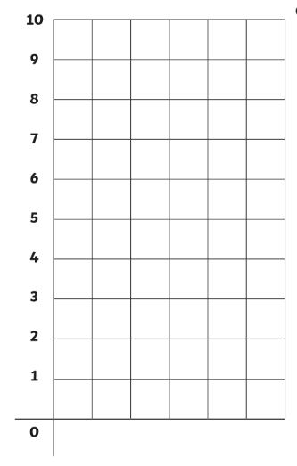
Bubbles
How many people said yes?
Prediction | Tally | Total
Yes
No
How many people said no?
yes
no

Slide 38
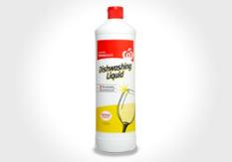
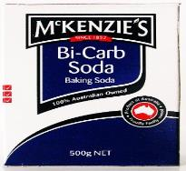
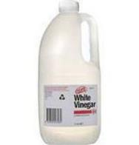
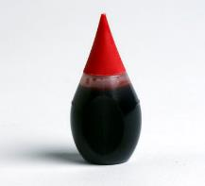
Equipment
detergent
Bi-carb soda
food colouring
vinegar

Slide 39
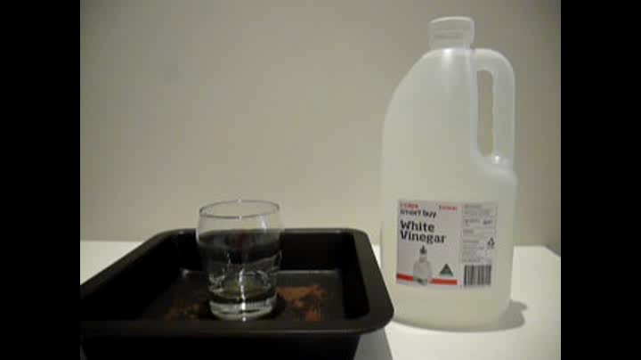
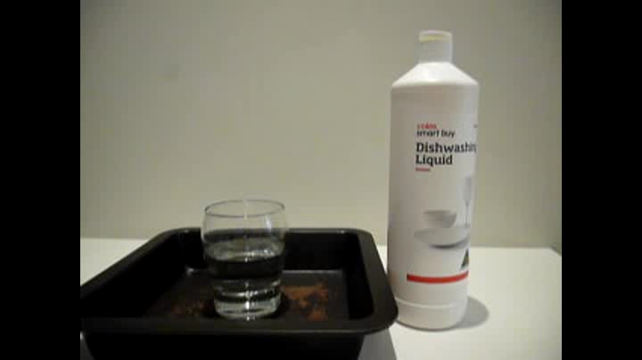
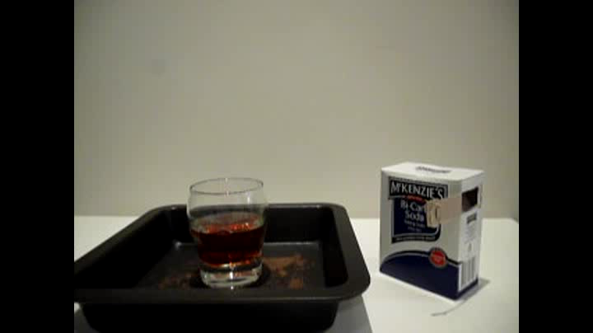
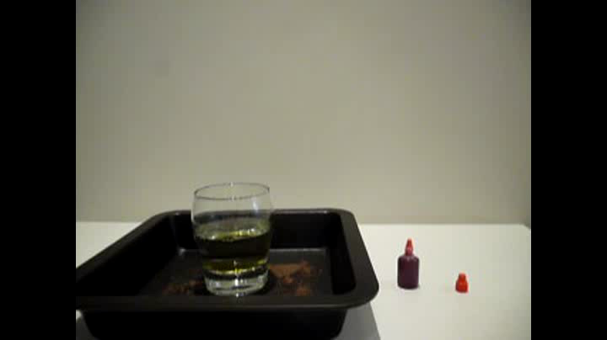
Method
1
2
pour vinegar
pour detergent
4
3
add red food colouring
pour bi-carb soda

Slide 40
Result
Did we see bubbles?
Was your prediction correct?
Yes
No

Slide 41

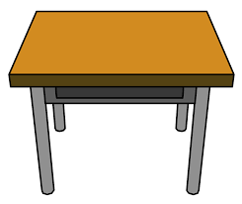
work

Slide 42

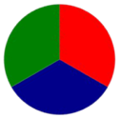
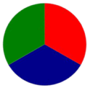

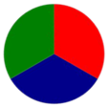

0
0
Colour | Tally | Total
Red
Green
Blue
1
1
1
1. Spin the spinner
2. Mark the tally
3. Spin 20 times
4. Count the total
2
2
2
2
3
3
3
3
4
4
4
4
5
5
5
5
6
6
6
6
7
7
7
7
8
8
8
8
9
9
9
9
10
10
10
10
20
19
18
17
16
15
14
13
12
11
10
9
8
7
6
5
4
3
2
1

