Slide 1
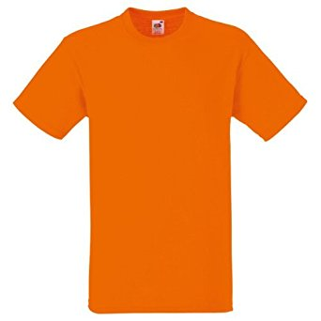
+
=
3
4

Slide 2
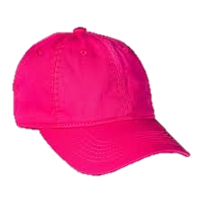
+
=
6
1

Slide 3
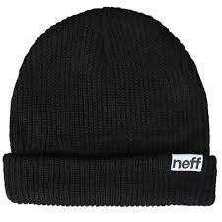
+
=
5
3

Slide 4
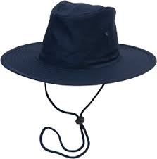
Yellow Class has three hats and Aqua Class has two hats. How many hats do they have?
+
=
hats

Slide 5
Tom has four socks and Ian has one sock. How many socks do they have?
+
=
socks

Slide 6
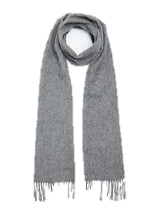
Philip has three scarves and Sam has two scarves, how many scarves do they have altogether?
=
+
scarves

Slide 7
Zak has three gloves and Tim has four gloves, how many gloves do they have altogether?
+
=
gloves

Slide 8
+
=
8
7

Slide 9
+
=
9
9

