Slide 1
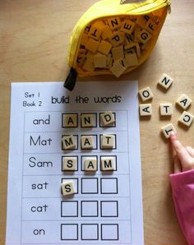
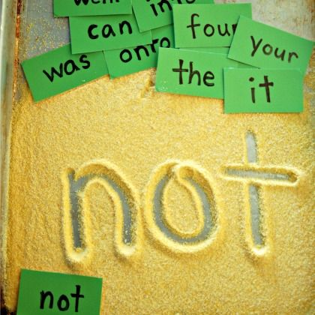
Group Work
Group Work
bingo
scrabble
sand words

Slide 2
Scrabble instructions
Students find letters to create given words
Pages 3-4 for students who require text prompts
Pages 5-6 for students who do not require text prompts

Slide 3
Scrabble
coral
algae
ocean

Slide 4
Scrabble
flora
ocean
fauna

Slide 5
Scrabble
TH, SD
1.
2.
3.

Slide 6
Scrabble
TH, SD
1.
2.
3.

Slide 7
Sand words instructions
Student write 1 word at a time, when shown by staff
Focusing on letter formation
May require adult modelling or hand over hand to form letter correctly
Some students may require words in front of them
Some students may spell words independently but require more practise with letter formation

Slide 8
flora
sea
earth
seaweed
coral
ocean
Australia
algae
fauna

Slide 9
Bingo instructions
Adult reads out words/shows word and students use blocks to cover correct word
Page 11 is an extension for students who can fill-in-the-banks by finding the words on their board

Slide 10
BINGO
flora
sea
earth
seaweed
coral
ocean
Australia
algae
fauna

Slide 11
BINGO
TH, SD
Adults ask…
Students respond…
Flora and Fauna are found under the…
Sea
We live on planet….
Earth
What is spikey?
Coral
Seaweed is a type of….
Flora
A type of ocean flora
Seaweed/algae
Another name for animals
Fauna
What country do we live in?
Australia
A type of ocean flora
Seaweed/algae
Earth has 5 ….
oceans

