Slide 1
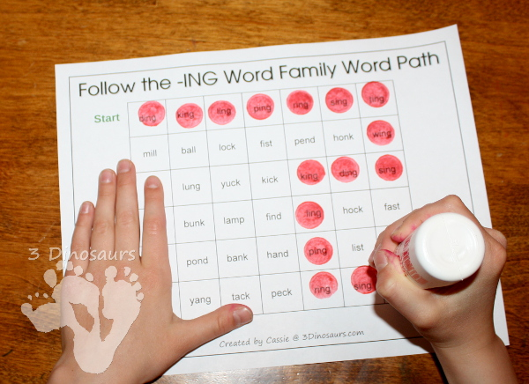
Group Work
Group Work
Treasure hunt
Roll It
Wheel of fortune

Slide 2
Treasure hunt -laminate
Students work independently to find –ing words on the worksheet
Colour them in with whiteboard marker until they get to the treasure
Or
Staff show student one word at a time and students find it on the board

Slide 3
Verbs
-ing words
swimming
eating
diving
crawling
snapping
sliding
shuffling
hiding
growing

Slide 4
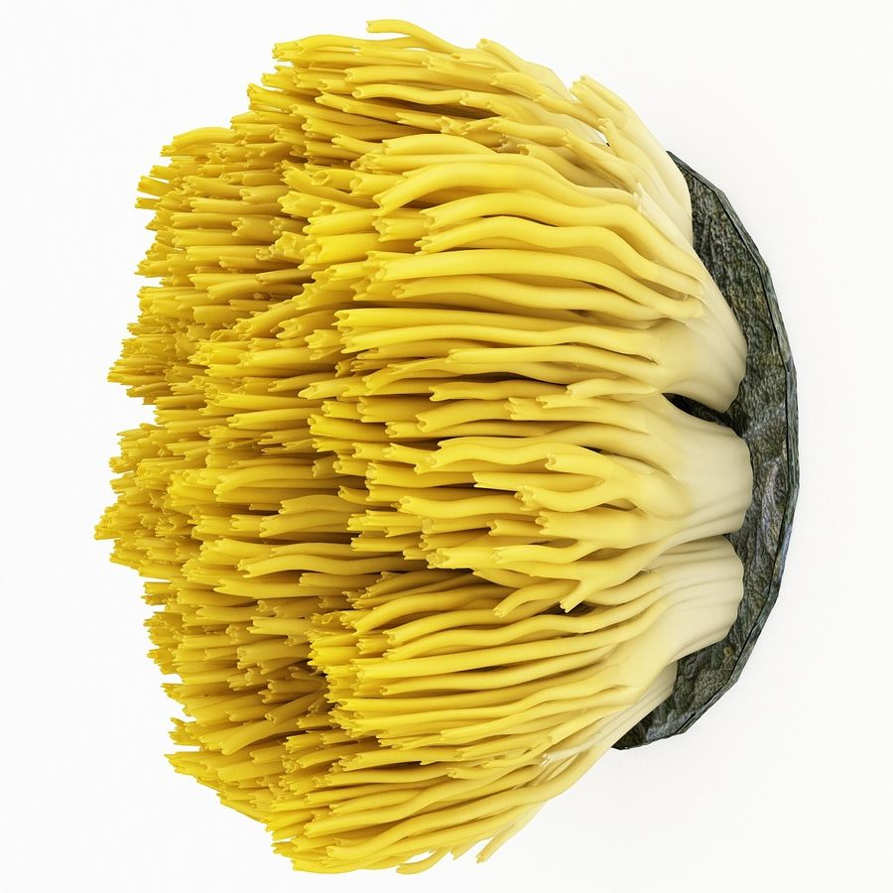
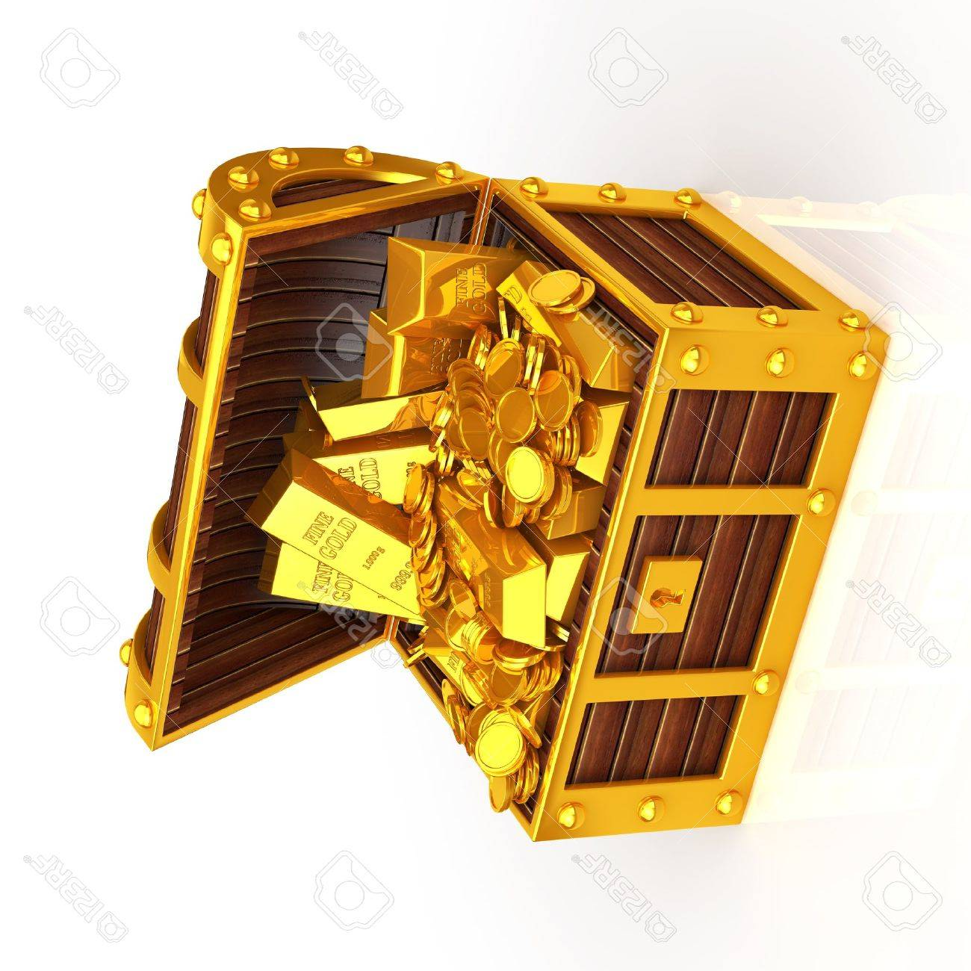
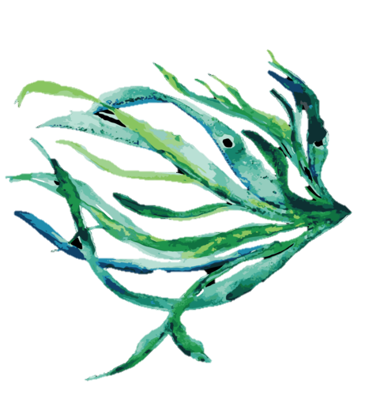
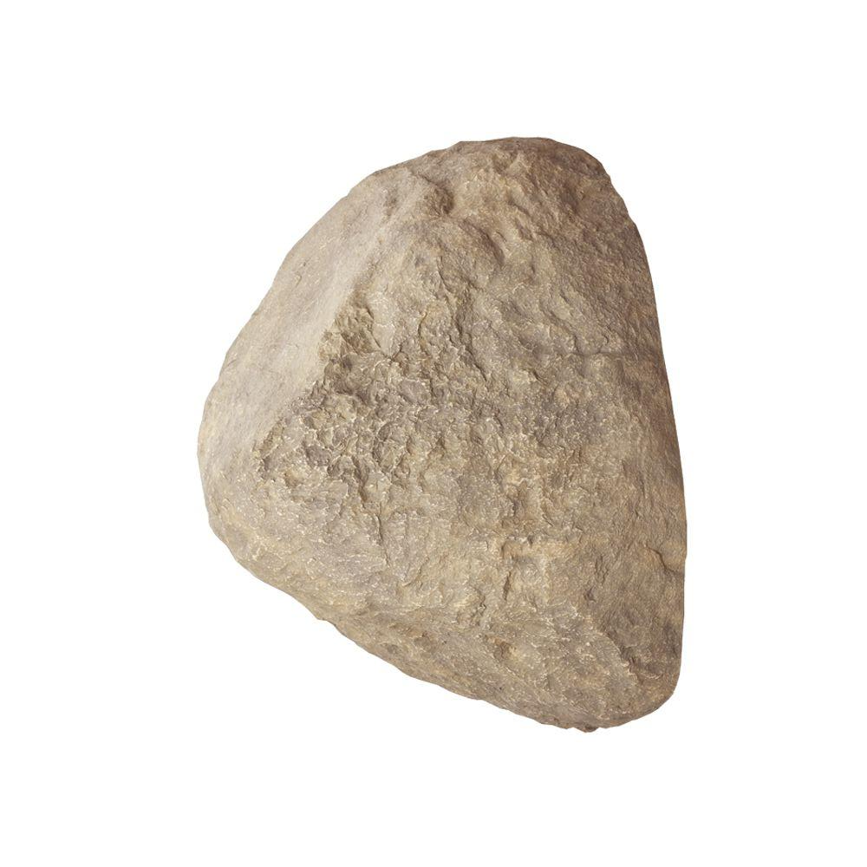
Treasure hunt
Australia
fauna
growing
seaweed
coral
shuffling
hiding
crawling
snapping
sliding
ocean
flora
diving
sea
earth
swimming
eating
algae
Start here

Slide 5
Treasure hunt
Australia
fauna
growing
seaweed
coral
shuffling
hiding
crawling
snapping
sliding
ocean
flora
diving
sea
earth
swimming
eating
algae
Start here

Slide 6
Roll It instructions
Staff put together 2 x dice
Extension – students put together dice
Students roll dice and put together prefix and suffix to make verbs
Student write words on worksheet 1
Or
Students spell words using letter tiles

Slide 7
-ing verbs
Worksheet 1

Slide 8
- ing words
Worksheet 2
1.
2.
3.
4.

Slide 9
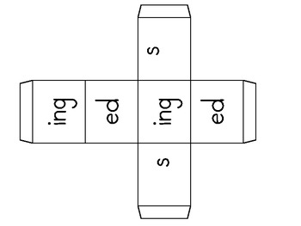

Slide 10
grow
crawl
hid
swimm
eat
snapp
div
slid
shuffl

Slide 12
grow
swimm
crawl
hid
eat
snapp
div
slid
shuffl

Slide 13
Wheel of Fortune
Students spin spinner
Students read word, lining up prefix and suffix
Students match words on board

Slide 14
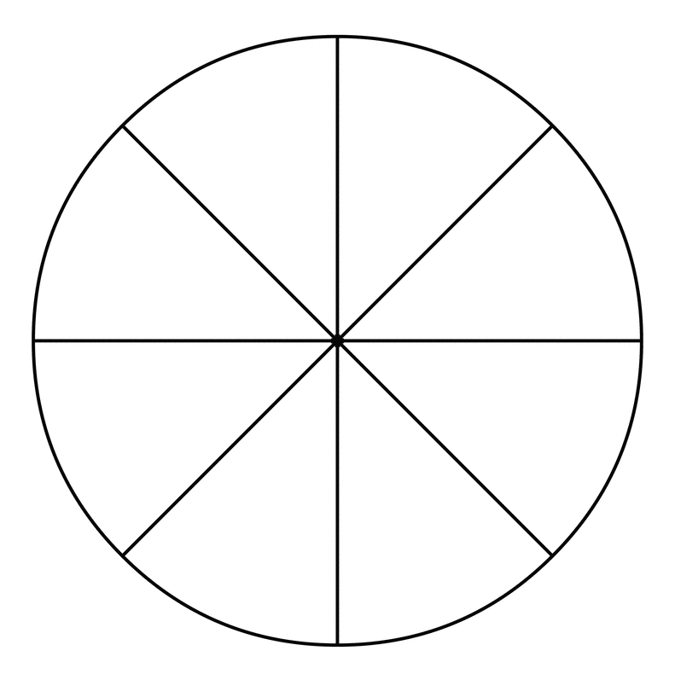
grow
snapp
div
swimm
crawl
shuffl
A3
eat
hid

Slide 15
i n g
A4

Slide 16
Wheel of Fortune
swimming
eating
diving
crawling
snapping
sliding
shuffling
hiding
growing

