Slide 1
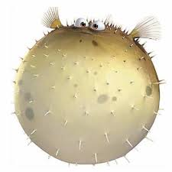
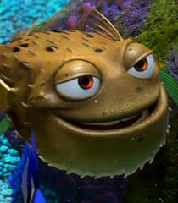
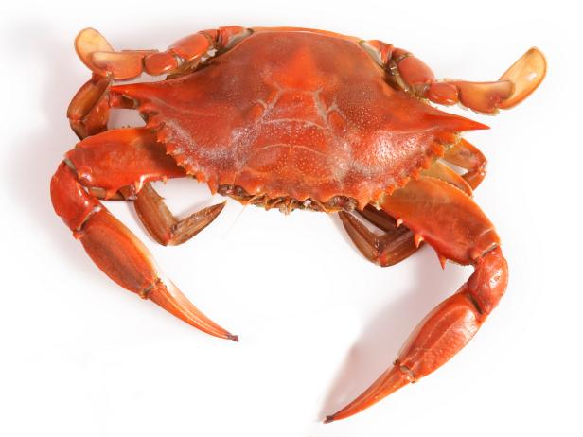
Sentence construction worksheet
growing
The spiky puffer fish is growing
spiky
s
g
snapping
h
s
hard
The hard crab is snapping

Slide 2
Sentence construction worksheet
growing
spiky
g
The spiky and bumpy puffer fish is growing
s
b
bumpy
snapping
hard
h
r
s
The hard and red crab is snapping
red

Slide 3
growing | crawling | swimming
diving | snapping | hiding

Slide 4
blue | soft | bumpy
long | colourful | spiky

