Slide 1
my wardrobe

Slide 2
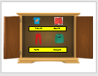
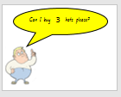
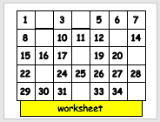
Lesson components

Slide 3
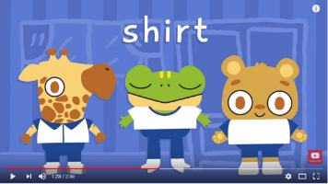
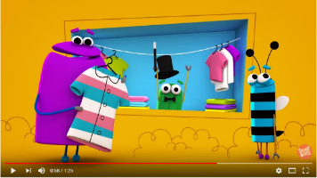
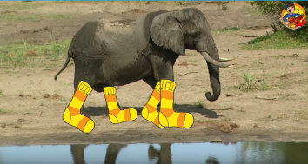
wardrobe songs

Slide 4
Student photo
Student photo
Student photo
Student photo
Student photo

Slide 6
Writes numbers 1-30

Slide 7
2 digit numbers

Slide 8
Counts objects up to 30

Slide 9
Counts objects up to 30

Slide 10
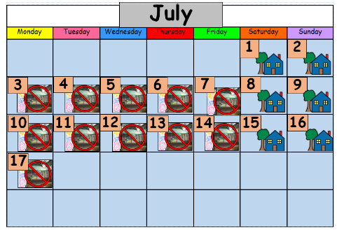
Order numbers 1-20

Slide 11
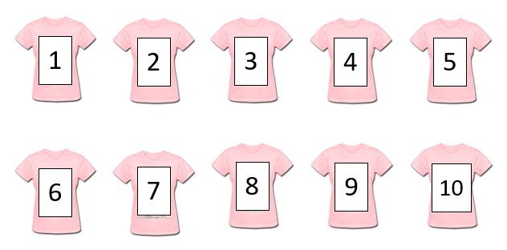
Order numbers 1-10

Slide 12
What’s before or after?

Slide 13
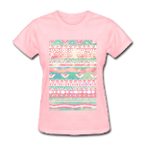
1
2
3
4
5
6
7
8
9
10

Slide 15
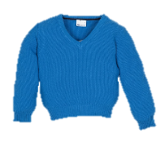
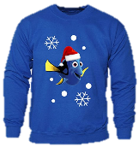
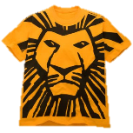
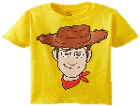
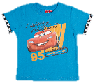
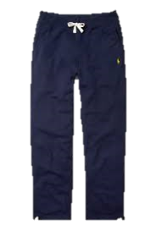
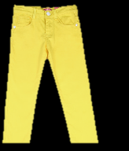
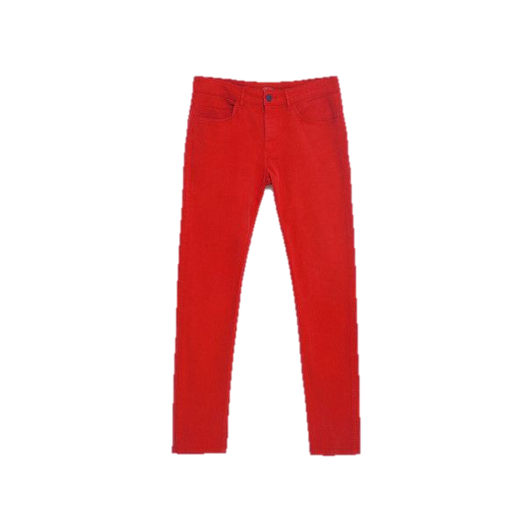
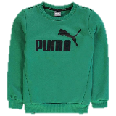
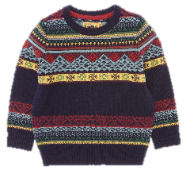
T shirts Shorts
Pants Jumpers

Slide 16
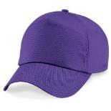
Can I buy hats please?
3

Slide 17
Can I buy hats please?
2

Slide 18
Can I buy hats please?
6

Slide 19
Can I buy hat please?
1

Slide 20
Can I buy hats please?
5

Slide 21
Can I buy hats please?
7

Slide 22
1
3
5
6
7
8
10
11
12
14
15
16
17
19
20
22
24
25
26
27
28
29
30
31
33
34
worksheet

Slide 23
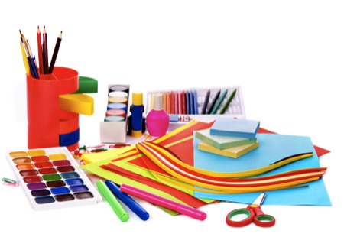
art and craft

Slide 24
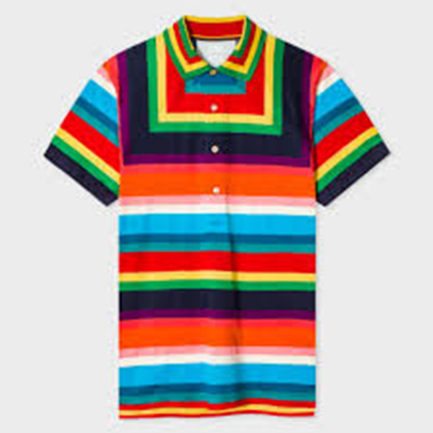

Slide 26
my wardrobe

Slide 27
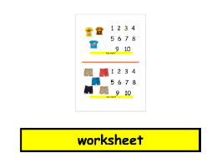
Lesson components

Slide 28
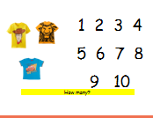
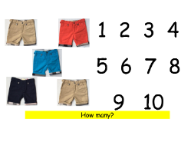
worksheet

Slide 29
M
write sign

Slide 30
my wardrobe

Slide 32
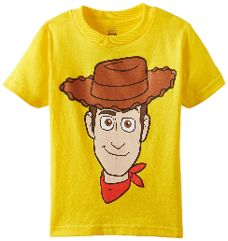
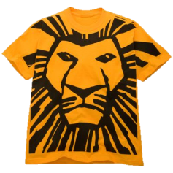
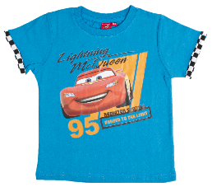
1 2 3 4 5 6 7 8 9 10
How many?

Slide 33
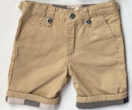
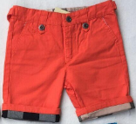
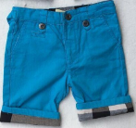
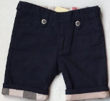
1 2 3 4 5 6 7 8 9 10
How many?

Slide 34
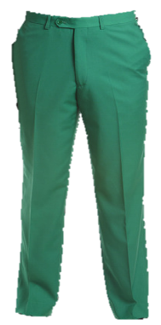
1 2 3 4 5 6 7 8 9 10
How many?

Slide 35
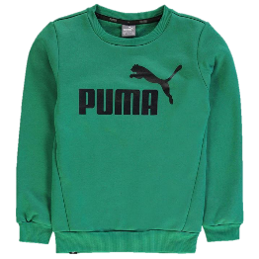
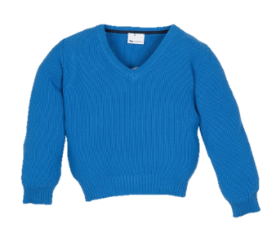
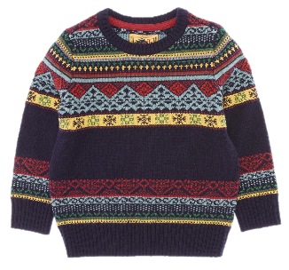
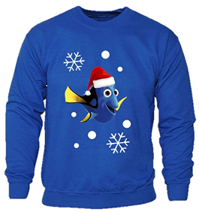
1 2 3 4 5 6 7 8 9 10
How many?

Slide 36
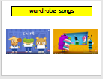
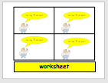
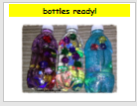
Lesson components

Slide 37
wardrobe songs

Slide 38
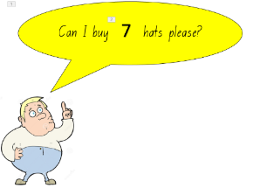
worksheet

Slide 39
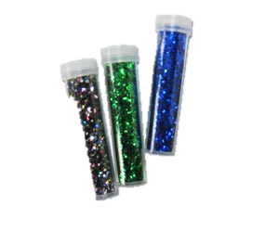
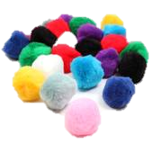
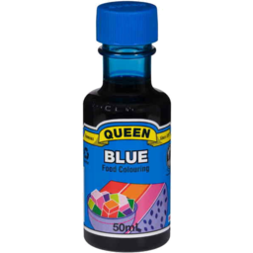
We need:
pom poms
glitter
food colouring
jewels

Slide 40
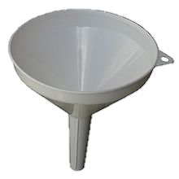
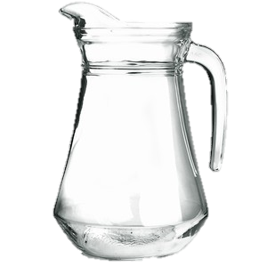
Step 1: pour water into bottle

Slide 41
Step 2: drop in 5 pom poms

Slide 42
Step 3: drop in 5 jewels

Slide 43
Step 4: pour glitter in bottle

Slide 44
Step 5: put 3 drops of colour in bottle

Slide 45
Step 6: shake bottle

Slide 46
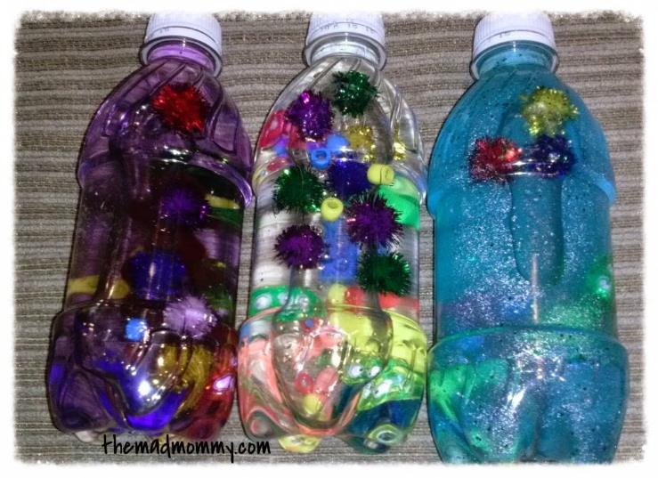
bottles ready!

